Slide 1

Director’s report
Dr Elisabete Weiderpass, Director
International Agency for Research on Cancer
Lyon, France
Scientific Council SC/57/2 , Lyon 10-12 February 2021, by Web conference
Notes:
Dear colleagues of our Scientific Council, dear friends, in this presentation I will provide a summary of IARC’s major scientific highlights in 2020.
I will also present highlights from the 62nd Session of the Governing Council, and provide an update from the 56th Session of the Scientific Council.
I will conclude my presentation with an update on the activities of the IARC Ethics Committee (IEC), taken from the IARC Biennial report.

Slide 2
4a. Major scientific highlights

Slide 3



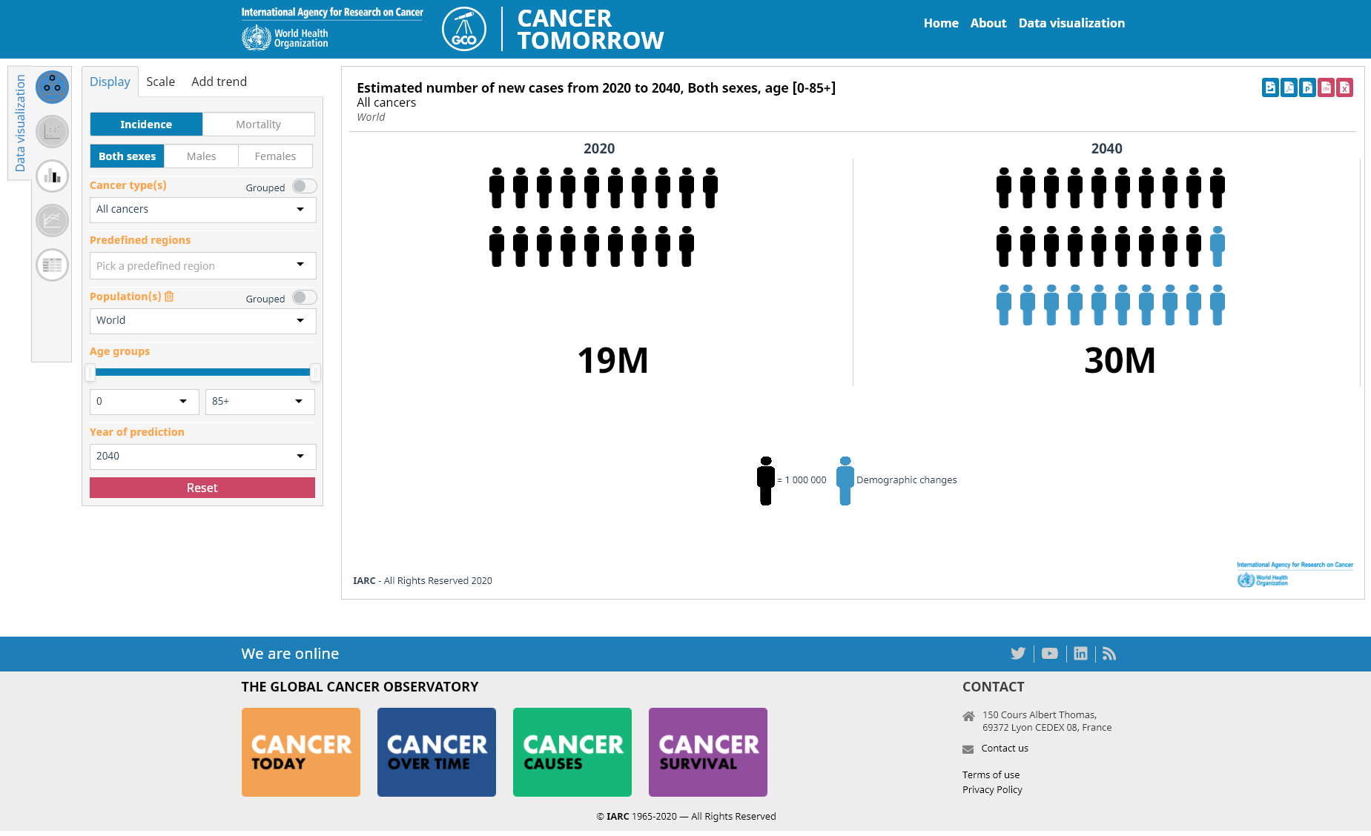
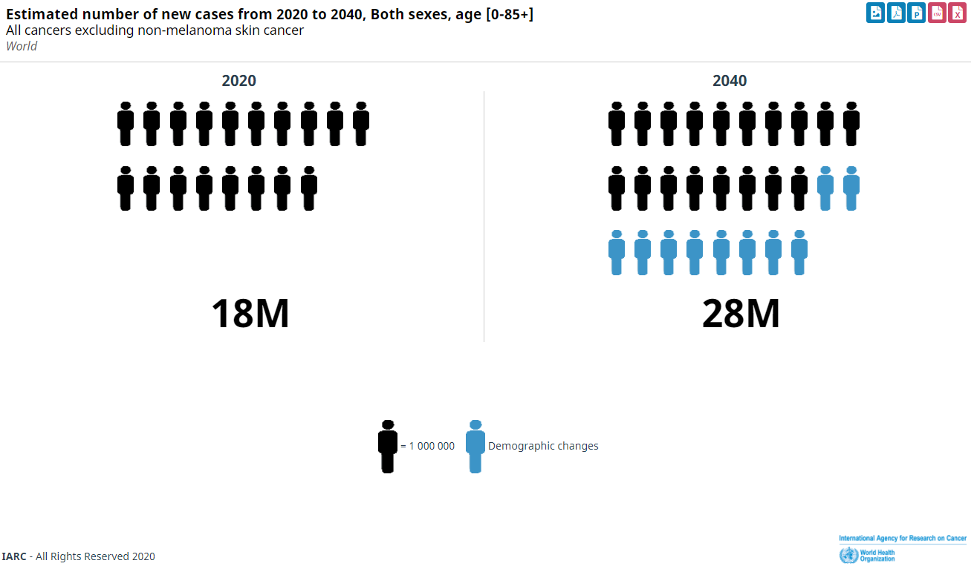
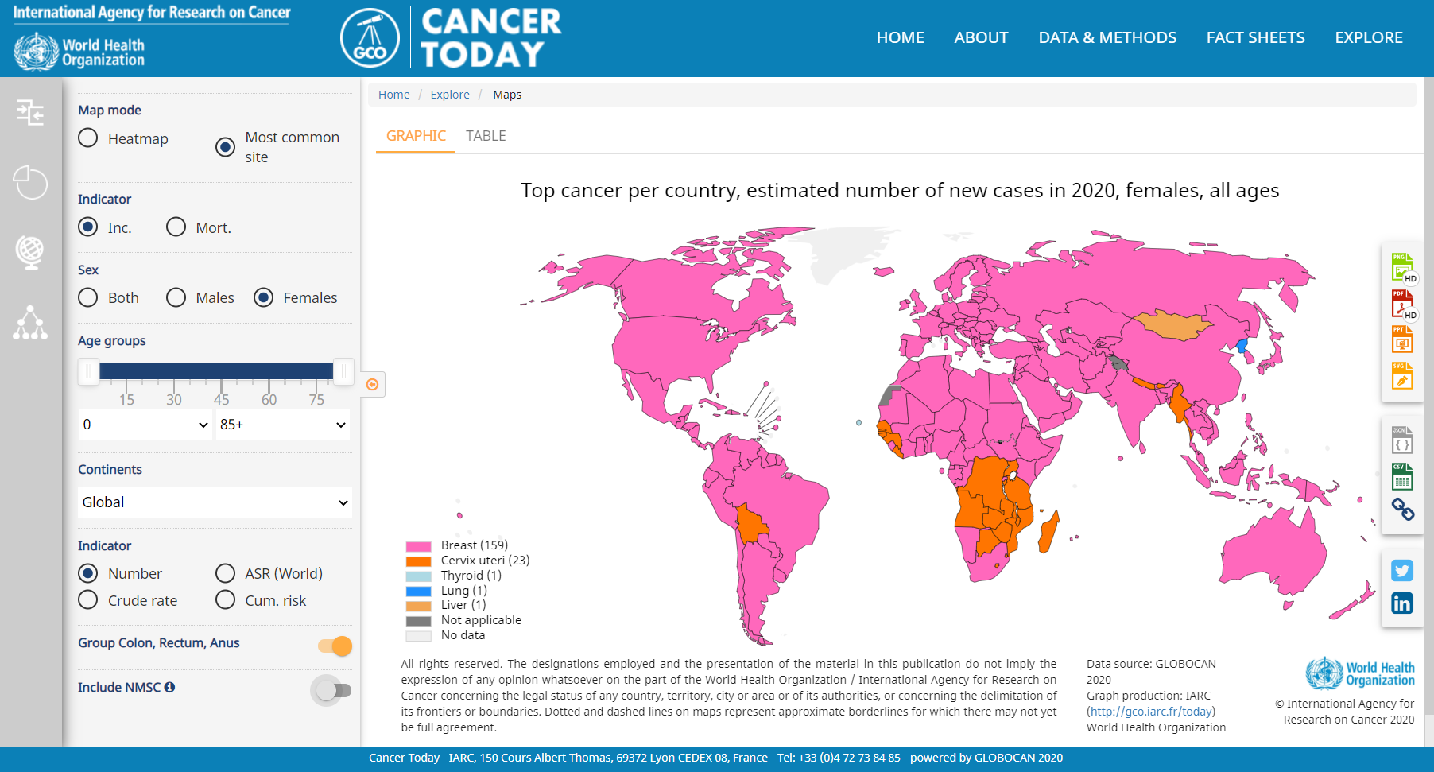
GLOBOCAN estimates 2020
19.1 million new cancer cases (incl. NMSC) worldwide in 2020
Breast has surpassed lung cancer as leading cause of cancer incidence.
28 million predicted cancer cases by 2040
Notes:
Slide 3
So for IARC’s major scientific highlights in 2020, let’s start with the Cancer Surveillance Section
The cancer incidence burden will almost double from the 19.1 million new cases in 2020, to 28 million predicted new cases by 2040. These figures and predictions are based on IARC’s cancer surveillance work which involves collecting and analyzing global cancer statistics to effectively and accurately describe the occurrence of cancer in the world.
The figures are alarming and so it is time to act! Given this prediction, of the enormous personal and societal losses, and the fact that up to half of all cancer cases could be prevented, prevention will become the key response to tackling the cancer epidemic for most countries in this century.
The second important finding is that breast cancer has surpassed lung cancer as the leading cause of cancer incidence, indicating that research on risk factors for breast cancer should be intensified.

Slide 4

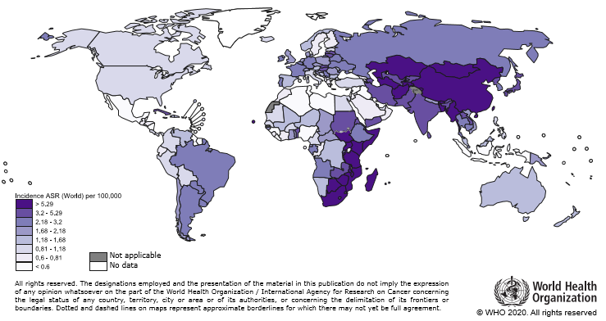
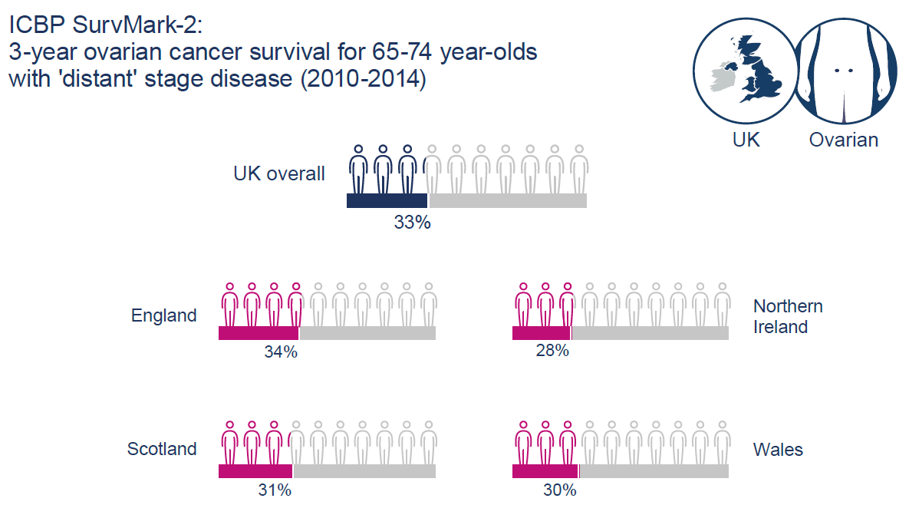
International Cancer Survival Benchmarking
Two focus areas:
High-income countries in-depth analysis on causes of disparities
Low- & middle-income countries to improve local data quality and capacity
Dissemination and knowledge transfer:
Publicly available data
Stakeholder’s Communication Tool
COVID-19 and impact on cancer
Notes:
Slide 4
In terms of survival, IARC will focus on two main areas:
In High-income countries, there will be an in-depth analysis on the causes of disparities,
In Low- & middle-income countries, there will be efforts to improve local data quality and capacity
Knowledge dissemination is essential, so IARC will:
Make data publicly available
Use Stakeholder’s Communication Tools
Communicate on the impact of COVID-19 on cancer

Slide 5
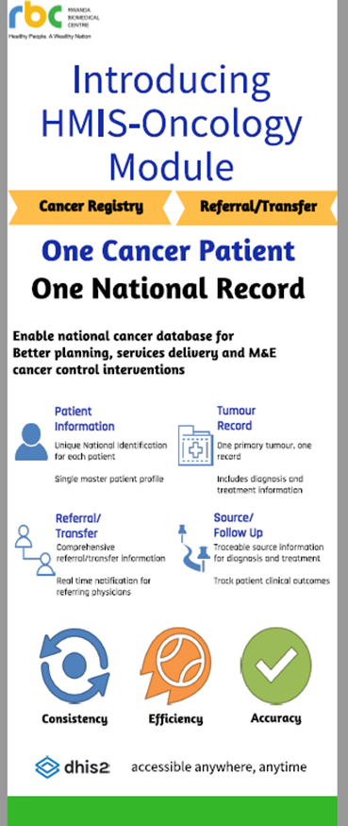
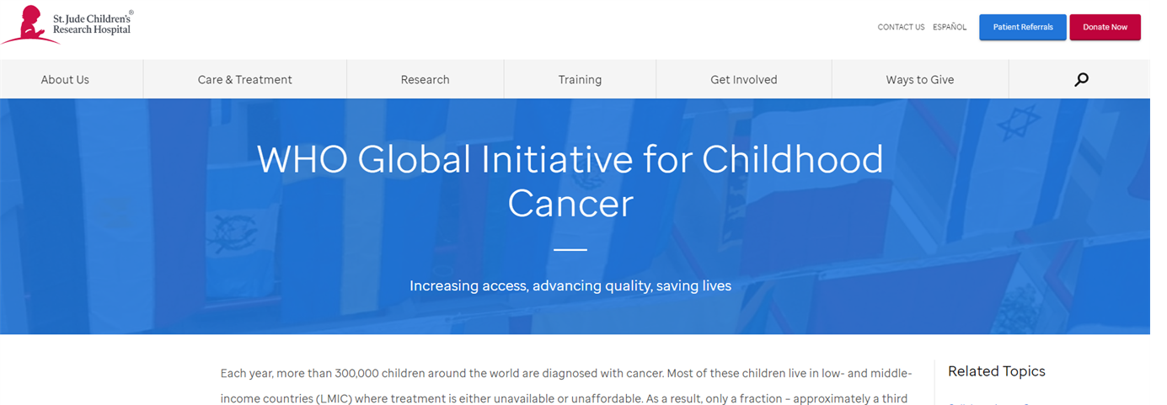
GICR Priority areas: 2020
E-learning modules (14) with Bloomberg Philanthropies
    Engagement with GICRNet trainers and partners
CanReg5+: enhanced stability and link with DHIS
    Rwanda and OECS countries (10) in the Caribbean
ChildGICR: partnership with St Jude’s Children’s Research Hospital:
    Country Assessments; Education; and Research
Notes:
Slide 5
Led by IARC, the Global Initiative for Cancer Registry Development (GICR), is a unified strategy for international partners to share knowledge and facilitate research to inform cancer control strategies.
In 2020, the priority areas were:
The development of E-learning modules
CanRegistry 5+
Childhood cancer in partnership with St Jude’s Children’s Research Hospital:
With unprecedented efforts to raise awareness of the impact of childhood cancer and the marked disparities in childhood cancer survival observed between low- and high-income settings, CSU’s surveillance and research work is increasingly embedded within the GICR programme and linked to the continuing efforts of the WHO Global Initiative for Childhood Cancer.

Slide 6
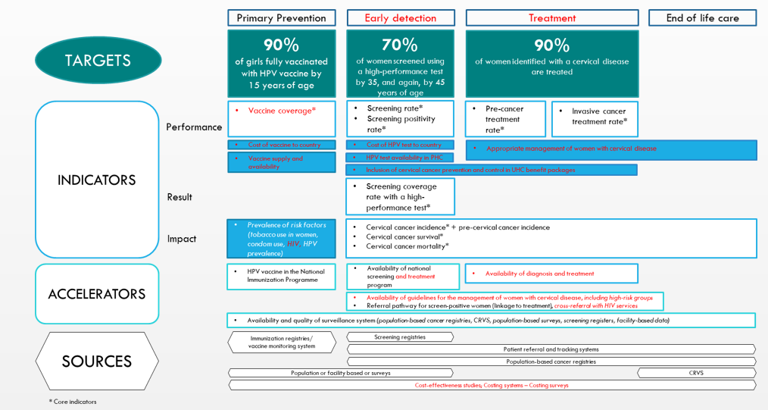
Draft framework for monitoring and evaluation of the Cervical Cancer Elimination Initiative
Notes:
Slide 6
This slide shows the draft framework to monitor and evaluate the Cervical Cancer Elimination Initiative.
CSU estimated the cervical cancer burden until the year: 2100 based on a scale-up of screening and human papillomavirus (HPV) vaccination programmes.
Targets of this initiative involve:
Primary prevention: to scale up HPV vaccination so that 90% of girls are fully vaccinated with HPV vaccine by 15 years of age.
Early detection: to screen 70% of women
And treatment: aiming to reach 90% of women identified with a cervical disease.

Slide 7

Cancer risk in childhood cancer survivors (CRICCS): understanding the causes to target prevention
Objectives:
Estimating prevalence of childhood cancer survivors in Europe
Quantifying risk of second cancers in survivors in Europe
Assessing determinants of risk of SPN
Recommendations for registries
Expected impact:
  Information for patients and clinicians and guidance of priority-setting in the future prevention of SPN by:
  Quantifying cancer burden in survivors
  Assessing evidence-based treatment choices
  Helping to reduce the risk of a second cancer in survivors
Timeline:
  November 2020 – October 2023
Collaborators:
Australia
  The University of Queensland
Germany
  Johannes Gutenberg University
Denmark
  Danish Cancer Society
Sweden
  Lund University
Switzerland
  University of Bern
UK
  Public Health England
  University of Birmingham
  University College London
Europe
  Childhood Cancer International
  IARC
  Section of Cancer Surveillance
Funder:
Notes:
Slide 7
Another key area is to study cancer risk in childhood cancer survivors and understand the causes in order to develop targeted prevention strategies.
To do this, data collected by cancer registries will be used, following the protocol of the project “Cancer risk in childhood cancer survivors (CRICCS): understanding the causes to target prevention”. This project is supported by the Children with Cancer UK foundation.
The expected outcome of the research programme is to provide information on risk factors for patients, families and clinicians, and knowledge to governments that may be useful in setting cancer prevention priorities.

Slide 8
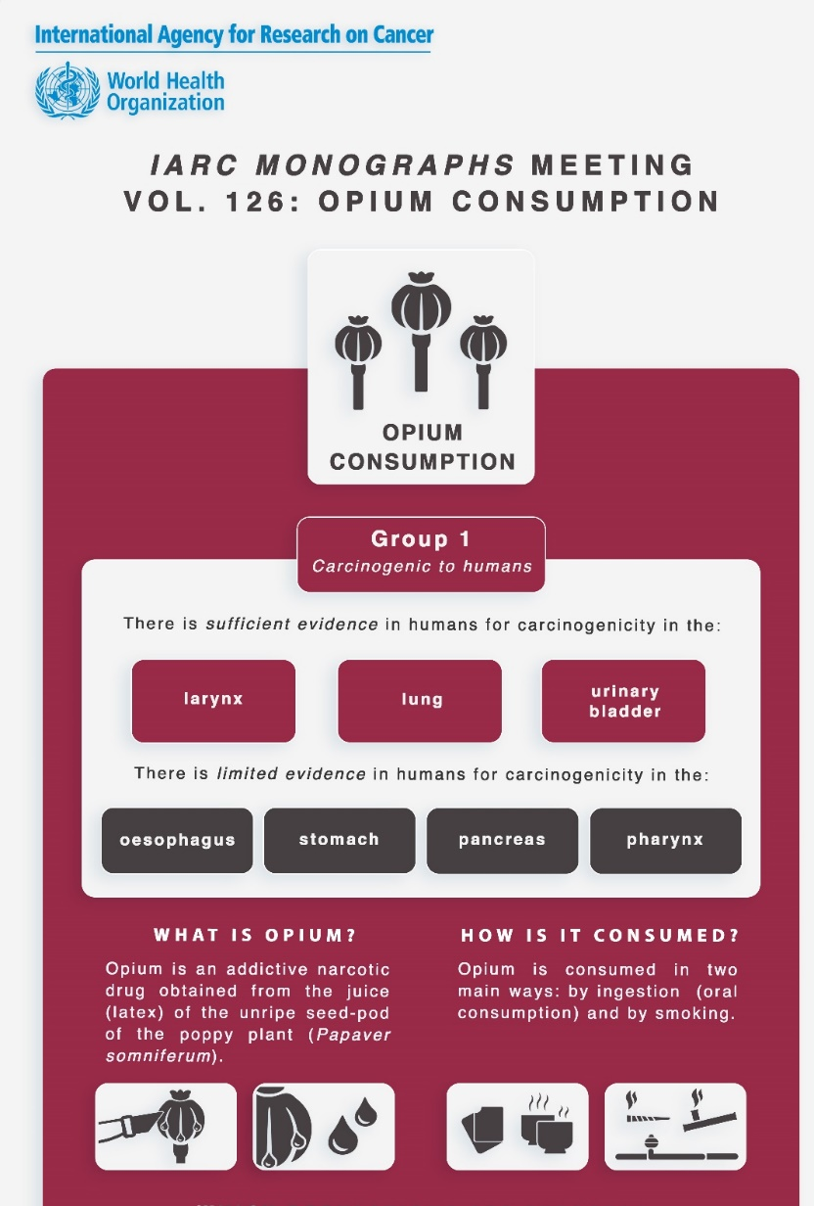
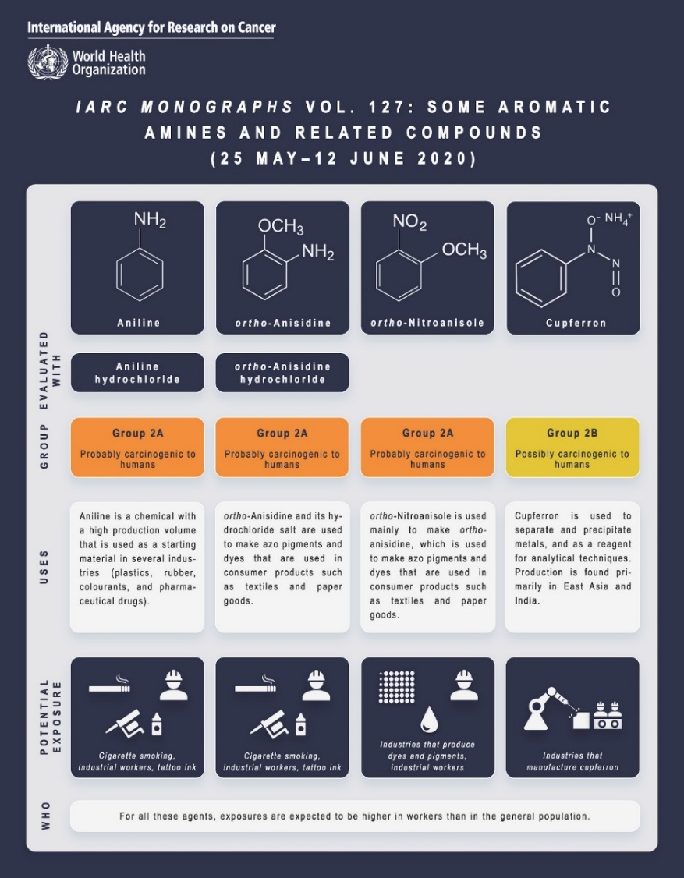
IARC Monographs Programme
Scientific Accomplishments in 2020
Adapted Monographs meetings to be fully remote due to Covid-19
Held three remote Monographs meetings (126-128) from May to November 2020
New or updated classifications for 8 agents:
  Group 1: Opium consumption
  Group 2A: Acrolein, Aniline, ortho-Anisidine, ortho-Nitroanisole
  Group 2B: Arecoline, Crotonaldehyde, Cupferron
Published three articles in Lancet Oncology
Published three Monographs volumes
  v.123: Some nitrobenzenes & other industrial chemicals
  v.124: Night shift work
  v.125: Some industrial chemical intermediates & solvents
Notes:
Slide 8 – Evidence Synthesis and Classification
Regarding the IARC Monographs Programme, the Monographs meetings were held 100% remotely in 2020 due to Covid-19.
Three remote Monographs meetings (volumes 126 to 128) were held from May to November 2020.
New or updated classifications have been made for 8 agents:
Opium consumption has been classified as Group 1 carcinogen (carcinogenic to humans)
Acrolein, Aniline, ortho-Anisidine, ortho-Nitroanisole are classified as Group 2A probably carcinogenic to humans
Arecoline, Crotonaldehyde, Cupferron are classified as Group 2B possibly carcinogenic to humans.
These three classifications have been published as articles in Lancet Oncology

Slide 9
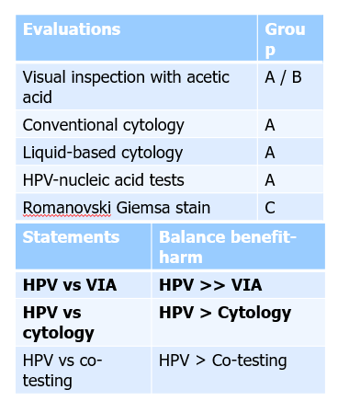
IARC Handbooks Programme
Handbook 18 - Cervical Cancer Screening
  Run completely remotely over 4 months
  First meeting with the new Preamble
  (new evaluation scheme / comparative statements)
Collaboration with WHO on the Cervical Cancer Elimination Initiative
  Handbooks Statements (in bold) for used for making
  the WHO recommendations
  Summaries/evaluations as Annex to the guidelines
  Simultaneous launch of IARC Handbook vol. 18 and
  WHO recommendations in Spring 2021
Handbook 19 – Oral cancer prevention (Dec. 2021)
  Special emphasis on oral cancer prevention in South Asia
  Collaboration with WHO-HQ and WHO-SEARO on scientific and logistics aspects
Notes:
Slide 9 –
IARC held the meeting for Handbook 18 on cervical cancer screening remotely with sessions in June, September and October.
It was the first meeting using the new Preamble. IARC evaluated 5 screening methods: visual inspection with acetic acid, conventional cytology, liquid-based cytology, HPV-nucleic acid tests, and Romanovski Giemsa stain, and developed “comparative statements” for HPV versus VIA, HPV versus cytology, and HPV versus co-testing.
The meeting was run in close collaboration with the WHO, who updated the recommendations (statements in bold). IARC and WHO are coordinating a simultaneous launch of the Handbook and the WHO recommendations for Spring 2021.
Preparation for Handbook 19 is underway, with an emphasis on oral cancer prevention in South-Asia, where smokeless tobacco and areca-nut related products are prevalent. This Handbook again will be developed in close collaboration with WHO-HQ and the SEARO Regional Office (WHO South-East Asia Region).

Slide 10
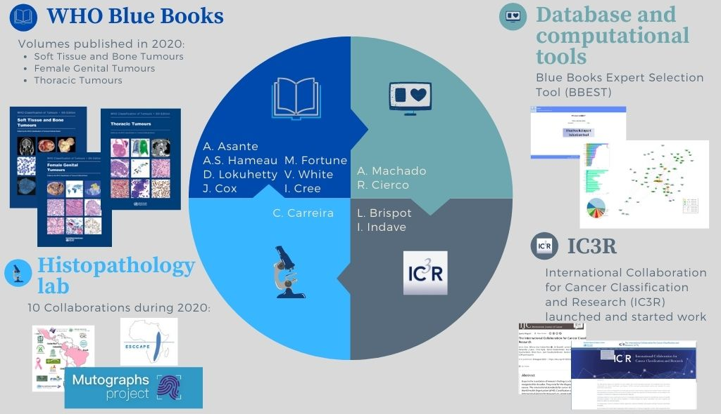
WHO Classification of tumours
2020 Highlights
Notes:
Slide 10
2020 was a successful year for the WHO classification of tumours, despite the need for considerable agility from the team to meet the demands of teleworking, and remote meetings, the first of which was in March.
IARC scientists have published two books in 2020, and the thoracic book is now in the final proofing stage, and is expected to go to the printers in early 2021..
The volume on Female Genital Tract tumours was particularly important, as it included a revision of the classification of cervical cancer, which now underpins the WHO program for the elimination of cervical cancer, which is caused by HPV.
The Histopathology laboratory continues its work with numerous groups within IARC, which depend on it for processing samples from all over the world for their projects.
It is increasingly focused on the whole slide imaging of the preparations prepared in the laboratory, as well as those from outside sent to us.
Images from the Histopathology laboratory have made their appearance on the Blue Books Online website, and are much appreciated by users and the larger scientific community.
IARC has developed a new computational tool for the systematic identification of expert editors and authors, and are now beginning to use this widely.
This is an example of the work of the IARC international collaboration for cancer classification research (IC³R), which has 11 core and full members, and is proving successful in stimulating evidence-based pathology.

Slide 11
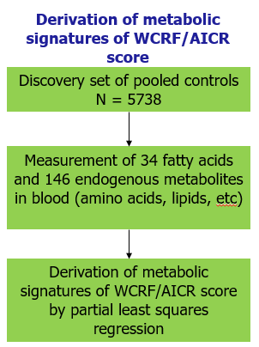
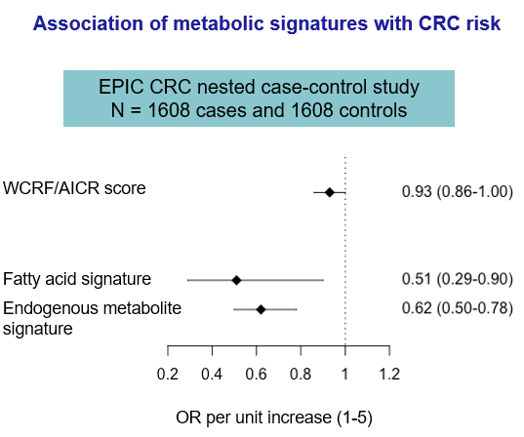
Metabolic signatures of healthy lifestyle are associated with lower colorectal cancer risk
Rothwell J, Murphy N et al. Chajes V, Gunter MJ (In press). Clin. Gastroenterol. Hepatol. 2020
Notes:
Slide 11 – Nutrition and Metabolism
This study shows that metabolic signatures of healthy lifestyle are associated with lower colorectal cancer risk in the European Prospective Investigation into Cancer and Nutrition (EPIC) study.
This is the first study to derive metabolomic signatures of World Cancer Research Funds (WCRD) scores for cancer prevention
The metabolic score predicted colorectal cancer much better than the score derived from questionnaire data – showing potential for metabolic profiling to capture etiologic pathways and identify early biomarkers of risk.

Slide 12
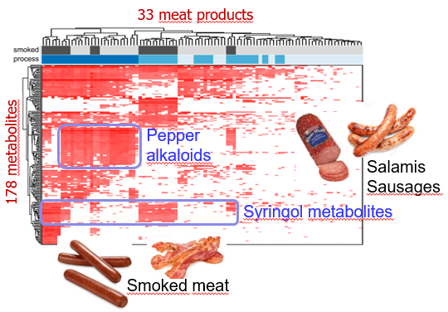
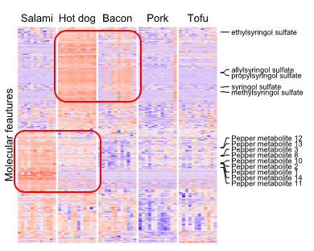
New biomarkers for processed meat intake
Analysis of processed meat products
Dietary intervention study (n=12)
Several biomarkers of processed meat intake identified
Biomarkers validated in a cross-sectional study in EPIC (n=474)
Biomarkers now used to study associations of processed meat intake with colorectal cancer in EPIC
Wedekind et al., Metabolites. 2020
Wedekind et al, submitted
Notes:
Slide 12
Processed meat has been associated with higher risk of colorectal cancer, while intake assessments of this heterogeneous food group remain challenging due to the lack of detail in dietary questionnaires.
The objective of this study was to identify novel biomarkers for processed meat intake using metabolomics.
After a dietary intervention -in which 12 volunteers consumed successively 3 processed meat products- (and tofu or pork as control foods) for 3 days, mass spectrometry was applied to urine and blood samples.
The identified biomarkers were then measured in urine and blood from almost 500 subjects from the EPIC cohort for validation against habitual intake estimated through Food Frequency Questionnaires.
Syringol compounds were found in smoked meats, while pepper compounds (piperine and related alkaloids) were mainly found in salami and fried sausage.
The biomarkers of processed meat intake identified in this study may be used to improve assessment of processed meat intake in epidemiological studies and assist in understanding the role of various processed meat products in cancer risk.

Slide 13
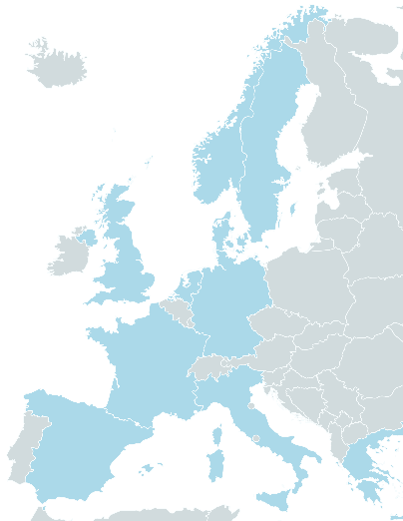


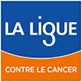
Inflammatory biomarkers and breast cancer risk in EPIC
Median age at diagnosis
ER+
PR+
HER2+
61 years
80%
68%
21%
Median time between collection and diagnosis
8 years
Overall (1,618 cases/1,618 controls)
Biomarkers
OR (95% CI)
Adiponectin
Pre/perimenopausal women
(720 cases/720 controls)
Leptin
Leptin/adiponectin
CRP
Leptin/adiponectin
OR (95% CI)
Postmenopausal women
(838 cases/838 controls)
TNF-α
Quartiles
IFN-y
< -0.89
IL-6
[-0.89 - -0.14[
TNF-α
OR (95% CI)
IL-8
[-0.14 - 0.53[
Quartiles
IL-10
≥ 0.53
< 0.5
IL-1-RA
Ptrend=0.04
0.6
1.0
1.6
[0.5 - 1.2[
IL-17-D
[1.2 - 1.5[
IL-13
≥ 1.5
Ptrend=0.07
1
0.85
1.00
1.20
Notes:
Slide 13
Chronic inflammation has been hypothesized to play a role in the development and progression of breast cancer. However, few prospective studies have been conducted on the association between circulating inflammatory markers other than C-reactive protein (CRP) and breast cancer risk.
The objective of this study was to examine whether pre-diagnostic circulating concentrations of 11 cytokines and adipokines were associated with breast cancer risk, overall and by subtypes.
Pre-diagnostic levels of cytokines and adipokines were measured in plasma from over 1,600 matched breast cancer case-control pairs within EPIC.
Overall, no statistically significant association was observed between the inflammatory markers and breast cancer risk in models adjusted for known risk factors.
Among pre/perimenopausal women, the leptin-to-adiponectin ratio was inversely associated with breast cancer.
Among postmenopausal women, TNF-α levels were positively associated with breast cancer risk. No heterogeneity was observed by breast cancer subtypes.
These results suggest that systemic inflammation plays a limited role in breast cancer development but does not rule out a potential role of local inflammation or of inflammation or immune pathways that were not captured by the measured biomarkers.

Slide 14
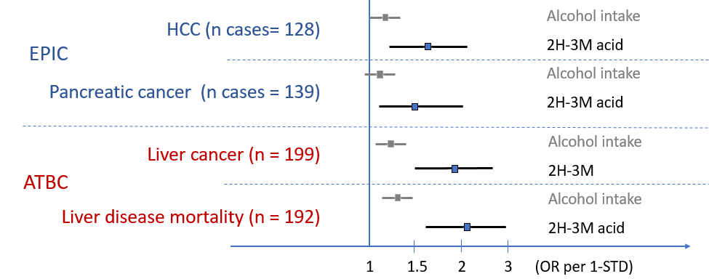
Alcohol biomarker discovery: IARC and US NCI
Untargeted metabolomics to identify metabolites correlated with alcohol intake in a discovery-replication study in EPIC and ATBC cohorts
One metabolite, 2-hydroxy-3-methylbutyric acid (2H-3M), was associated with alcohol and consistently with risk of diseases
Loftfield, Viallon, et al. Submitted to JNCI
Notes:
Slide 14
The identification of a biomarker of habitual alcohol intake could enhance evidence on its impact on cancer onset.
Untargeted metabolomics was used to identify blood metabolites and this correlated with habitual alcohol intake in EPIC and in the ATBC studies.
One metabolite, the 2-hydroxy-3-methylbutyric acid, showed a dose-response association with alcohol intake, and was associated with risk of hepatocellular carcinoma (HCC) and pancreatic cancer in EPIC, and with liver cancer and liver disease mortality in the ATBC study.
2-Hydroxy-3-methylbutyric acid is a (potential?) biomarker of habitual alcohol intake that may advance our understanding on the role of alcohol in cancer aetiology.

Slide 15




ABC-DO African Breast Cancer Disparities in Outcomes
Breast cancer (BC) cohort of 2200 women diagnosed across 5 Sub-Saharan African countries. Aims to investigate how to improve survival: cultural, health system, tumour biology, treatment factors.
2020 publications:
Reducing treatment gaps and improving stage at diagnosis are the greatest contributors to low survival and would avoid an equal number of breast cancer deaths: McCormack et al.
Every 100 BC deaths lead to 121 maternal orphans: Galukande et al.
Wide window of opportunity (8 – 12 months) is a wide window of opportunity to achieve early diagnosis: Foerster et al.
Geospatial barriers lead to later diagnosis: Togawa et al.
mHealth active follow-up reduces cohort losses: Foerster et al.
Notes:
Slide 15
Let’s move to environmental factors and cancer, starting with the ABC-DO study
ABC-DO is a breast cancer cohort of 2200 women diagnosed across 5 Sub-Saharan African countries. ABCDO aims to investigate how to improve survival from multiple viewpoints: whether it be cultural, in terms of the health system, with regard to tumour biology and treatment gaps.
The team’s 2020 publications include:
Firstly, a Lancet Global Health paper: reporting that reducing treatment gaps and improving stage at diagnosis are the greatest contributors to better survival, and would avoid an equal number of breast cancer deaths.
Secondly, published in JAMA Oncology, the team has produced the first ever estimate of maternal orphans associated with breast cancer, i.e. minors left behind when a woman dies. For every 100 breast cancer deaths, there were 121 maternal orphans. Avoidable premature cancer deaths should be on the global health agenda.
Thirdly, they documented the wide window of opportunity (8 – 12 months) for early diagnosis, and the geospatial barriers to diagnosing patients within this timeframe.
This highlighted the utility of mobile phones in cohort follow-up, which may also be used to achieve early diagnosis, enhance treatment compliance and ensure patient appointment attendance.

Slide 16

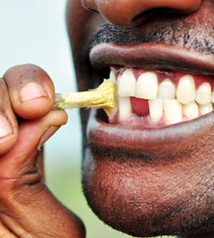
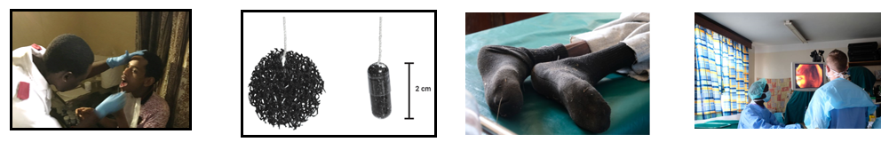
ESCCAPE Esophageal Squamous Cell Carcinoma – African PrEvention Research
East African case-control studies in Kenya, Tanzania and Malawi.
2020 progress:
Completed recruitment: 1300 cases, 1300 controls
Missing teeth, lack of daily oral hygiene and use of a chewed stick associated with increased risk in Tanzania: Mmbaga et al.
CytoSCCAPE: Study of cytosponge acceptability in 100 Tanzanian community volunteers. Highly acceptable and safe: Middleton et al.
Notes:
Slide 16
The ESCCAPE activities were initiated by IARC 5 years ago to address why there are incredibly high rates of squamous cell oesophageal cancer in east Africa.
These efforts now form an impressive three country case-control study of over 1300 cases and the same number of controls.
In 2020, the ESCCAPE team has continued to explore the role of poor oral hygiene: missing teeth and lack of daily tooth brushing with a toothbrush (and not a chewed stick) were identified as risk factors for oesophageal cancer.
The ESCCAPE team has also conducted the first feasibility study of the Cytosponge, i.e. a pill on a string with an encapsulated sponge, to obtain cytology cells from the oesophagus.
This sponge was highly acceptable to 100 community participants in Tanzania.

Slide 17
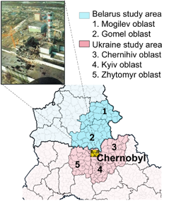

Breast cancer incidence after Chernobyl: 1986 - 2016
Breast cancer risk after Chernobyl fallout remains a public concern
Ecological study on female residents of the areas most contaminated with long-lived isotopes of caesium in Ukraine and Belarus
Little evidence of association between district-average cumulative absorbed breast dose and breast cancer incidence
Due to potential dose misclassification, a case-control study with individually reconstructed breast doses is required
Zupunski et al., 2020 Oct 16. doi: 10.1002/ijc.33346. Online ahead of print
Notes:
Slide 17
Even 35 years after the Chernobyl accident, there are still several open questions about radiogenic site-specific cancer risks, including female breast cancer, in the residents of radioactively contaminated territories.
IARC carried out an ecological study of breast cancer incidence in female populations of Ukraine and Belarus living in the areas heavily contaminated with long-lived isotopes of caesium (Cs-134, Cs-137).
The study included 85 thousand breast cancer cases, and 150 million person-years at risk in two countries combined.
Annual district-average absorbed radiation doses to the breast were reconstructed, and estimated for the entire adult female population over the period of 1986-2016.
Adjusting for time, age and urbanicity effects, no evidence of increasing incidence with the dose was found.
Owing to ecological study design limitations, a case-control study covering this area with individually reconstructed absorbed breast doses is needed to test for association between low-dose protracted radiation exposure and breast cancer risk after Chernobyl.

Slide 18
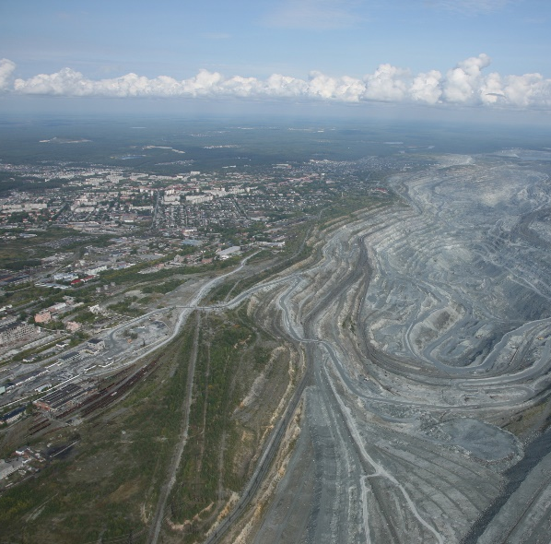
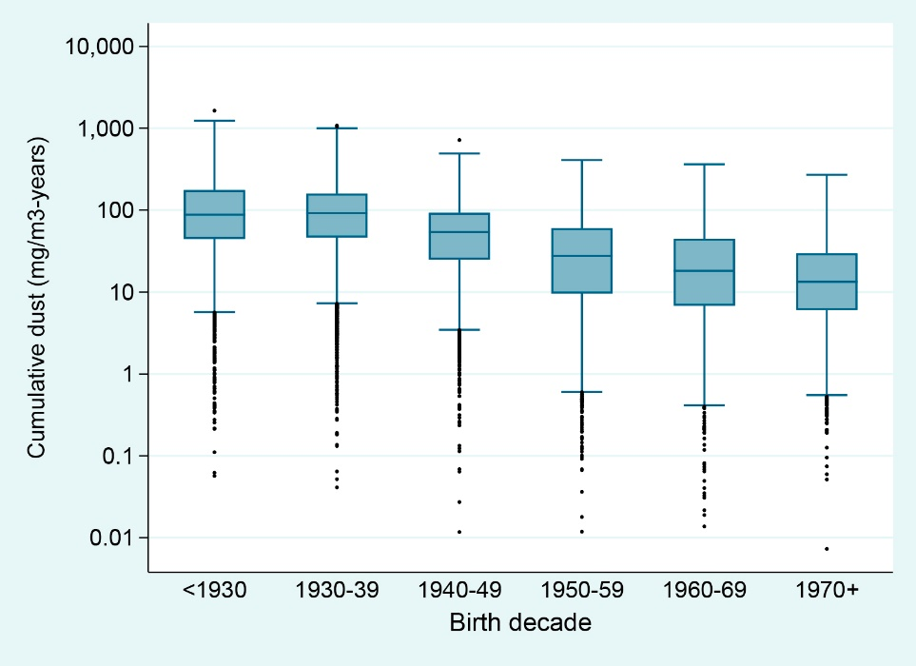
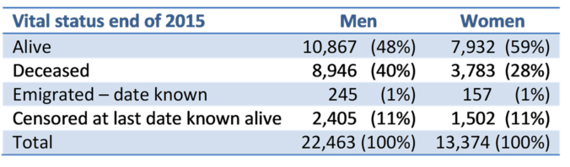
Asbest Chrysotile Cohort Study
Largest cohort of miners and millers n=37,837 (37% women)
Risk analyses on-going (completed 2021)
Already published papers (n=6) are available OPEN ACCESS from the study website: https://asbest-study.iarc.fr/publications/index.php
Notes:
Slide 18
This is a unique occupational cohort study conducted in close collaboration with the Izmerov Research Institute of Occupational Health in Moscow.
Preparatory work started in 2009 and the main project was launched in 2012.
All these efforts have resulted in the largest cohort worldwide of miners and millers. This is also the only available cohort study with a large proportion of women exposed to chrysotile.
Follow up for vital status and for cancer mortality resulted in record linkages with official mortality and resident registers, and 16,000 original death certificates were coded to ICD-10 at IARC.
Risk analyses are underway, and the main results are going to be published in 2021.

Slide 19
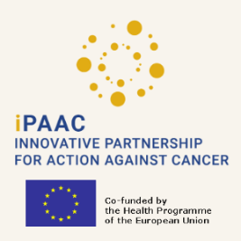









Recommendations for the Sustainability and Monitoring
of the European Code Against Cancer
Rec #1: individual- and population- level measures
Rec #5: several target groups
(includ. health professionals &policy-makers)
Rec #2:
    mapping and prioritization plan
    assess/translate/evaluate impact
    governance structure
Rec #6:
periodic update
high-quality process
centralized inter-institutional governance
Rec #3: multidisciplinary approach
(cancer-specific
+ NCDs preventive messages)
Rec #7: Dissemination Action Plan
Rec #4: cancer prevention “EU toolbox”
Rec #8: intersectoral partnerships
Further information
https://www.ipaac.eu/
http://cancer-code-europe.iarc.fr/
https://cancerpreventioneurope.iarc.fr/
Schüz J, et al. (2019) Primary prevention: a need for concerted action. Mol Oncol
Schüz J, et al. (2015) European Code against Cancer 4th edition: 12 ways […] Cancer Epidemiol
Espina C, et al. (2018) Cancer prevention policy in the EU: best practices […] J Cancer Policy
Ritchie, et al. (2020) Evaluation of the impact of the European Code […] Submitted Cancer Epidemiol
Berns A, et al. (2020) Towards a Cancer Mission in Horizon Europe. Mol Oncol.
Notes:
Slide 19
At the last European Commission’s Joint Action on Cancer (iPAAC, which stands for Innovative Partnership for Action Against Cancer), IARC was requested to provide the “Road map” for the sustainability and monitoring of the European Code Against Cancer, in collaboration with the Association of European Cancer Leagues and the Cancer Society of Finland.
A co-creational consultation process with more than 100 experts in cancer prevention, public health, as well as experts in communication, resulted in 8 recommendations on the scope of a future 5th edition of the European Code, including updating the evidence and strategies for its implementation and dissemination across Europe.
Some of the recommendations are:
(i) Adding population-level measures and policies in synergy with NCDs preventive messages,
(ii) targeting health professionals and policy-makers,
(iii) establishing a framework to periodically update the Code through a centralized governance and intersectoral collaborations,
(iv) and developing a Dissemination and Evaluation Plan,
Overwhelming support for the update of the European Code was expressed by all the stakeholders.
In addition, 4 research needs were identified: implementation research; research dissemination, evaluation of the impact of future Codes Against Cancer, and continued aetiological research.

Slide 20
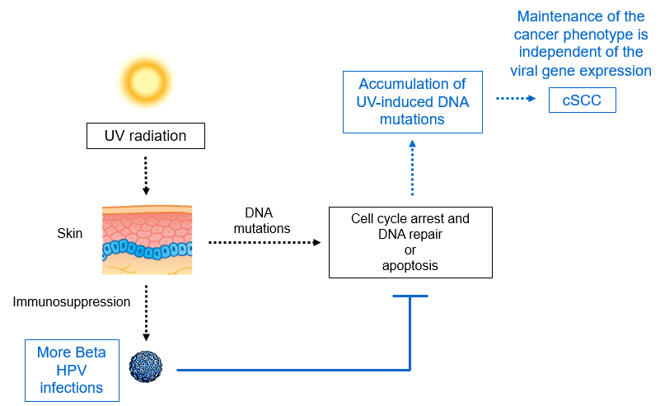
Model of skin carcinogenesis based on biological and epidemiological findings
Lambert et al. (In press) Nature. 2021 (comment)
Notes:
Slide 20
Let’s move to the area of infections and cancer.
IARC developed a model for cooperation between some beta Human Papilloma viruses (HPV) types and UV radiation in promoting skin cancer.
Under physiological conditions, UV irradiation of the skin induces DNA mutations in keratinocytes and immunosuppression.
The UV-induced damage results in (i) cell cycle arrest and repair of DNA mutations or (ii) apoptosis, if the DNA damage is unrepairable.
Beta HPV early proteins, E6 and E7, can alter the cellular response to UV-induced stress, maintain alive DNA-damaged cells that have a high risk of evolving into cancer cells.
After accumulation of mutations in oncogenic driver genes, e.g. cellular tumour suppressor genes or oncogenes, the expression of the viral genes becomes dispensable.
This study is in press in Nature.

Slide 21
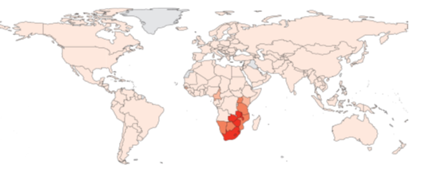
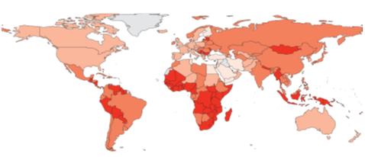
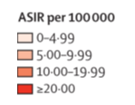
Global burden of cervical cancer associated with HIV
Incidence of cervical cancer attributable to HIV
non-attributable to HIV
5% of global cervical cancer attributable to HIV
In Eastern/Southern Africa, HIV adds to existing high burden of cervical cancer.
Stelzle D,... Ibrahim Khalil A, Baussano I, Bray F,…Clifford GM et al; Lancet Global Health. 2020
Notes:
Slide 21
This study is a collaboration with WHO.
Approximately 5% of global cervical cancers are attributable to HIV.
But this proportion reached approximately 20% in Eastern Africa and 50% in Southern Africa.
This highlights the need for cervical cancer prevention in Africa (i.e. HPV vaccination), where HIV adds to an already existing high burden (see map of incidence non-attributable to HIV).
The publication of this study coincided with the launch of the WHO Global Strategy towards the Elimination of Cervical Cancer.

Slide 22
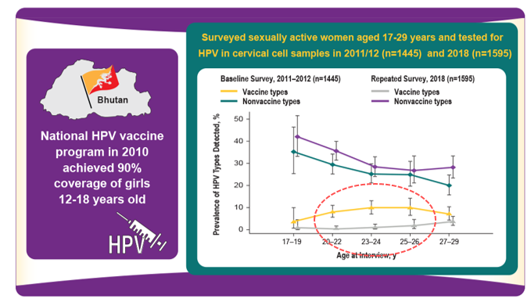
HPV vaccination effectiveness in Thimphu, Bhutan
Baussano I, …Tenet V… Clifford GM, Annals Internal Medicine. 2020
Notes:
Slide 22
Bhutan implemented a national program for human papillomavirus (HPV) vaccination in 2010 involving girls aged 12 to 18 years and achieving nearly 90% coverage
The objective of this study was to estimate HPV vaccine effectiveness in Bhutan
IARC conducted 2 cross-sectional surveys (2011–2012 and 2018) among sexually active women aged 17 to 29 years, including 1445 participants from the baseline survey and 1595 from the repeated survey
Between the 2 surveys, the prevalence of HPV vaccine types decreased from 8.3% to 1.4%, whereas the prevalence of nonvaccine types increased from 25.8% to 31.4%
Among women younger than 27 years, who were targeted by the vaccination program, the overall and indirect adjusted vaccine effectiveness was 93% (CI, 87% to 97%) and 88% (CI, 69% to 95%), respectively
No impact on nonvaccine HPV types was detectable
In Bhutan, the prevalence of vaccine-targeted HPV types has decreased sharply, providing the first evidence of the effectiveness of a high-coverage national HPV vaccination program in a lower-middle-income country.

Slide 23
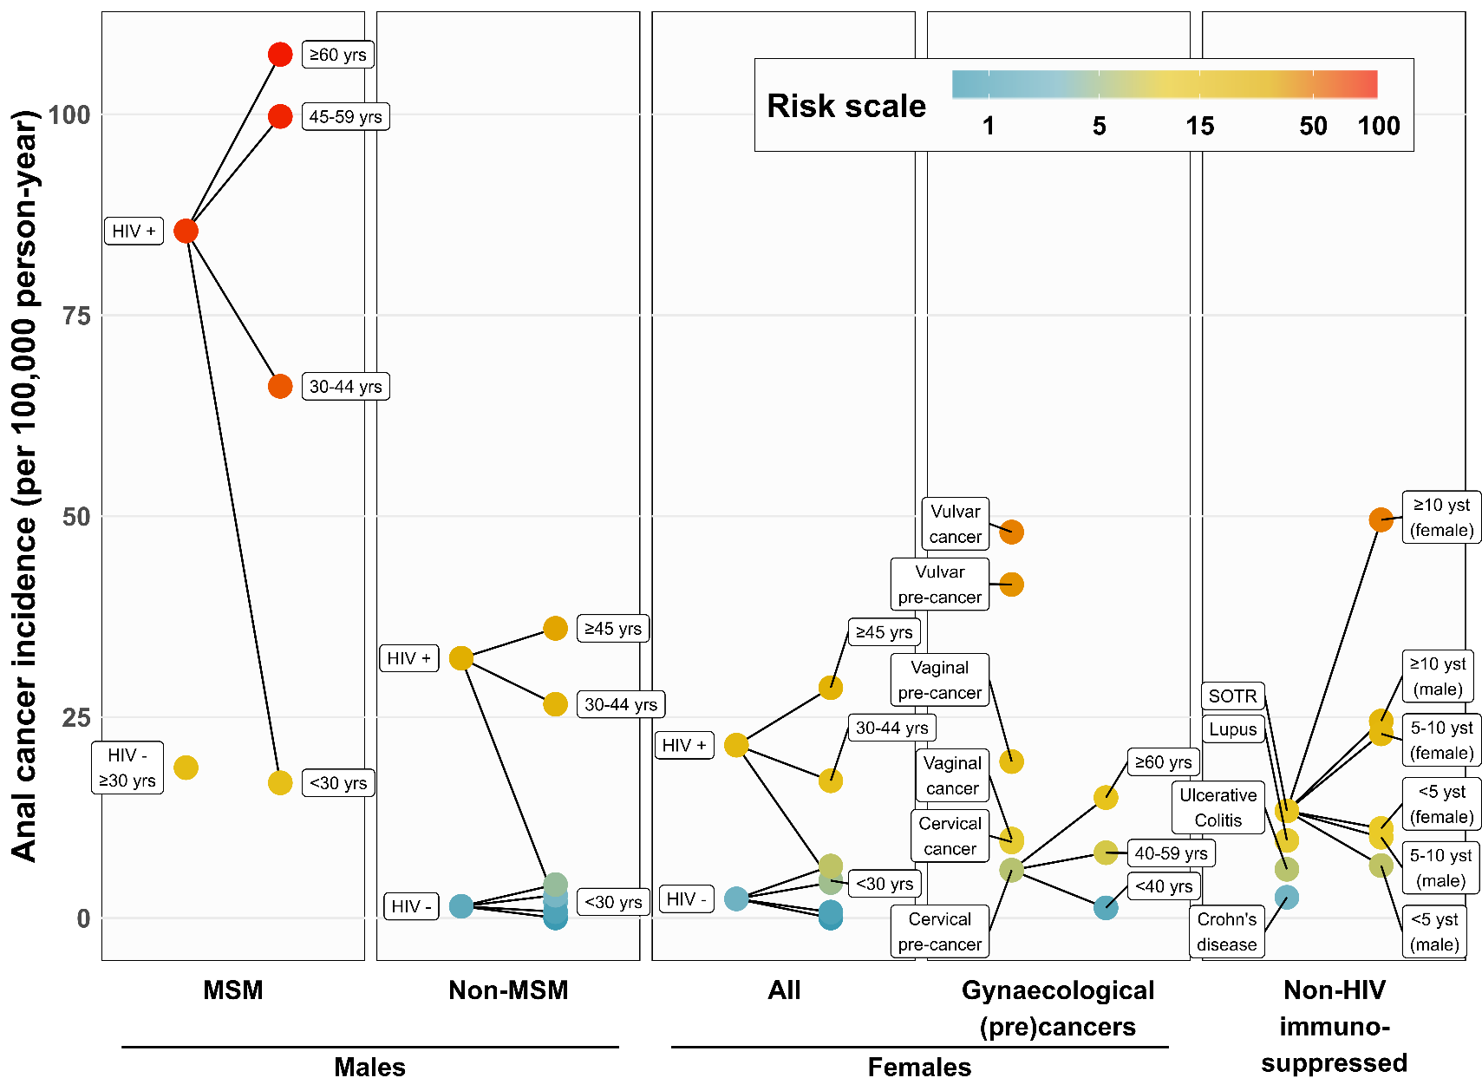
Anal cancer risk stratification & implications for prevention
Towards an anal cancer risk scale:
Clifford GM, Georges D, et al. International Journal Cancer. 2021
Notes:
Slide 23
This slide shows results from a meta-analysis, including unpublished data through Collaboration with U.S. NCI
Estimates of anal cancer incidence were calculated across the full spectrum of at-risk groups, namely, persons living with HIV, men who have sex with men (MSM), women diagnosed with HPV-related gynaecological precancerous lesions or cancer, solid organ transplant recipients, and patients with auto-immune diseases
This unifying anal cancer risk scale can improve prioritisation and standardisation in anal cancer prevention and research initiatives (i.e. screening/early detection), based on a principle of similar management for populations of similar absolute risk.

Slide 24
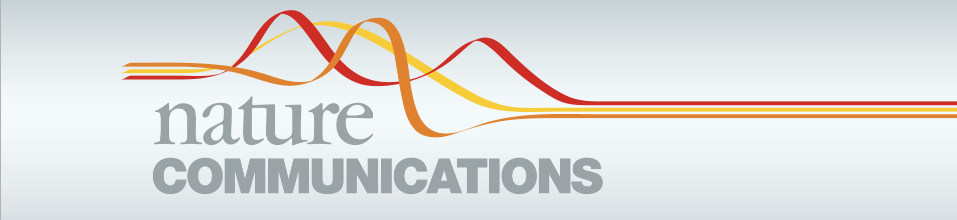
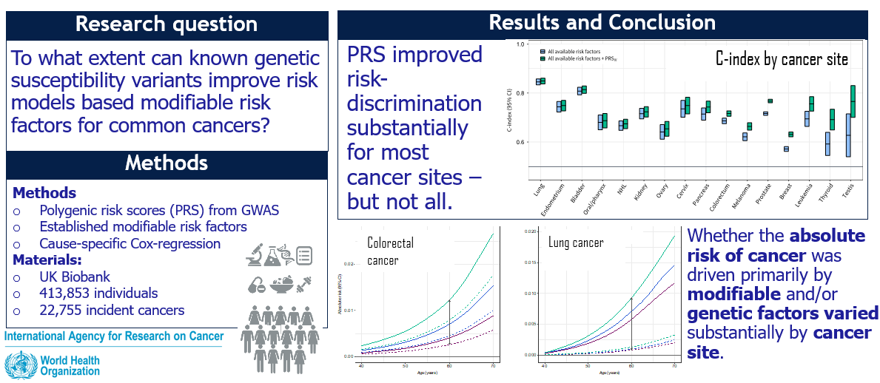
Pan-cancer analysis demonstrates that integrating polygenic risk scores with modifiable risk factors improves risk prediction
Kachuri et al. 2020
Notes:
Slide 24
Let’s move to genetics
Cancer risk is determined by a complex interplay of environmental and heritable factors.
Polygenic risk scores (PRS) provide a personalized genetic susceptibility profile that may be leveraged for disease prediction.
Using data from the UK Biobank, IARC scientists quantified the added predictive value of integrating cancer-specific polygenic risk scores with family history and modifiable risk factors for 16 cancers.
Findings show that incorporating polygenic risk scores measurably improves prediction accuracy for most cancers, but the magnitude of this improvement varies substantially.
IARC also demonstrated that stratifying on levels of polygenic risk scores identifies significantly divergent 5-year risk trajectories after accounting for family history and modifiable risk factors.
At the population level, the top 20% of the polygenic risk scores distribution accounts for 4.0% to 30.3% of incident cancer cases, exceeding the impact of many lifestyle-related factors.
In summary, this study illustrates the potential for improving cancer risk assessment by integrating genetic risk scores.

Slide 25

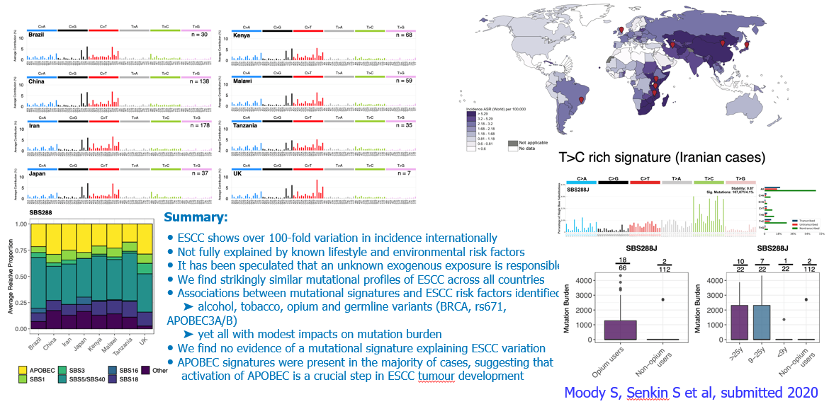
Mutational signatures in esophageal squamous cell carcinoma from eight countries of varying incidence
Notes:
Slide 25
Esophaegal squamous cell carcinoma shows over 100-fold variation in incidence internationally
This variation is not fully explained by known lifestyle and environmental factors
It has been speculated that that an unknown exogenous exposure is responsible for this variation
IARC findings show similar mutational profiles of esophaegal squamous cell carcinoma across the 8 countries
Associations between mutational signatures and esophaegal squamous cell carcinoma risk factors were identified for alcohol, tobacco, opium and some germline variants, with modest impact on mutation burden
This study shows no evidence of a mutational signature explaining esophaegal squamous cell carcinoma variation
However, APOBEC signatures were present in the majority of cases, suggesting that activation of APOBEC is a crucial step in Esophaegal squamous cell carcinoma development.

Slide 26
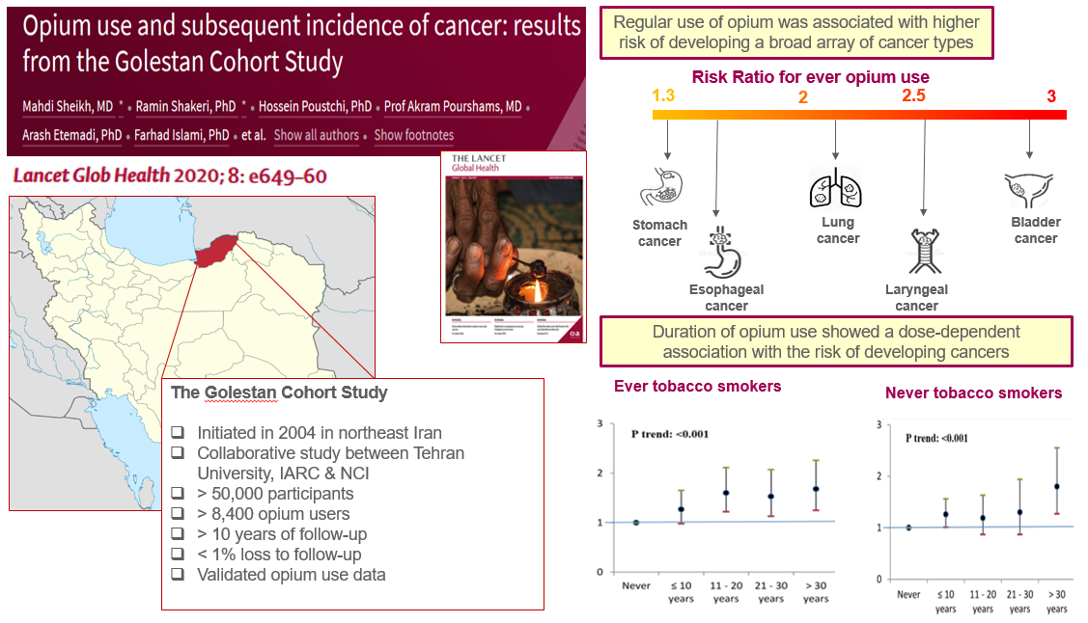
Notes:
Slide 26
This study is based on more than 10 years of follow-up of more than 50 000 individuals within the Golestan Cohort Study, which was initiated in 2004 by the Digestive Disease Research Institute of the Tehran University of Medical Sciences (Islamic Republic of Iran) in Northeast Iran, in collaboration with the IARC and the United States National Cancer Institute.
Because of the challenges inherent in studying this exposure, there is a lack of prospective studies of opium use with long-term follow-up.
The Golestan Cohort Study is the only population-based prospective study that includes a large group of long-term opium users with validated data on opium use.
This study provides robust evidence indicating:
That the regular use of opium was associated with higher risk of developing a broad array of cancer types, stomach, oesophageal, lung, laryngeal and bladder cancers among ever and never tobacco users
Duration of opium use showed a dose-dependent association with the risk of developing cancer
Given the huge increase in the use of opiates in the past few years, further global initiatives are needed to reduce opiate misuse and implement preventive strategies to mitigate their hazardous long-term effects.

Slide 27
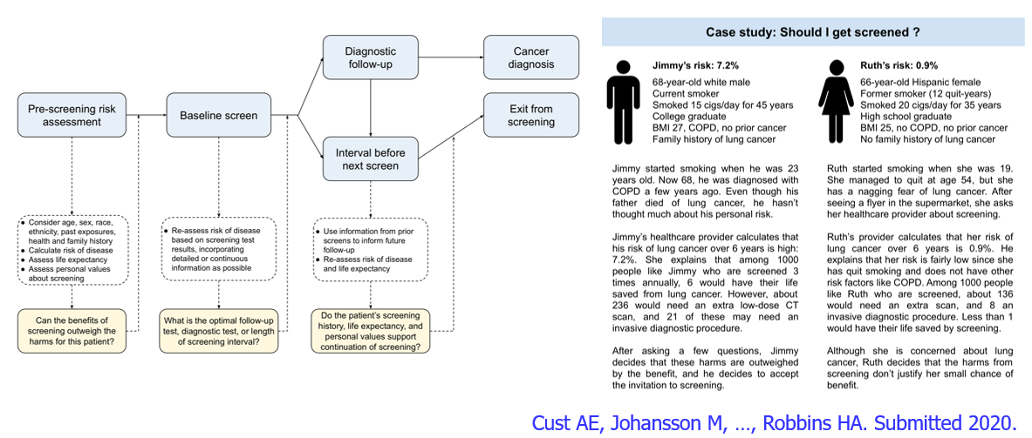
Risk-tailored cancer screening:
A review addressing evidence and implementation considerations
This project was led by Dr. Anne Cust from the University of Sydney during her period as a visiting scientist at IARC, together with Dr. Hilary Robbins (GEP)
Notes:
Slide 27
Early detection of cancer seeks to identify cancers at an early disease stage. When cancer is detected at an early stage, it can be more easily treated with fewer side effects, and a higher proportion of patients will survive.
Early detection is typically achieved by screening large numbers of unsymptomatic individuals in the general population to identify those few with early-stage cancer.
Cancer screening has been shown to reduce mortality for a number of common cancers, but its impact remains limited and is associated with many harms.
This review conducted by the Genetics Section addresses evidence and implementation consideration for screening programmes.
Indeed, there is a strong potential to improve the effectiveness of cancer early detection and decrease its harms through multiple means.
IARC focuses primarily on improving the identification of the group of high risk individuals who are most likely to benefit from screening through risk modelling.
IARC focus on a few specific cancers, in particular cancers of the lung, bladder, esophagus, and head and neck.

Slide 28
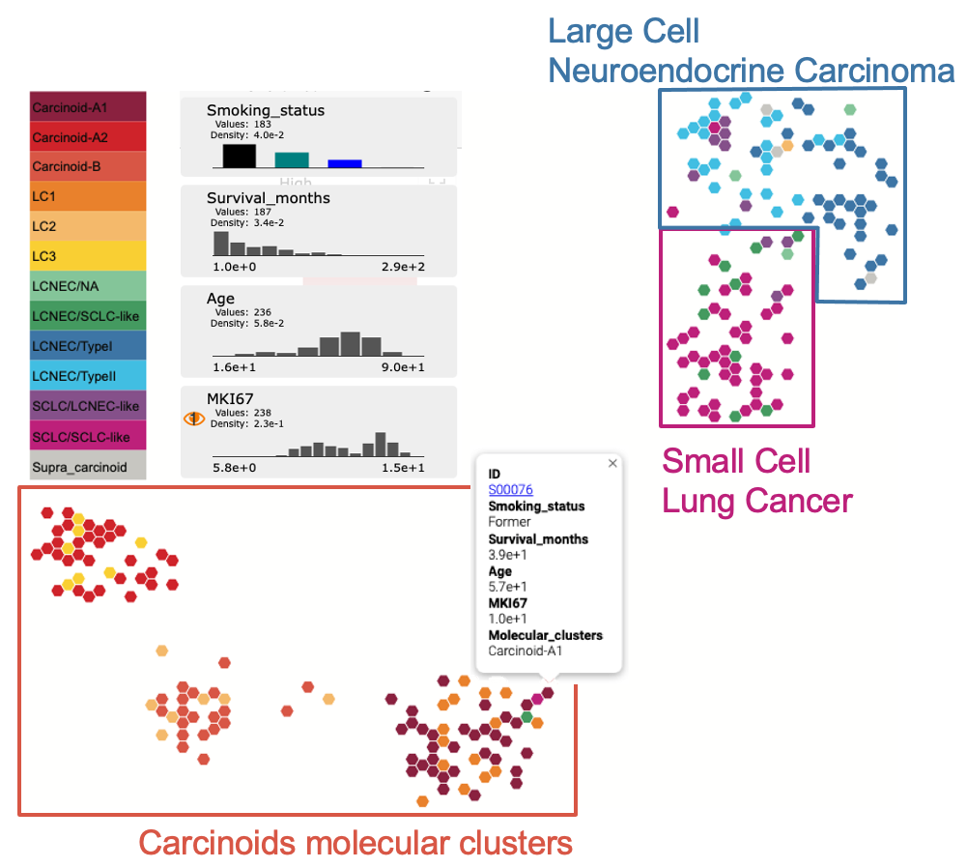



A molecular map of lung neuroendocrine neoplasms (LNEN)
First comprehensive LNEN molecular map using transcriptomic data from 6 different studies
Open-science effort to promote data re-use and integrate samples from future studies
Essential for rare cancers studies due to limited sample sizes available
Tumor Map
Reproducible bioinformatics pipelines to integrate new samples
Gabriel et al., GigaScience. 2020
Notes:
Slide 28
Rare tumours have been largely left aside from large cancer genomic programs, even if they collectively account for ~25% of all cancers diagnosed
Rare cancers encounter the limitation of availability of good quality biological material, with most genomic studies therefore including a limited number of samples
Here IARC generated the first comprehensive molecular map based on homogenized transcriptomic data available for the four types of lung neuroendocrine neoplasms (NENs) from six different studies
Findings have shown that this map captures the main biological findings of previous studies.
IARC provides a full spectrum of data and tools needed to integrate it with future lung neuroendocrine neoplasms transcriptomic studies, allowing to draw meaningful conclusions that will eventually lead to a better understanding of this rare understudied disease.
The generated map can be interactively explored and interrogated on the UCSC TumorMap web portal.
Considering the small sample sizes of molecular studies on rare lung neuroendocrine neoplasms, promoting data integration will empower more reliable statistical testing, and this map will therefore serve as a reference in future studies.

Slide 29
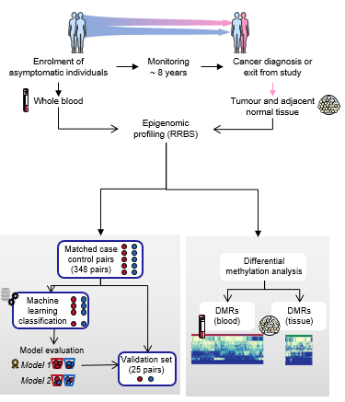
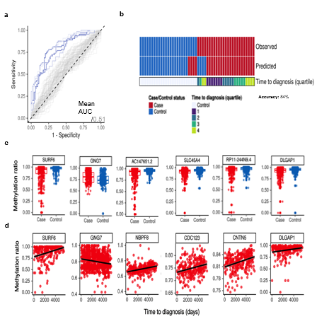
Epigenetic signatures in whole blood as predictors of breast cancer risk
Chung et al. 2020 In revision
Notes:
Slide 29
Let’s move to epigenetics
The Epigenetics Group of IARC and a consortium of collaborators from Austria, Germany and France conducted epigenome-wide profiling in more than 600 prospectively-collected blood samples and more than 200 tumour and normal adjacent tissue samples.
They applied machine learning algorithms to identify a panel of epigenetic events that could differentiate individuals who went on to develop cancer from those who did not with an accuracy of 84%, and could identify future cases up to 13.8 years before diagnosis of the disease was reported.
Interestingly, epigenetic states in a subset of these marks were significantly correlated with time to diagnosis.
The investigators also found that there was little overlap between cancer-specific epigenetic events in the blood and the tumour tissue, suggesting that the identified blood-based epigenetic events are unlikely to originate from micrometastases of existing tumours, but are instead reflections of cellular processes occurring in the early stages of carcinogenesis.

Slide 30
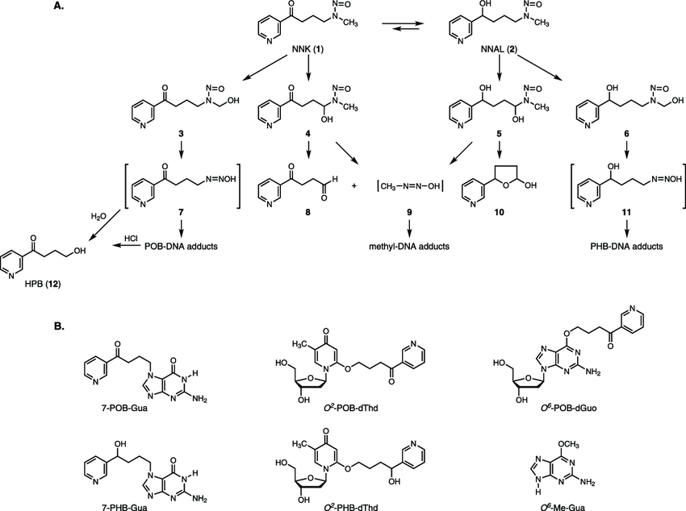
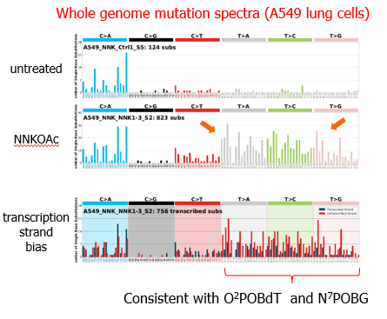
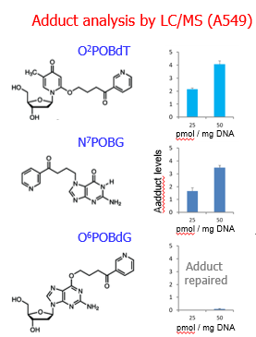
Novel mutational signature of tobacco nitrosamine NNK
4-(Methylnitrosamino)-1-(3-pyridyl)-1-butanone
Highly potent carcinogen in tobacco smoke
IARC Group 1 carcinogen
carcinogenic in animals - lung, liver, pancreas, oral/nasal cavity, forestomach, stomach
  DNA adducts well characterized
  genome-scale mutational signatures unknown
NNK generates a unique, novel mutational signature, to be identified in relevant human cancers
Notes:
Slide 30
Nicotine-derived tobacco nitrosamine or NNK is a highly potent mutagenic carcinogen present in tobacco smoke.
NNK is classified as IARC Group 1 carcinogen and it induces cancer in rodents, with the lung being the primary target site. However, the specific genomic mutational signatures of NNK had never been characterized.
IARC investigated both the specific DNA adducts formed by NNK using mass spectrometry, and the genome-scale mutational signatures of NNK in human lung cancer cell line.
IAR scientists found 2 major adducts forming in cancer cells, with the 3rd major known adduct being repaired.
Whole-exome sequencing analysis revealed a striking novel mutational signature associated with NNK treatment.
Transcription strand bias analysis of the sequencing data revealed specific mutagenesis consistent with the bulky adducts on thymidine and also guanine.
This novel signatures is now being identified in silico in the vast pan-cancer genomics data, to identify the contribution of NNK to carcinogenesis linked to tobacco use.

Slide 31
Efficacy of a single dose of 4-valent HPV Vaccine against persistent HPV infection compared to 2 or 3 doses
Unmarried girls aged 10-18 year were vaccinated with 3 doses (N=4348), 2 doses (N=4979) & 1 dose (N=4950) of 4-valent HPV vaccine in 2009-10
10 year follow up of the vaccinated cohorts & an age-matched unvaccinated cohort shows a very high efficacy against persistent HPV infection, irrespective of the number of doses
Frequency of persistent HPV 16/18 infection in different dose cohorts 10 years post-vaccination
Study Group | Women assessed for persistent infection (N) | Persistent HPV 16/18 infection N (%; 95% CI)
Unvaccinated | 1265 | 32 | (2.5; 1.7-3.6)
1- dose | 2136 | 1 | (0.0; 0.0-0.3)
3- dose | 1460 | 1 | (0.1; 0.0-0.4)
2- dose | 1451 | 1 | (0.1; 0.0-0.4)
“The Committee agreed the evidence strongly indicated that a single dose of quadrivalent vaccine would provide protection over a long period of time”- The Joint Committee on Vaccination & Immunization (JCVI), UK after reviewing IARC study data (minutes of JCVI meeting held on 3/6/2020)
Supported by the Bill & Melinda Gates Foundation
Notes:
Slide 31
Let’s move to HPV vaccination and cervical cancer screening programmes
IARC has assessed the efficacy of a single dose of quadrivalent HPV vaccine against persistent HPV infection compared to 2 or 3 doses
This study was financed by the Bill and Melinda Gates Foundation
Using data from 10-year follow-up of the vaccinated cohorts and an age-matched unvaccinated cohort in India, findings show a very high efficacy against persistent HPV infection, irrespective of the number of doses
Due to the cost-effectiveness of one dose, findings of this study are determinant for the successful implementation in limited resource settings.

Slide 32
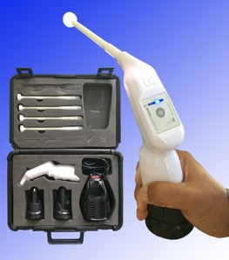
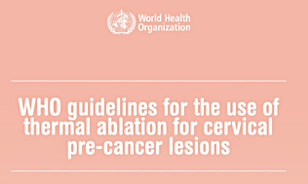
Development & field testing of a low-cost portable thermal ablator to treat cervical precancers
Within the framework of US-NIH sponsored study, IARC team worked with a private enterprise to develop a portable, battery-driven thermal ablator
The thermal ablator was field tested in Zambia
VIA-positive women eligible for ablative treatment were randomized into 3 arms to be treated with either thermal ablation (N=250) or cryotherapy (N=250) or LLETZ (N=250)
The cure rates at 6 month follow up were no different between the treatment arms
The complication rates were very low and comparable between the treatment arms
The IARC study provided valuable evidence to the WHO to recommend thermal ablation as a method to treat cervical precancer in 2019
Pinder et al. Lancet Oncology 2019
WHO guidelines for the use of thermal ablation for cervical pre-cancer lesions, 2019
Supported by US National Institutes of Health
Notes:
Slide 32
Within the framework of US-NIH sponsored study, IARC worked with a private enterprise to develop a portable, battery-driven thermal ablator
The thermal ablator was field tested in Zambia
Women eligible for ablative treatment were randomized into 3 arms to be treated with either thermal ablation or cryotherapy or LLETZ
Results showed that the cure rates at 6 month follow up were no different between the treatment arms
This IARC study provided valuable evidence to the WHO to recommend thermal ablation as a method to treat cervical precancers.

Slide 33
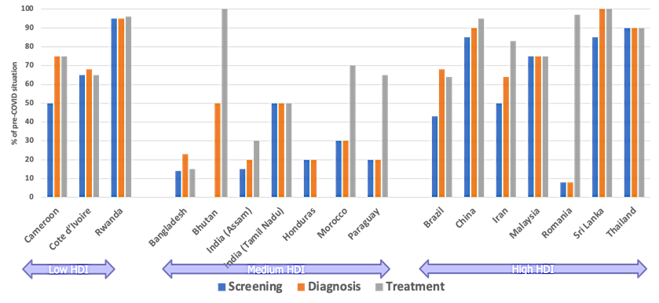
Impact of COVID-19 outbreak on cancer screening programmes in 17 LMICs belonging to different HDI categories
Managers/supervisors of cancer screening programs from 17 LMICs participated in an online survey & subsequent in-depth interview.
Screening was suspended for 30+ days in all except Iran.
Diagnostic services were suspended for 30+ days in all except Iran, Malaysia & Sri Lanka.
Cancer treatment services were suspended for 30+ days in Cameroon, Bangladesh, India, Honduras & China.
Availability of cancer screening, diagnostic & treatment services in Sept-Oct 2020 compared to the pre-COVID situation – as rated by program managers in a scale of 0 to 100
Notes:
Slide 33
IARC has assessed the impact of the COVID-19 outbreak on cancer screening programmes in 17 LMICs within different Human Development Index (HDI) categories
Managers and supervisors of cancer screening programs from 17 LMICs participated in an online survey and subsequent in-depth interview.
Results from this survey indicate that:
Screening was suspended for more than 30 days in all countries except Iran.
Diagnostic services were suspended for more than 30 days in all countries except Iran, Malaysia and Sri Lanka.
Cancer treatment services were suspended for more than 30 days in Cameroon, Bangladesh, India, Honduras and China.
These results suggest an increase in the burden of cancer in the following years as a consequence of the COVID-19 pandemic, particularly in LMICs.

Slide 34
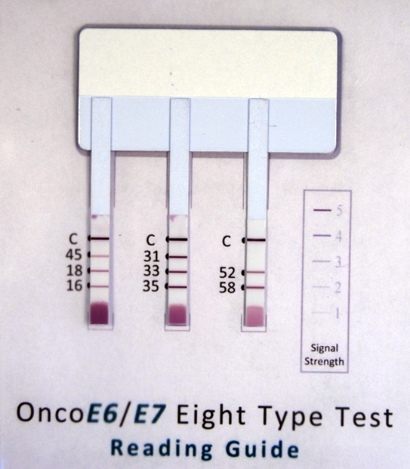
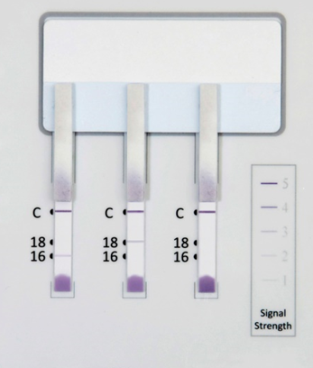
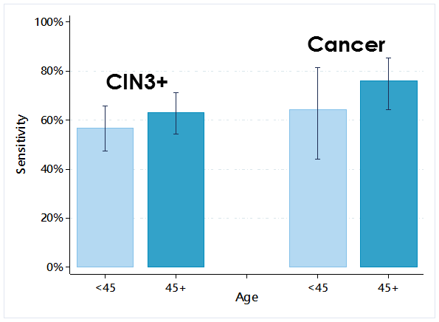
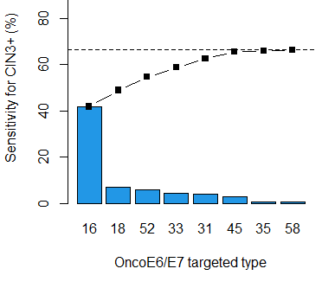
Oncoprotein tests to detect high-grade cervical lesions within the ESTAMPA study
Characteristics of oncoprotein tests
E6/E7 oncoprotein detection of HPV16/18/45/31/33/35/52/58 (OncoE6/E7)
Low-cost rapid tests
Easy to run
Results available in 2.5 h
No specialised personnel required
Room temperature storage
Three strips to detect oncoproteins of 8 HPV types
Strip 1: HPV16/18/45
Strip 2: HPV 31/33/35
Strip 3: HPV 52/58
Hypothesis: Adding detection of other high-risk HPV types oncoproteins might increase the sensitivity of the oncoproteins test without loss specificity
E6 oncoprotein detection of HPV16/18 (OncoE6TM Test)
E6 oncoprotein has proved to be highly sensitive and specific for detection of HPV16/18‐related high-grade cervical lesions (CIN3+):
Sensitivity: 56% (95%CI 43-69)
Specificity: 98% (95%CI 94-99)
Performance of OncoE6/E7 test for CIN3+ detection: preliminary results
Sensitivity: 60% (95%CI 54-66)
  Increased by age
  Few contribution of HPV 35&58 oncoproteins
Specificity: 82% (95%CI 78-85)
  ~93% among HPV negatives
Ferrera et al., IJC 2019
A new prototype of 8-HPV types is under evaluation (OncoE6/E7)
Next steps
Continue fine tuning of the test
Performance assessment of the 8-HPV type OncoE6/E7 test in the ESTAMPA screening population for triage of HPV positive women, in primary screening and in real-life testing
Notes:
Slide 34
The E6 and E7 oncoproteins are necessary for HPV oncogenic transformation and may be useful for triage of HPV positive women at higher risk of developing cervical cancer
In the ESTAMPA study a test for oncoprotein detection is under evaluation, it is a rapid and simple technology test to generate results in 2.5 hours.
The first version of the test is the OncoE6TM Test which detects E6 oncoprotein of HPV16 and HPV18, was evaluated in a population from Honduras showed a sensitivity for CIN3+ detection of 56% and specificity of 98%.
A new prototype of 8-HPV types is under evaluation, it detects E6 and E7 oncoproteins of 8 HPV types (16/18/45/31/33/35/52/58) using 3 strips. The hypothesis for the evaluation of this new prototype is that adding detection of other high-risk HPV types oncoproteins might increase the sensitivity of the oncoproteins test without loss specificity.
The preliminary results show a sensitivity of 60% and specificity of 82%, the sensitivity increased by age and there was few contribution by adding HPV35 and 58 types.
The next steps for this study include the fine tuning of the test and to evaluate the performance assessment of the 8-HPV type Onco test in the ESTAMPA screening population for triage of HPV positive women, in primary screening and in real-life testing.

Slide 35


Cervical Screening and Treatment of Women Living With HIV
The Cervical cancer Screening-and-Treatment algorithms study using HPV testing in Africa (CESTA)
Background
WHO cervical cancer global strategy: 70% of women screened twice by age 45 and 90% of cervical disease treated
WLHIV are at higher risk of HPV infection, HPV persistence, cervical disease as well as cervical treatment failure
Previous results from Kenya:
  HPV prevalence of 53% on screening samples (De Vuyst, Mugo et al., BJC, 2012)
  Efficacy LEEP vs. cryotherapy for CIN2/3 treatment: 81% vs. 70% (P=0.1) (Greene, De Vuyst et al., JAMA, 2019)
Current status
400 WLHIV recruited in Durban, South Africa
HPV prevalence of 48% on clinician sample
High colposcopy referral mostly due because of the SCJ not visible
On women with visible SCJ, 81% received ablative treatment in the VIA-triage Arm vs 93% in the no-triage Arm
Next step: reach statistical power with the further recruitment of 700 WLHIV in a new study site in East London, South Africa
The visibility of the squamous columnar junction (SCJ) is necessary for a screen-and-treat approach
Objective: Compare the efficacy of HPV screen-and-treat strategies with and without VIA triage
  1,100 WLHIV aged 25-54 years old to be screened with HPV-testing and HPV-positives to be randomised to
    VIA triage followed by treatment of HPV+/VIA+ (VIA-triage Arm)
    Treatment of HPV+ (no-triage Arm);
  Ablative treatment is performed by cryotherapy and thermal ablation
Notes:
Slide 35
Women living with HIV (WLHIV) are at higher risk of HPV infection, HPV persistence, cervical disease as well as cervical treatment failure. Research is needed to fill the gap for this population with high-risk of cervical cancer to accelerate cervical cancer elimination.
CESTA is a randomized controlled trial aiming to recruit 1,100 WLHIV aged 25-54 years old with the objective of comparing the efficacy of HPV screen-and-treat strategies with or without Visual Inspection with Acetic Acid (VIA) triage.
HPV-positive women were randomized into the VIA-triage where only VIA-positive women eligible to ablative treatment were treated by cryotherapy or thermal ablation and to the no-triage Arm where all eligible HPV-positive women were treated by ablative treatment.
Currently, 400 women living with HIV were recruited in Durban, South Africa. The prevalence on the clinician sample was 48%. The VIA triage test as well as the ablative treatment could not be performed to a large proportion of women because the squamous columnar junction was not visible, leading the women to be referred to colposcopy for further management.
Among the women who had a visible junction, 81% received ablative treatment in the VIA-triage Arm and 93% in the no-triage Arm.
The recruitment of 700 women living with HIV is under planning in a new study site in South Africa to reach the statistical power to compare both strategies and bring clear answer of the scheme that should be used for those high-risk women.

Slide 36







Multicentric study of cervical cancer screening and triage with HPV testing
The ESTAMPA study in Latin America*
Evaluation of new strategies and biomarkers for triage of HPV positive women in cervical cancer screening
50,000 women 30-64y HPV-screened in 12 centres in Latin America
HPV positives referred to colposcopy/biopsy with treatment of CIN2+
Women with <CIN2 follow-up screening at 18 months
CIN3+ gold standard for triage evaluation
Triage methods: cytology, VIA, HPV genotyping, HPV persistence, E6/E7 oncoproteins, p16/Ki67, methylation, risk stratification model
  Progress to date
  Over 40,000 screened
  14% HPV prevalence
  95% of HPV positives with colposcopy/biopsy
  93% adherence 18 months screening visit of <CIN2
  879 CIN2+ detected/treated (549 CIN3 and 49 cancers)
Performance of several tests for triage of HPV positive women within the ESTAMPA study
Network of Latin American investigators
Local health systems and funding
Extensive training of staff: research governance, epidemiology, cytology, histology, laboratory
Planned ancillary studies
  HPV screening cost-effectiveness
  Adoption of WHO guidelines in Latin America
  Acceptability and feasibility of HPV-based screening
  Psychosocial impact of HPV screening
Sensitivity for CIN3+ (%)
Specificity (%)
Platform for HPV-based screening implementation
  Outreach & follow-up strategies
  Introduction of HPV testing & QA system
  Standardisation of diagnostic procedures
  In this setting, VIA and repeat HPV test at 2 months detect more than 80% of CIN3+ cases among HPV positive women, while Pap and HPV 16/18 genotyping CIN3+ detection do not excess 60%. Pap performance may improve if HPV positive status is known (ongoing study). Additional tests are under evaluation.
  Psychosocial impact of HPV positive results
  Validation of PsychoESTAMPA scale (Arrossi S, Almonte M, et al., Prev Med Rep 2020)
*Almonte M et al., BMJ 2020
Notes:
Slide 36
This study aims to address the performance and feasibility of several strategies to identify HPV positive women at risk of developing cervical cancer in the ESTAMPA study.
The study will include around 50,000 women aged 30-64 in 12 study centres
ESTAMPA has created a solid network of leading Latin American researchers who have enriched their own research experiences with the transfer of knowledge across the continent
This collaboration has facilitated the planning of future important research topics for the coming years and has established a platform to implement HPV-based cervical screening in the region
So far, more than 40,000 women have been screened of whom 14% have tested positive for HPV and more than 90% of these have received colposcopy and appropriate clinical management. In total, almost 900 women with cervical precancerous lesions have been diagnosed and treated
The performance of some of the strategies to detect cervical precancerous lesions among HPV positive cases has been evaluated. Visual inspection with acetic acid (VIA) and short-term HPV persistence have shown to detect more than 80% of the lesions while detection through the use of Pap and HPV16/18 genotyping does not exceed 60%.
It is important to note that Pap performance may improve if HPV positive status is known (ongoing analyses are being carried out)
As presented previously, additional tests are under evaluation including a new E6/E7 oncoprotein test prototype, dual staining cytology, methylation, and a risk stratification model
ESTAMPA has also provided a valid scale to measure the psychosocial impact of receiving a HPV positive test which may help to understand how to communicate such results to the general population

Slide 37

IARC Research Training and Fellowship Programme
177 overall – 68 new
IARC Groups funding or
IARC Fellowships
12% - 25% decrease [COVID]
2 IARC postdoctoral fellowships
Agreement with Children with Cancer UK
Notes:
Slide 37
Let’s move to the IARC Research Training and Fellowship Programme
In total, 177 students, postdoctoral scientists and visiting scientists were hosted at the Agency in 2020. This category of personnel known as IARC’s Early Career and Visiting Scientists or ECVS, received training and participated in collaborative research projects as part of their stay. This corresponds to an overall 12% decrease in comparison with 2018 and 2019.
There was indeed an estimated decrease of 25% in new arrivals due to the COVID crisis. In response to the first lockdown in France, and considering the uncertainty over the summer, new ECVS arrivals were suspended from mid-March to 1 September 2020. As a mitigation measure, approximately 20 ECVS started their training remotely (and then moved to Lyon as soon as it was safe and possible to do so).
ECVS joining IARC are financially supported either by IARC’s Scientific Sections or through the IARC Fellowships programme.
The regular annual call for postdoctoral fellowships was opened in October 2020. And in addition, there was an ad hoc call and award for 2 IARC postdoctoral fellowships supported by Children with Cancer UK.
The selection for the regular IARC postdoctoral fellowship programme will be made early 2021 and the number of fellowships awarded will depend on the budget discussions at the Governing Council in May 2021.

Slide 38




Notes:
Slide 38
As an important complement to face to face courses, online learning material have been increasingly been made available in 2020.
Just over one year ago, the Education and Training Group launched the IARC Learning portal, an open website hosting learning resources to support the professional development of cancer researchers and health professionals.
This portal is organized around several thematic platforms, which are growing to offer a variety of learning and training resources (self-paced modules, manuals and guidelines, tutorials and demos, lectures and webinars, etc.).
The platforms currently available focus on: Biobanking, Cancer Prevention and Early Detection, the World Cancer Report Updates, and the Human Exposome Assessment Platform (HEAP) project.
One of the latest additions to IARC’s learning activities is the World Cancer Report Updates learning platform. The platform was launched in November 2020 with the support of the European Society of Medical Oncology, through a series of live events: “HPV Vaccination”, in November, “Obesity and cancer” in December, Social inequalities and cancer in January 2021.
Events are also webcasted live on YouTube and the recording can be viewed, on request, from the platform. More events will be organized in 2021 and self-learning resources developed around the highlights of the World Cancer Report.

Slide 39


IARC Laboratory Services and Biobank
The IARC Biobank contains some of the most diverse global collections on cancer.
The Laboratory Services and Biobank group ensures that optimal services are provided for research within the Agency
The unit’s activities fall into four aspects:
1) Maintain high-class Laboratory Services and a Biobanking facility, supporting Open Science,
2) Generate scientific research from interdisciplinary activities,
3) Build local capacity for research infrastructure in LMICs,
4) Synthesize information for global guidelines and standards in biobanking and laboratory-based research.
Notes:
Slide 39
Let’s move to the IARC Laboratory services and Biobank
The IARC Biobank contains a total of over 6.3 million samples from IARC studies from across the world
Approximately half of those samples come from the European Prospective Investigation into Cancer and Nutrition (EPIC) study
Most of the samples stored are blood and blood-derivatives;
The geographical distribution of the IARC biobank samples in 2020 is shown in the second graph – truly global
In 2020 the biobank supported 28 major studies at IARC; it received funding from 3 competitive grants; processed over 100,000 samples and published over 30 peer-reviewed manuscripts

Slide 40


IARC: Leading a global Biobank Network
The Biobank and Cohort building Network (BCNet) was established in 2013.
35 Institutions from 23 Low and Middle-Income Countries (LMICs) are members.
BCNet provides:
Support for biobanking and cohort-building activities in LMICs, e.g. governance and SOPs
Global visibility of extant collections
A basis for collaborative research and publications
Ongoing training, in-person and online.
http://bcnet.iarc.fr
Notes:
Slide 40
The BCNet was created beacuse cancer incidence is expected to increase significantly in LMICs over the next decades, and LMIC populations in large biobank collections is lacking.
This has downstream implications in the effectiveness of identifying potential cancer diagnostics and treatments.
BCNet supports the creation of biobanks within the country of origin of the samples, as the first step to developing infrastructure for locally relevant precision medicine research on cancer.
It can also act as the foundational network for IARC-based multicentre research proposals.
In 2020, BCNet received funding from the NIH/NCI and published 4 peer-reviewed manuscripts.
The IARC Learning platform on biobanking through the IARC online Learning platform receives on average 1000 different visitors per month.

Slide 41
4b. Highlights from the meeting of the 62nd Session of the Governing Council (held remotely)
Notes:
Slide 41
I will now present highlights from the 62nd Session of the Governing Council.

Slide 42







IARC Governing Council 62nd session – a successful virtual meeting
IARC investment case
Notes:
Slide 42
Due to the COVID-19 pandemic, this last session of the Governing Council was held remotely via web conference for the first time in IARC’s history.
The meeting went very well, and despite a shortened agenda, there were meaningful discussions and agreed decisions.

Slide 43

Participating States
IARC investment case
Admission of the People’s Republic of China to become a new PS
  review and decision on admission deferred to the next session of the GC
Withdrawal of Turkey confirmed with regret
Notes:
Slide 43
The review and decision on the admission of the People’s Republic of China to become a new IARC Participating State has been deferred to the next session of the GC (as the letter requesting membership reached WHO with less than the 90 days before the Governing Council meeting, which is a pre-requisite according to the statutes), and the withdrawal of Turkey was confirmed with regret.

Slide 44
Scientific achievements
The Director and her staff were commended on the IARC Biennial report 2018-2019 and on their success in winning competitive research grants
Strengthening coordination between IARC and WHO appreciated
Funding support to Open Access Publishing and Acquisition of the Scientific IT Platform authorized
While arrangements put in place to ensure the health and safety of IARC’s personnel appreciated
Notes:
Slide 44
In terms of scientific achievements:
The Director and her personnel were commended on the IARC Biennial report 2018-2019 and on their success in being awarded competitive research grants
Strengthening coordination between IARC and WHO was appreciated
Funding support to Open Access Publishing and Acquisition of the Scientific IT Platform was authorized
Arrangements put in place to ensure the health and safety of IARC’s personnel was appreciated.

Slide 45




A successful GC 62nd session
Notes:
Slide 45
Participating States were satisfied, as reflected in these messages, and the list of addresses is by no means complete…

Slide 46
4c. Director’s update from the 56th Session of the Scientific Council
Notes:
Slide 46
As we have several new members in this year Scientific Council, I will now provide an update from the 56th Session of the Scientific Council, held in 2020.

Slide 47
Sciences
The Scientific Council congratulated the Director and the Agency on the IARC Biennial Report 2018–2019
The SC appreciated the evaluation report of IARC activities vis a vis its mandate and generally agreed with the recommendations
A MTS Working Group SC/GC was established in May 2020, reviewed the draft of the MTS in September 2020 and provided guidance (draft IARC medium-term Strategy 2021-2025, SC/57/4)
The Scientific Council strongly supported the continuity of research activities in the field of social inequalities and health economics in cancer research
The Scientific Council appreciated the efforts of IARC Communications during the past year to increase awareness of IARC’s scientific output, and supported the continuation of regular tracking of citations of IARC publications
Notes:
Slide 47
In the field of sciences, the Scientific Council congratulated the Director and the Agency on the IARC Biennial Report 2018–2019
The Scientific Council appreciated the evaluation report of IARC activities vis a vis its mandate and generally agreed with the recommendations
A Working Group including members from the Scientific Council and from the Governing Council was established in May 2020. The Working Group reviewed the draft of the Medium-Term-Strategy in September 2020 and provided guidance.
The new draft IARC Medium-Term Strategy 2021-2025 is now available for the Scientific Council comments and feedback.
The Scientific Council strongly supported the continuity of research activities in the field of social inequalities and health economics in cancer research
The Scientific Council appreciated the efforts of IARC Communications during the past year to increase awareness of IARC’s scientific output, and supported the continuation of regular tracking of citations of IARC publications

Slide 48
Education and training
The Scientific Council emphasized the need to continue to provide excellent training opportunities to scientists, particularly in LMICs
The Scientific Council recommended to offer online learning (including webinars) to reach a wider audience, contain costs, and decrease the carbon footprint of IARC education/training activities
The Scientific Council recommended that IARC continues to monitor and record the outcomes of its education and training activities
Notes:
Slide 48
The Scientific Council emphasized the need to continue providing excellent training opportunities to scientists, particularly in LMICs
The Scientific Council recommended offering online learning (including webinars) to reach a wider audience, contain costs, and decrease the carbon footprint of IARC education/training activities
As an important complement to face to face courses, online learning material at IARC have increasingly been made available.
The Scientific Council recommended that IARC continues to monitor and record the outcomes of its education and training activities

Slide 49
Resource Mobilization strategy
The Scientific Council strongly supported the new resource mobilization strategy being developed by IARC to reach new potential donors:
non-State actors from Lyon and its surroundings, including for-profit entities, corporate and philanthropic foundations
IARC is officially entitled to receive donations which are tax-deductible from individuals as well as other legal entities, as per the conditions set forth in the relevant articles of the French “Code Général des Impôts”
The Organisation for Economic Co-operation and Development (OECD) put IARC on the list of Official development assistance (ODA)-eligible organizations with a coefficient of 51%.
Notes:
Slide 49
The Scientific Council strongly supported the new resource mobilization strategy being developed by IARC to reach new potential donors, such as:
non-State actors from Lyon and its surroundings, including for-profit entities, corporate and philanthropic foundations
Identification of potential resource mobilization opportunities has been further developed by building an extensive database of donors and targeting specific institutes, foundations or individuals who may be interested in investing in the new building;
The Secretariat obtained an official confirmation from the “French Ministère de l’Action et des Comptes publics” on the following, which are beneficial for IARC fundraising activities:
IARC is officially recognized as a public interest entity in France.
IARC is officially entitled to receive donations which are tax-deductible from individuals as well as other legal entities, as per the conditions set forth in the relevant articles of the French “Code Général des Impôts” (CGI).
In April 2020, the Organisation for Economic Co-operation and Development (OECD) put IARC on the list of Official development assistance (ODA)-eligible organizations with a coefficient of 51%.
In practical terms, this means:
IARC Participating States are able to report 51% of their IARC assessed contributions to the OECD (i.e. their IARC’s regular budget core contribution) from 2019 onwards.

Slide 50

The Nouveau Centre
Notes:
Slide 50
The “Nouveau Centre” is the perfect symbol of IARC’s ambition to be the global hub for cancer research with maximum impact in public health.
Strategically located within Lyon’s “biodistrict”, that will also house the future WHO Academy, the “Nouveau Centre” represents the beginning of a new and exciting era for the Agency.
With this new building, IARC can achieve its mission of reducing the burden of (and suffering from) cancer, now and for future generations.

Slide 51

A successful start
Notes:
Slide 51
As some of you will remember, the first stone laying ceremony was organized on 6 February 2020 in the presence of all scientific council members.
It was a very successful event with excellent press coverage that helped to raise IARC’s visibility and awareness about the funding gap.

Slide 52
4d. Highlights from the Biennial Report of the IARC Ethics Committee (IEC) 2019-2020
Notes:
Slide 52
I will finish this presentation with some highlights of the IARC Ethics Committee 2019-2020 from the Biennial Report

Slide 53
Mission and scope of the IARC Ethical Committee (IEC)
To ensure:
  The protection of the safety, well-being and privacy of participants in studies carried out by IARC, to enable and promote conduct of good quality research;
  That IARC’s studies demonstrate the respect for the most rigorous ethical principles and standards; and
  That IARC’s studies reflect the values of WHO and of the UN family.
Notes:
Slide 53
Conducting international cancer research to a high level of quality, as this is the case for IARC, carries not only scientific challenges, but also ethical responsibilities
The research conducted by IARC relies on the participation of humans from different sociocultural and economic contexts
In this context, the mission of the IARC Ethical Committee is to ensure that the research conducted by IARC conforms with international ethical standards for research involving humans and that measures are in place to safeguard the rights and welfare of participants.

Slide 54
Composition of the IEC
Senior individuals with diverse backgrounds and nationalities (Belgium, Brazil, Denmark, France, United Kingdom, Saudi Arabia, Turkey)
Representing sciences, medical care, and the general population.
Notes:
Slide 54
The broad diversity of experience and knowledge among IEC members ensures that the ethical review of research carried out at IARC is thoroughly addressed through its different components.

Slide 55


IEC evaluations
Increased expedite reviews during covid-19
Evaluations over the biennium
Notes:
Slide 55
Regarding evaluations:
On the left: an increased number of both new projects (1.2%) and re-submissions (8.5%) was recorded compared to the previous biennium
On the right: the IEC strongly supported IARC scientists during the 2020 covid-19 lockdown, by clearing 40% more projects, compared to 2019, in-between official meetings through the expedite review procedure.

Slide 56
Other activities
Ongoing update of Procedures;
Monitoring of potential Conflicts of Interest in research studies;
Monitoring of the Asbest study;
Training;
External collaborations with UN Agencies; and
Ongoing reflection on current bioethics issues.
Notes:
Slide 56
Among other activities, we can mention:
The IEC Procedures were updated to enhance the efficacy of projects’ evaluation in support of IARC Principal Investigators
Conflicts of interest were strictly monitored to ensure the unbiased evaluation of projects.
The IEC continued to monitor advances and potential ethical implications of the Asbest study, as recommended by the 50th session of the Scientific Council

Slide 57
Thank you!
Notes:
Slide 57
I thank you very much for your attention and I look forward to seeing you virtually in Lyon for our Scientific Council
Thank you.

