Slide 1
Report of the Fifty-eighth Session of the Scientific Council
See Document GC/64/4
Dr Janne Pitkäniemi, Outgoing SC Chair
12 May 2022
1
Notes:
Tamas

Slide 2
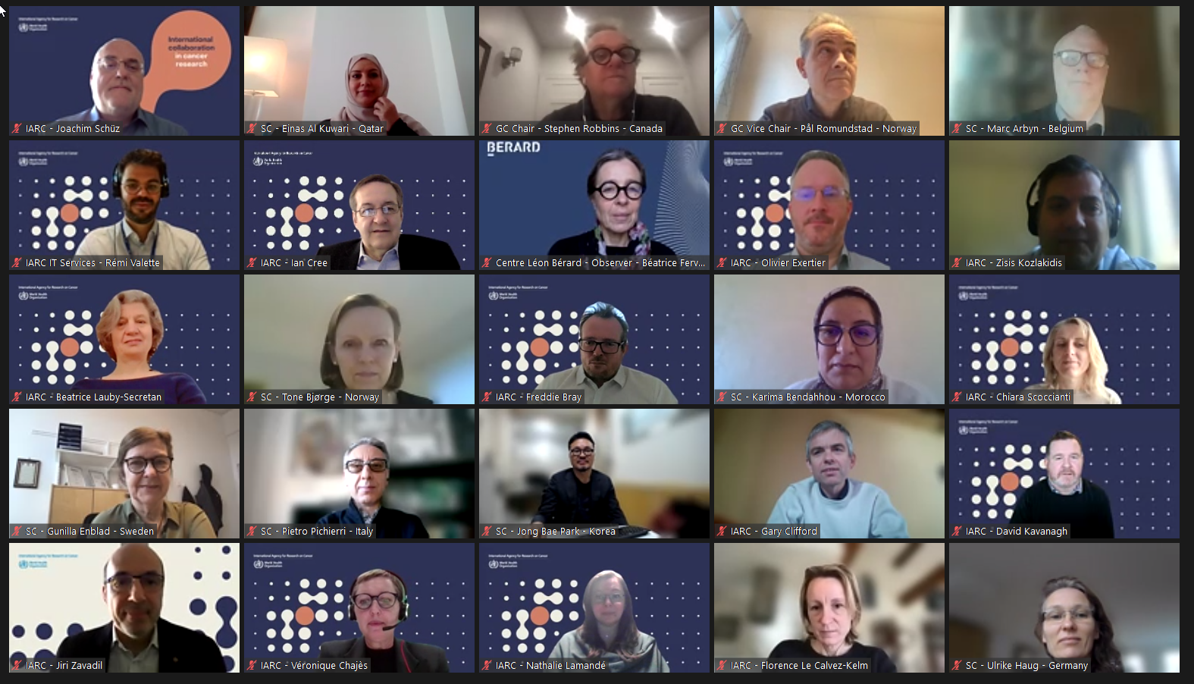
2

Slide 3
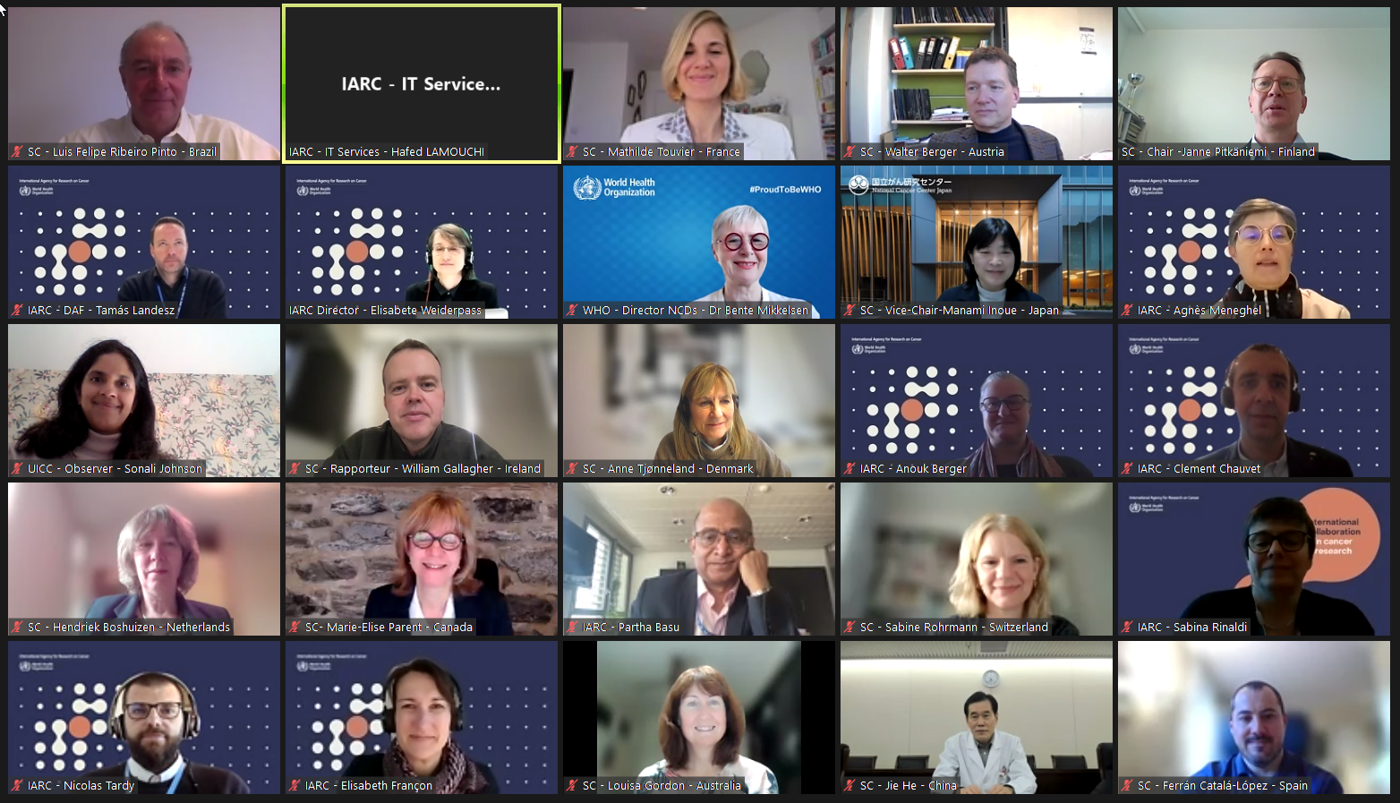
3

Slide 4
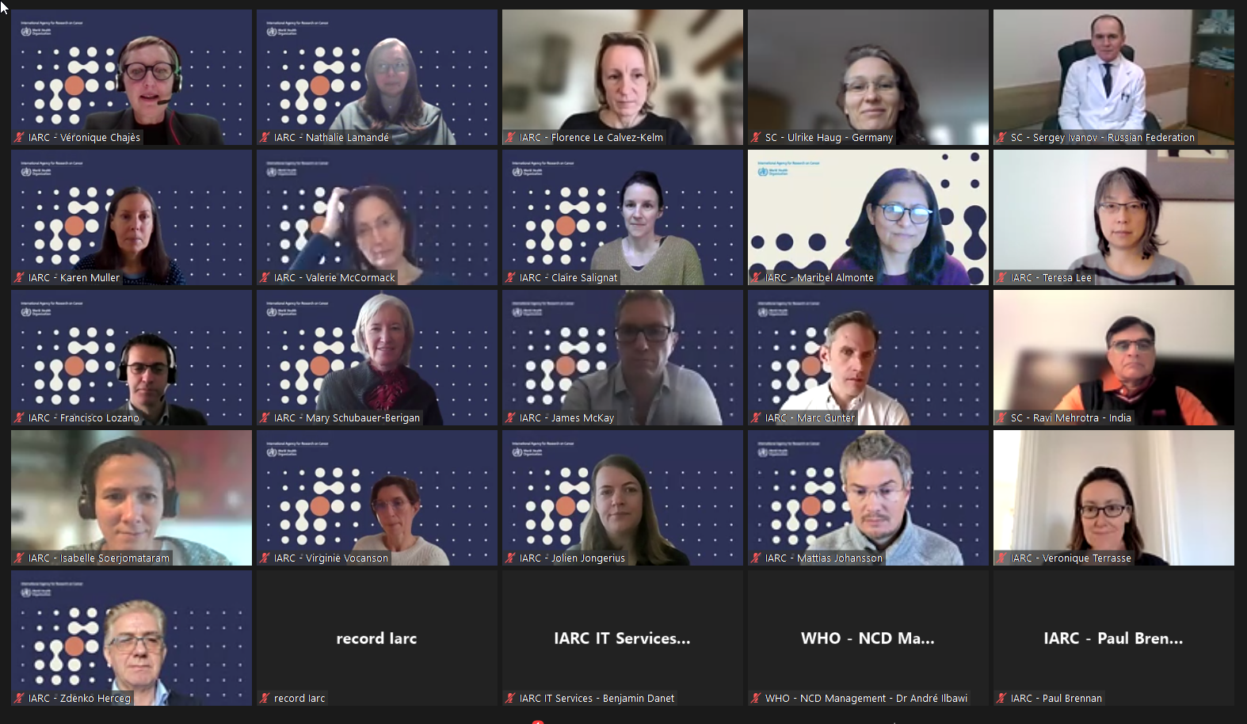
4

Slide 5
Discussion on the Director’s Report
The Scientific Council congratulated the Director on the IARC Biennial Report 2020–2021.
The Scientific Council noted the update of the Scientific IT Platform, supported the plan for the next phase of development and looked forward to future updates on a biennial basis.
5

Slide 6
Discussion with the Director, DAF, and the Scientific Council
Gender equality: new proposed measures at IARC
To put the Equity Diversity Advisory Group (EDAG) initiative on the IARC external website to increase its visibility.
To implement checklists related to Internal Selection Committees, as well as IARC-hosted meetings, and IARC external meetings
The SC strongly supports the implementation
of the EDAG initiative
6

Slide 7
Director’s response to GEM Branch Review (2021)
The Director noted with great satisfaction GEM’s outstanding overall evaluation.
The SC congratulated the GEM Branch on their work, particularly in respect to engagement with and capacity building in low- and middle-income countries.
7

Slide 8
Evaluation Framework of the IARC MTS 2021-2025
The SC appreciated the increased focus on qualitative evaluation of outputs, as opposed to purely quantitative measures (in light of DORA and Leiden guidelines) in the evaluation framework.
The SC appreciated the inclusion of KPIs related to gender equity and minorities in the evaluation framework.
The SC endorses the recruitment of new Participating States, where feasible. It was suggested that members of the SC could aid in recruitment of new Participating States.
The SC strongly endorsed the evaluation framework
8

Slide 9
Discussion on the COVID-19 and cancer initiative: a building back better proposal (IARC-C19)
The SC understands the critical importance of the IARC-C19 project and fully endorses its strategy and its mode of operation (with a strong emphasis on transfer of knowledge and capacity building for Participating States).
Dr Mikkelsen (WHO) reinforced that the links between IARC and the WHO in respect of this work are very strong.
The SC recommends that the GC looks carefully at the project IARC-C19 to identify resources needed for its implementation
9

Slide 10
Scientific Council membership of 2023 Review Panel:
NME Branch
The Nutrition and Metabolism (NME) Branch led by Dr Marc Gunter will be reviewed in 2023.
Drs Tone Bjørge (Norway), Ulrike Haug (Germany) and Marie-Elise Parent (Canada) have agreed to participate in the Review Panel.
The Review will take place remotely (five half days) on 23–27 January 2023.
10

Slide 11
Scientific Council’s recommendations following poster review
The SC acknowledges the excellent work performed and the quality of presentations.
The SC is satisfied by the design of the virtual session, the early career scientists being given enough space and time for an interactive and dynamic session.
The SC recommends that the Branch Heads give a short overview of the general scientific activities within each Branch before the presentation of posters.
The SC recommends including a take-away message at the end of all presentations.
The SC recommends having some talks which more specifically illustrate cross-branch structure and inter-disciplinary interactions.
The SC supports the Secretariat’s suggestion to bring forward the date of the virtual poster session to 6-8 December 2022.
11

Slide 12
Biennial Report on IARC education and training activities 2020-2021
The SC congratulated IARC on its endeavours in education and training.
The SC suggested to construct a permanent alumni programme to help build and sustain networks.
The SC suggested exploring possibilities of further interaction with the WHO Academy, as well as investigating opportunities afforded by the Nouveau Centre.
The SC supports the proposal to convert the 12-month Senior Visiting Scientist Award into shorter Mid-Career Visiting Scientist Awards.
The SC recommends some flexibility in the duration of the Mid-Career Visiting Scientist Awards, with an average of 6 months but varying from 3 months to 9-12 months depending on the specific project.
The SC would favour increased participation from LMICs.
12

Slide 13
Update on the Nouveau Centre and on resource mobilization
The SC congratulated IARC on their tireless work in respect of fundraising efforts.
The SC requested that a short media pack be circulated to SC members so as to facilitate dissemination of this opportunity.
The SC suggested to use more visuals relating to specific laboratory work and environments when fundraising for the Nouveau Centre, particularly pertaining to the biobanking activities.
13

Slide 14
Scientific Report of CSU Branch Review
The past performance and future plans for CSU was assessed as outstanding and the relevance of their work to the mission of IARC was assessed as a perfect fit
The Review Panel recommends:
To substantially increase secure support to CSU over the long term from RB funding.
That GICR be covered entirely and securely with RB funds, including the GICR leadership.
To proceed with obtaining cancer registry data more frequently (biannually/annually).
To work with IARC leadership to encourage WHO and UN to find longer-term solutions for data sharing agreements with countries worldwide.
To develop a transparent system to strategize and prioritize future projects with greater collective strategic clarity to assist with managing workloads.
To further pursue country level PAFs of cancer risk factors started at IARC to the predictions of cancer burden.
To monitor the impact and influence of CSU outputs in terms of health policy using research impact tools.
14

Slide 15
Scientific Report of ENV Branch Review
The past performance and future plans for ENV was assessed as outstanding and the relevance of their work to the mission of IARC was assessed as a perfect fit
The Review Panel recommends:
To expand the work being initiated and conducted in LMICs to other countries.
To secure programmes on cancer prevention and control and evidence translation.
To maintain critical mass in the area of radiation research and ensure sufficient training possibilities for international scientists.
To broaden the current focus on known and suspected carcinogens and include potentially important new causes of cancer.
To lead and support dissemination efforts in LMICs and help building up capacity in these countries.
15

Slide 16
2023 schedule
Dr Manami Inoue was elected Chairperson and Dr Luis Felipe Pinto as the Vice-Chair.
The next meeting of the SC is planned for Wednesday 8, Thursday 9 and Friday 10 February 2023 (remote format).
16

Slide 17
Opportunity for questions
17

Slide 18
  Thank you
18
Notes:
Tamas

