Slide 1
The IARC-C19 Initiative: ongoing activities and future steps
building a global cancer surveillance platform to support national planning before, during and after crises
-
Freddie Bray
Isabelle Soerjomataram
Cancer Surveillance Branch
Scientific Council 59  9 February 2023

Slide 2
The IARC-C19 Initiative:
ongoing activities and future steps
IARC-C19: Ongoing activities and partnerships
Building for tomorrow –
IARC C-19 and future plans
Building partnerships through the COVID-19 Pandemic

Slide 3
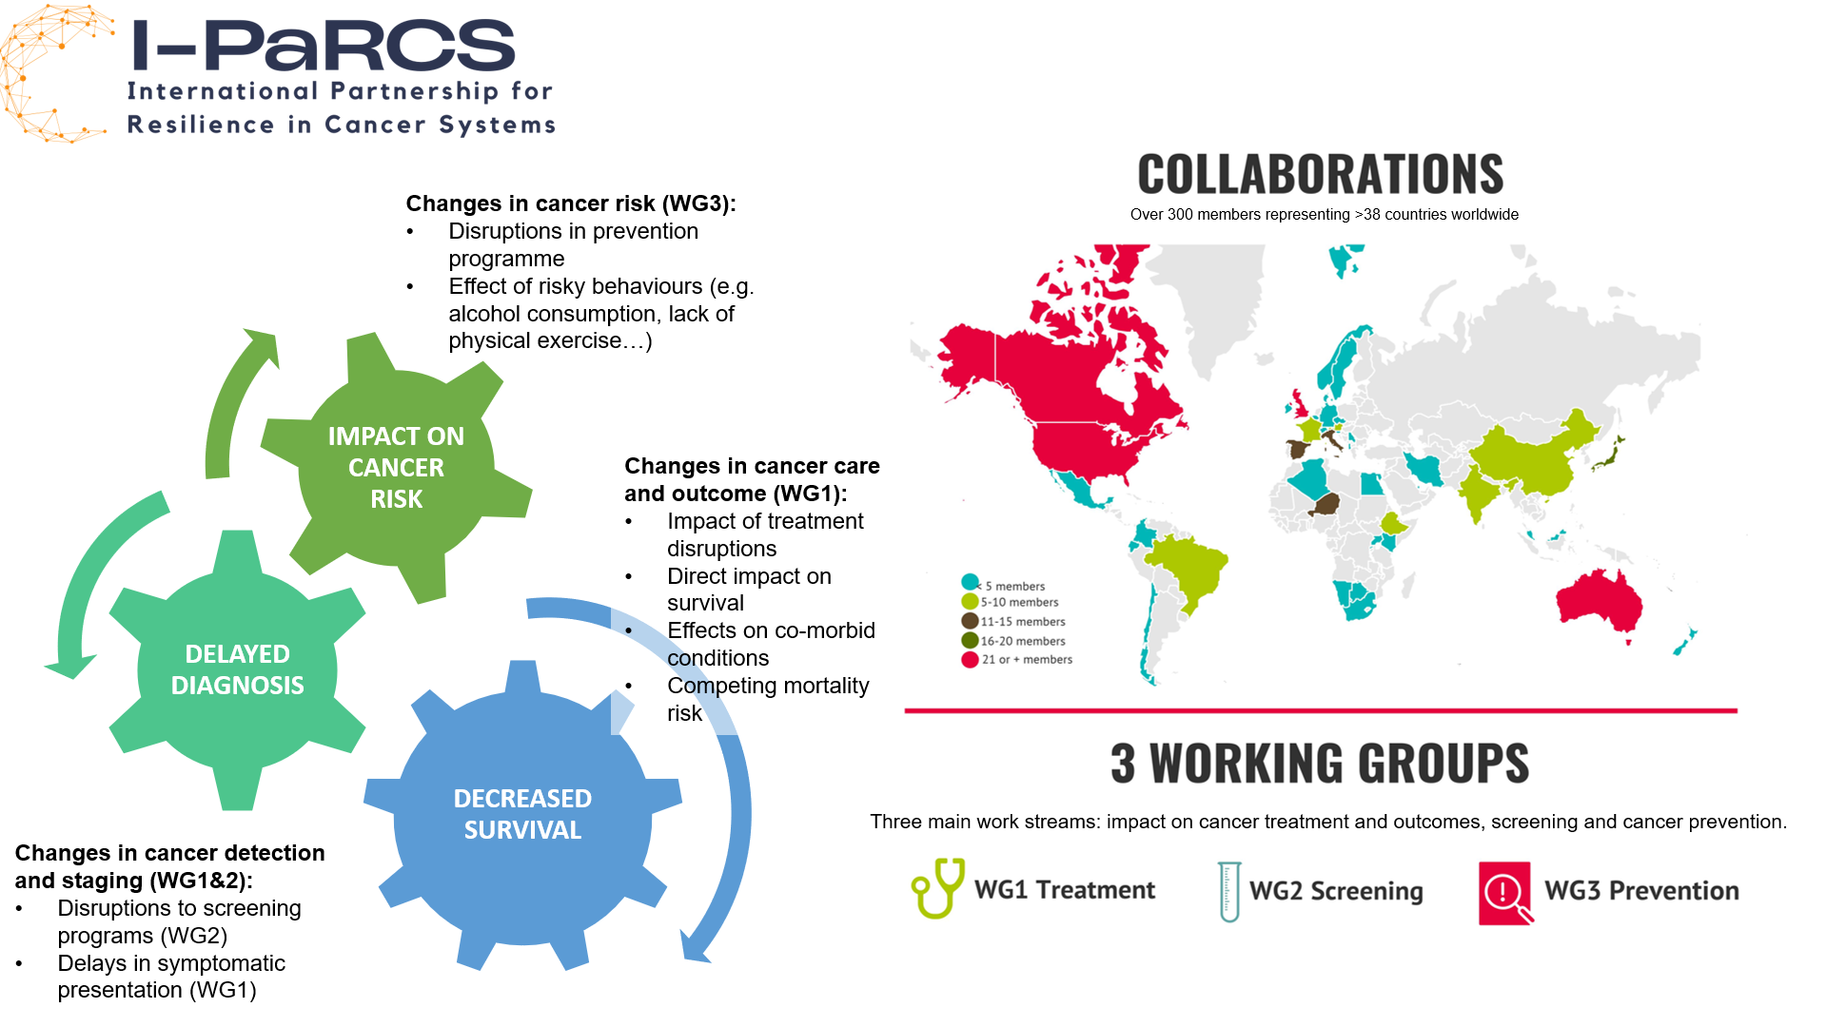

Slide 4
Recent publications of the I-PaRCS
Ginsburg et al, 2021
Luo et al, 2022
Soerjomataram et al,
2022
Carle et al, 2022
Sarich et al, 2022

Slide 5
The IARC-C19 Initiative:
priorities and expected outcomes
IARC-C19: Ongoing activities & partnerships
Building for tomorrow –
IARC C-19 and future plans
Building Partnership through the COVID-19 Pandemic

Slide 6



IARC C-19 Initiative: aims and ongoing activities
Increased understanding of the impact of crisis on cancer, to inform governments and national agencies on mitigation, recovery strategies and preparedness for future crises
Collate evidence & strengthen data collection systems to better understand linkages between policies and outcomes during the COVID-19 pandemic, especially those related to cancer
2. Improve health system resilience of countries to provide guidance in building back better
Ensure knowledge dissemination and transfer for greater buy-in from various national stakeholders
Seeking support and collaboration from IARC Participating States (20% secured)
Governance: Executive Committee and International Advisory Panel being established

Slide 7
IARC C-19 Initiative: aims and ongoing activities
Collate evidence & strengthen data collection systems to better understand linkages between policies and outcomes during the COVID-19 pandemic, especially those related to cancer
  Covid and Cancer systematic reviews
Diagnosis (1.6 Million cases)
Overall: - 24%
Haematological cancers: - 42%
Lung cancer: - 15%
Screening (60 Million Persons)
Breast cancer: - 49%
Colorectal cancer: - 21%
Cervical cancer: - 39%
Treatment (16 Million Patients)
Overall: - 27%
Medium HDI: - 54%
Very high HDI: - 23%

Slide 8
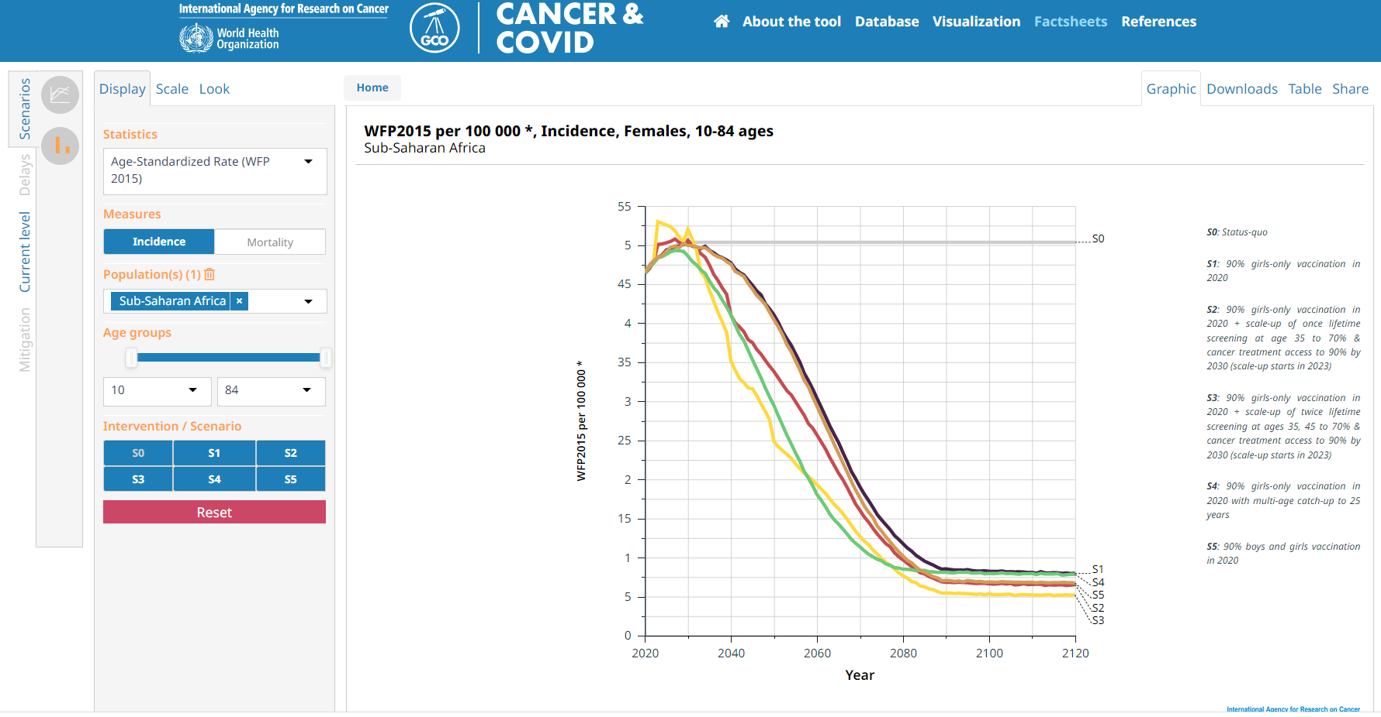
IARC C-19 Initiative: aims and ongoing activities
2. Improve health system resilience of countries to provide guidance in building back better
CERVICAL CANCER ELIMINATION
Notes:
, creativity and brilliance can only take you so far
Play to the Comparative advantages of IARC
Budget and timeline: €4M + €2M in-kind for a 4-year project
Governing Council kindly requested to support IARC in securing two-thirds of funding
In brief, IARC C-19 aims to inform governments and national agencies of how cancer outcomes are likely to be impacted by cancer service disruption over the next years as a result of this pandemic but noting that this information is equally relevant to any future emergency, and that an assessment of the positive impact of mitigation and recovery strategies is also critical, as countries move beyond the acute phase of a crisis and seek to build back better.
When presented at SC58, there was consensus among Members of the critical importance of the IARC-C19 and full endorsement of the proposed programme; there was also a broader comment that the Initiative illustrated the responsive nature of the Agency to key international challenges in cancer control including national and global responses to future health emergencies.
Three work streams were proposed:
Review
We need to review national policy responses to the pandemic and the control measures that were put in place initially as well as mitigation strategies that served to ensure disruptions were minimised across the cancer continuum of intervention during the pandemic, and as we continue to hopefully come out those that aim to ensure our health systems and cancer control policies are more robust than before - “to build back better”.
Part of that information can be gleaned by semi-structured interviews with national experts in policy and operations.
We need to look at research studies that have evaluated (based on as close to real-time data that was at available) to convey the short-impact and mainly through simulation and model-based analyses and long-term impact of disruptions in cancer-related services and outcomes and/or through quantified
Data collection
There will be specific data collection – focusing on population-based cancer registry and complemented with other sources such as reimbursement data.
Global modelling Platform Can_Emerge
To improve health system resilience of countries to provide guidance in building back better, a primary objective is to curate a dynamic evidence-based decision-making platform, with a dashboard that will provide a detailed and systematic mapping of policy responses, with a primary focus on responses that impact cancer-related services and outcomes.
The global modelling platform will be based on survival-based simulation of cancer burden at national and global levels and include mitigation strategies that can be adapted to national contexts.
Technology transfer
Lastly, technology transfer is a key aspect that will enable Participating States and partner countries from low- and middle-income countries (LMICs) to second staff to IARC to be directly involved in the Initiative via dedicated fellowships. This will ensure experience and expertise in cancer policy, in modelling and tool development is fostered and delivered at the national level.

Slide 9
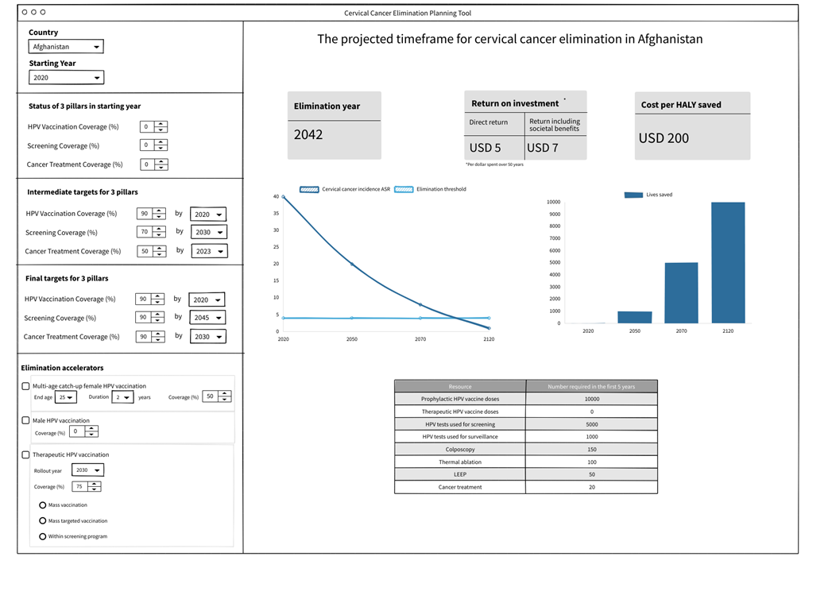
IARC C-19 Initiative: aims and ongoing activities
2. Improve health system resilience of countries to provide guidance in building back better
CERVICAL CANCER ELIMINATION

Slide 10
The IARC-C19 Initiative:
priorities and expected outcomes
Building partnerships –
the last two years
Building for tomorrow –
IARC C-19 and future plans
Global context

Slide 11
IARC C-19 Initiative: aim & next steps
Data collection and estimation
Data call & workshops:
Incidence and survival by stage and treatment data (protocol, support, & quality assurance)
Qualitative assessment and reviews of impact of cancer interventions + service disruptions
Estimate baseline (trends-based) prediction + impact of interventions :
National and global impact on cancer (survival and excess mortality)
Scenarios of delays impact and mitigation
Model hypothetical scenarios to represent range of different health care system disruptions at the national level and their impact on future excess mortality:
average duration of intervention delay
proportion of patients for which interventions are disrupted
Model mitigation strategies that can be adapted to national contexts to reduce expected mortality
Knowledge dissemination
The global modelling platform will be housed at IARC’s Global Cancer Observatory
Knowledge transfer
Technology transfer will enable IARC Participating States and partner countries from LMIC to second staff to IARC
Governance
International Advisory Panel
Executive Committee - Stakeholders from PS

Slide 12
Questions for SC members
Initiative will be expanded as resources become available, which cancer site(s) should be initially prioritised?
(colorectal, lung, breast, in addition to cervical cancer initially selected)
What role can IARC SC play in building competencies and capacity in developing this Initiative?
Which specific areas of expertise should be developed at IARC / collaborating institutions?

