Slide 1
Cancer Surveillance Branch (CSU) - Social inequalities and cancer Speaker: Deependra Singh Cancer Inequalities Team (CIN)

Slide 2
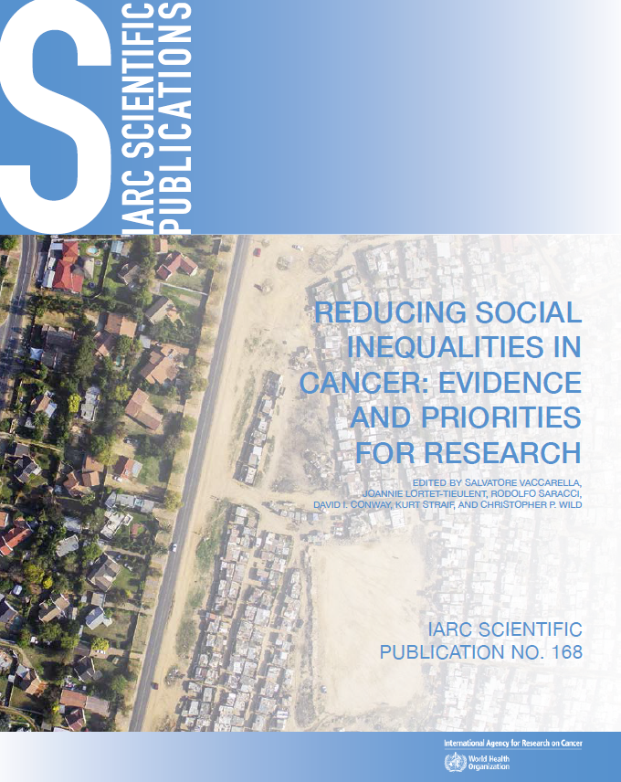
Cancer Inequalities Team programmatic research areas
http://publications.iarc.fr/580

Slide 3
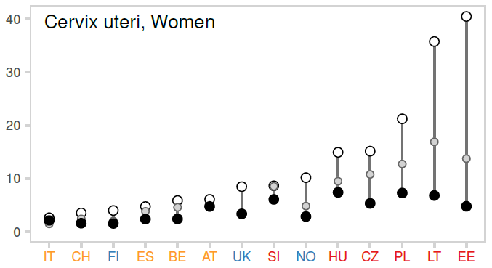
Inequalities in cancer mortality between and within European countries
Cervical cancer mortality around 2010
DEMETRIQ/LIFEPATH: Harmonized dataset on cancer mortality data by education level. Entire national population for 18 countries. Census-based mortality follow-up studies

Slide 4
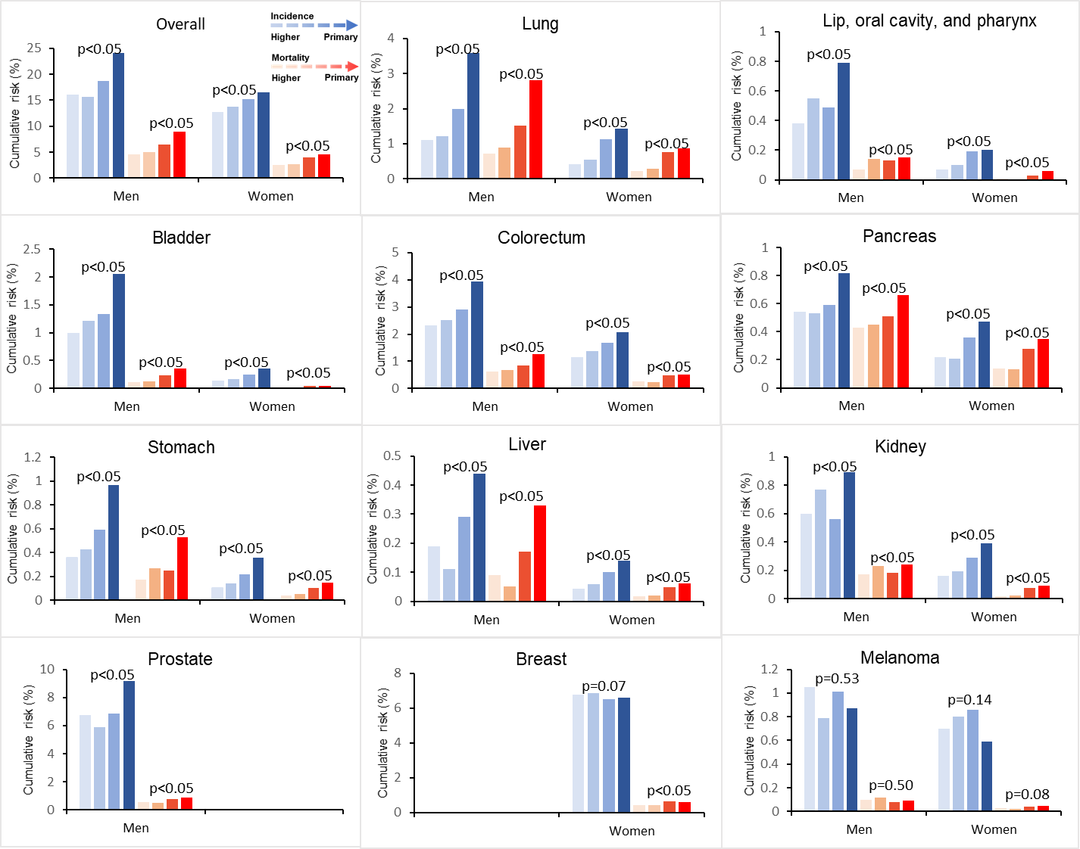
Social inequalities in cancer incidence and mortality in Europe
Cumulative risk of cancer incidence (blue) and cancer mortality (red) by educational levels
Using EPIC dataset, we aimed to describe and measure the magnitude of social inequalities in cancer and understand the mechanisms driving these inequalities
Figure shows the incidence and mortality risk of certain cancers across educational levels in men
Identifying, monitoring and understanding inequalities in cancer along the different phases of cancer continuum should be a public health priority
Notes:
Use the red and blue bar charts of the cum risk

Slide 5
Thank you!

