Slide 1
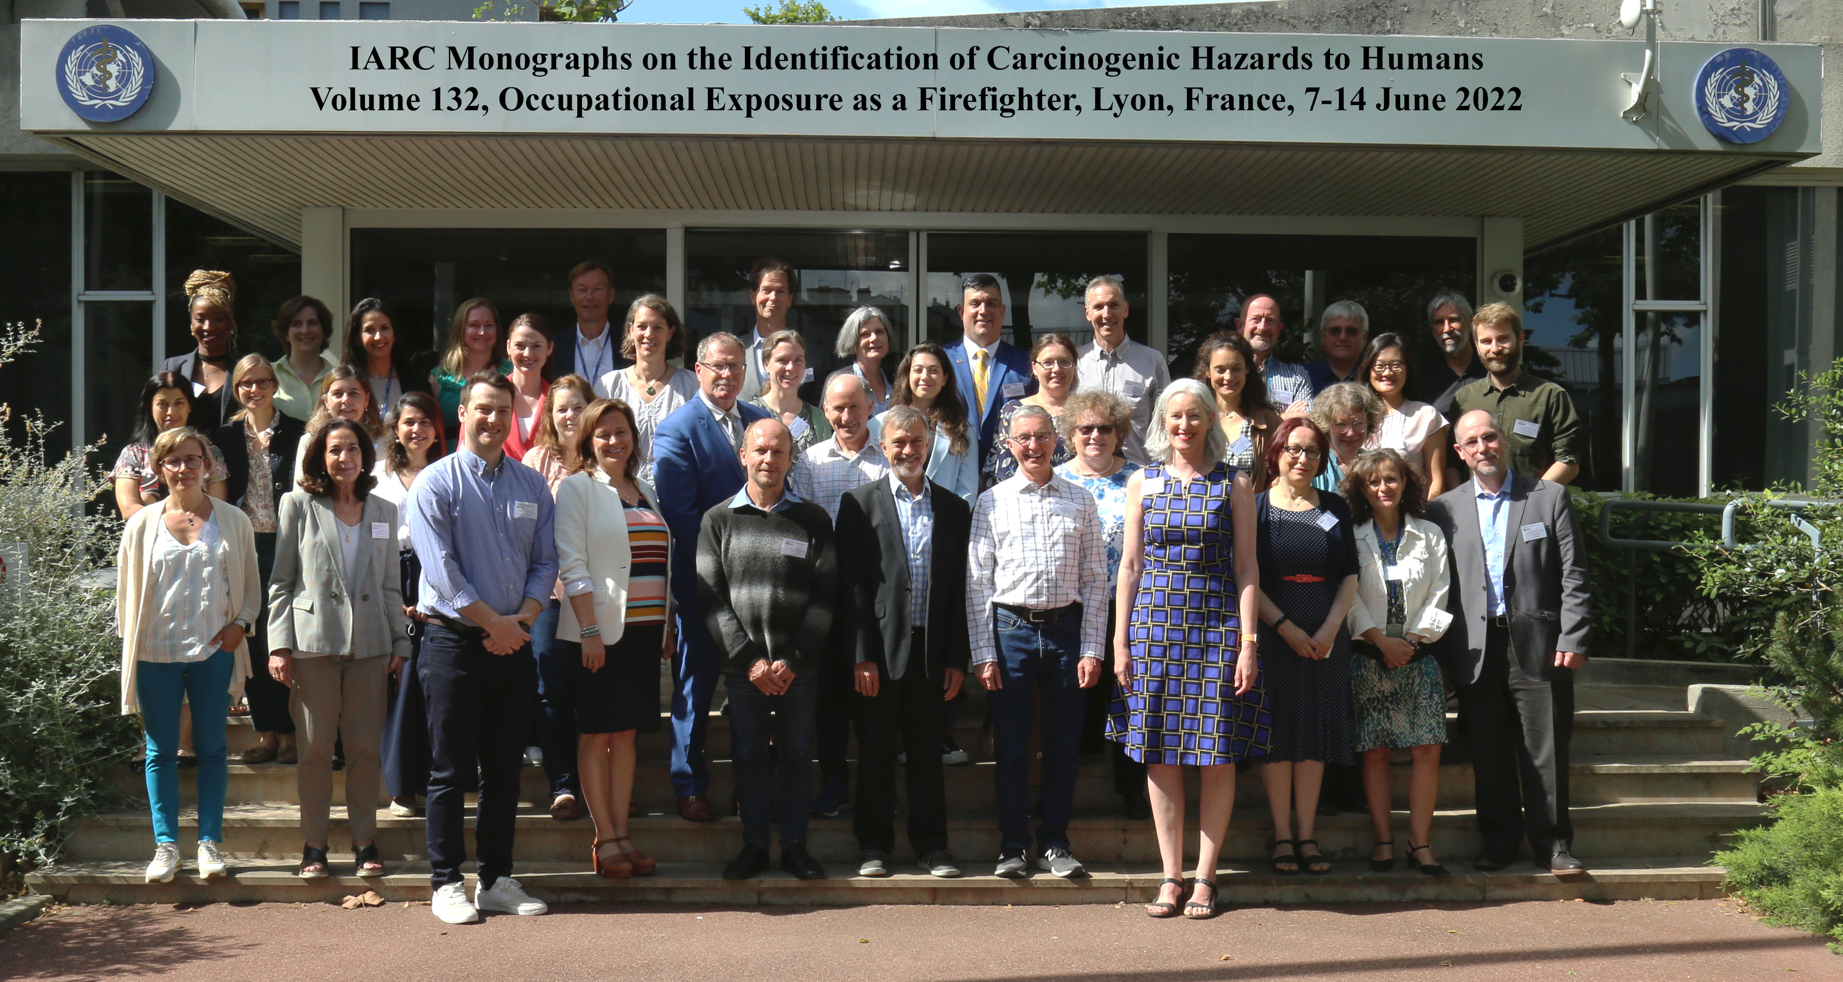
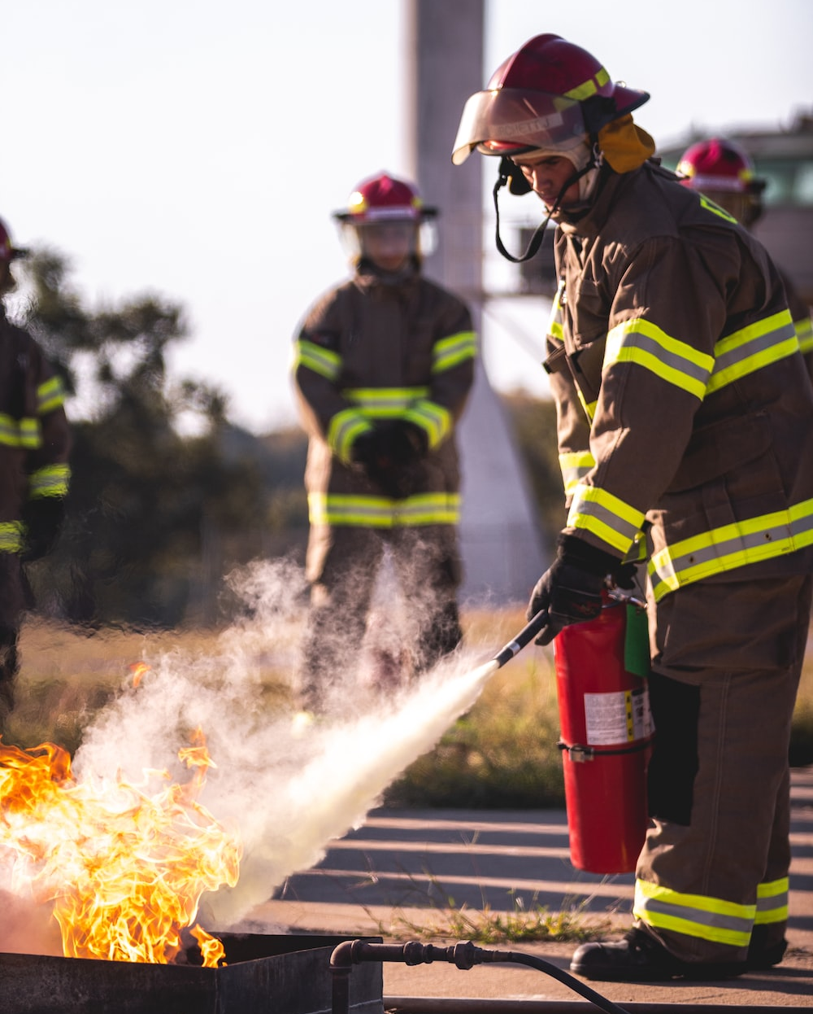
Does Firefighting Cause Cancer? A Meta-Analysis for Cancer Hazard Identification Dr. Nathan DeBono, Scientist (Epidemiology) IARC Monographs Programme
The carcinogenicity of ‘Occupational Exposure as a Firefighter’ evaluated as part of Volume 132 of the IARC Monographs Programme in June 2022
The Working Group conducted a meta-analysis of epidemiological studies evaluating the association between firefighting and cancer risk

Slide 2
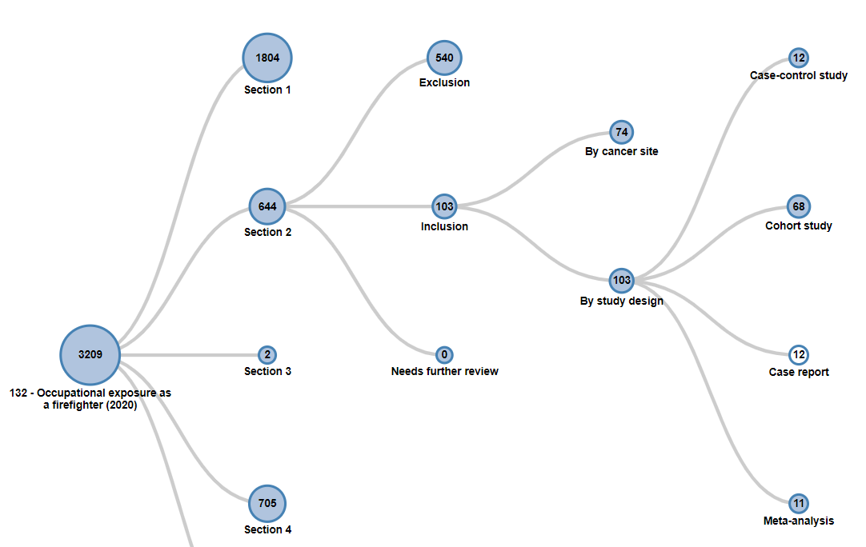
Meta-Analysis of Human Cancer Studies
Systematic literature search identified 103 human cancer studies for review
Meta-analyzed 35 cohort studies of predominantly male career firefighters from North America, Europe, Oceania, and Asia
Meta-Rate Ratios (mRR) estimated using random-effects models
Meta-regression used for dose-response analyses
Conducted ‘Risk of Bias’ assessment
Extensive sensitivity analyses
Figure 1. Flowchart of the number of literature search results and study exclusions

Slide 3
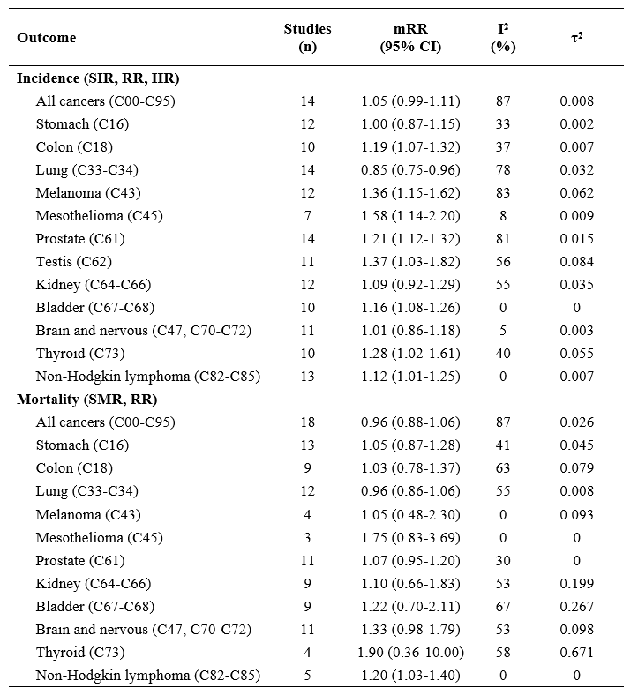
Key Results
Table 1. Meta-Rate Ratios for ever-employment as a male career firefighter compared to an external referent
Positive associations between ‘ever’ employment as a firefighter and incidence of:
Mesothelioma
Bladder
Testis
Melanoma
Prostate
Colon
Non-Hodgkin lymphoma
No evidence of increased risk of lung cancer

Slide 4
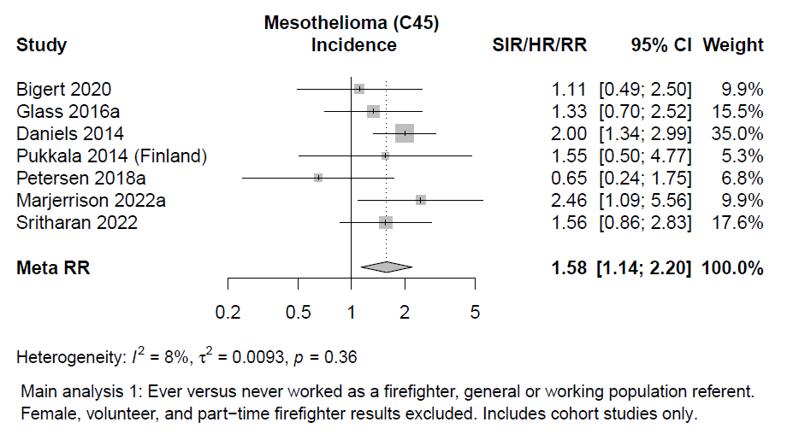
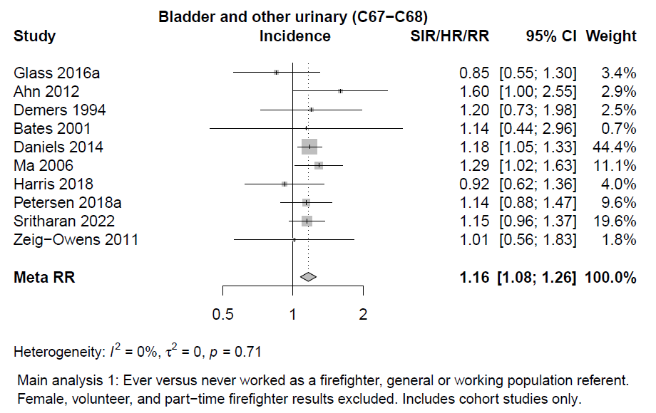
Mesothelioma and Bladder Cancer
mRR 1.58 (95% CI 1.14-2.20, I² = 8%)
- Statistically precise estimates
- No or little between-study heterogeneity
- Robust in sensitivity analyses
mRR 1.16 (95% CI 1.08-1.26, I² = 0%)

Slide 5
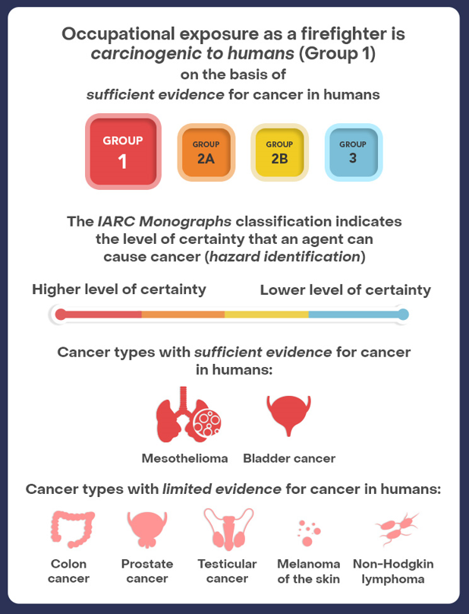
Conclusion
Occupational exposure as a firefighter classified as carcinogenic to humans (Group 1)
Meta-analysis was a critical component of the broader monograph evaluation
Contact:
Dr. Nathan DeBono, PhD
debonon@iarc.who.int

