Slide 1
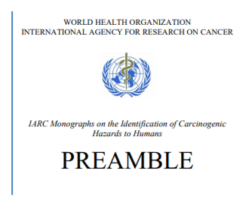
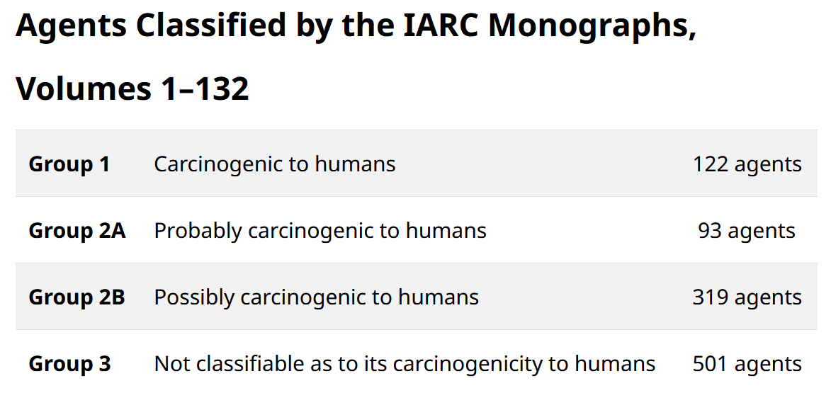
The mechanistic evidence for cancer hazards identified by the IARC Monographs Programme
Aline de Conti (decontia@iarc.fr)
Lamia Benbrahim-Tallaa, Fatiha El Ghissassi, Yann Grosse, Federica Madia, Mary Schubauer-Berigan
IARC Monographs Programme; Evidence, Synthesis and Classification Branch
Mechanistic studies have gained in prominence and have increased in volume, diversity, and relevance to cancer hazard evaluation.
Baan RA, Straif K. The Monographs Programme of the International Agency for Research on Cancer. A brief history of its Preamble. ALTEX. 2022;39(3):443–450.

Slide 2
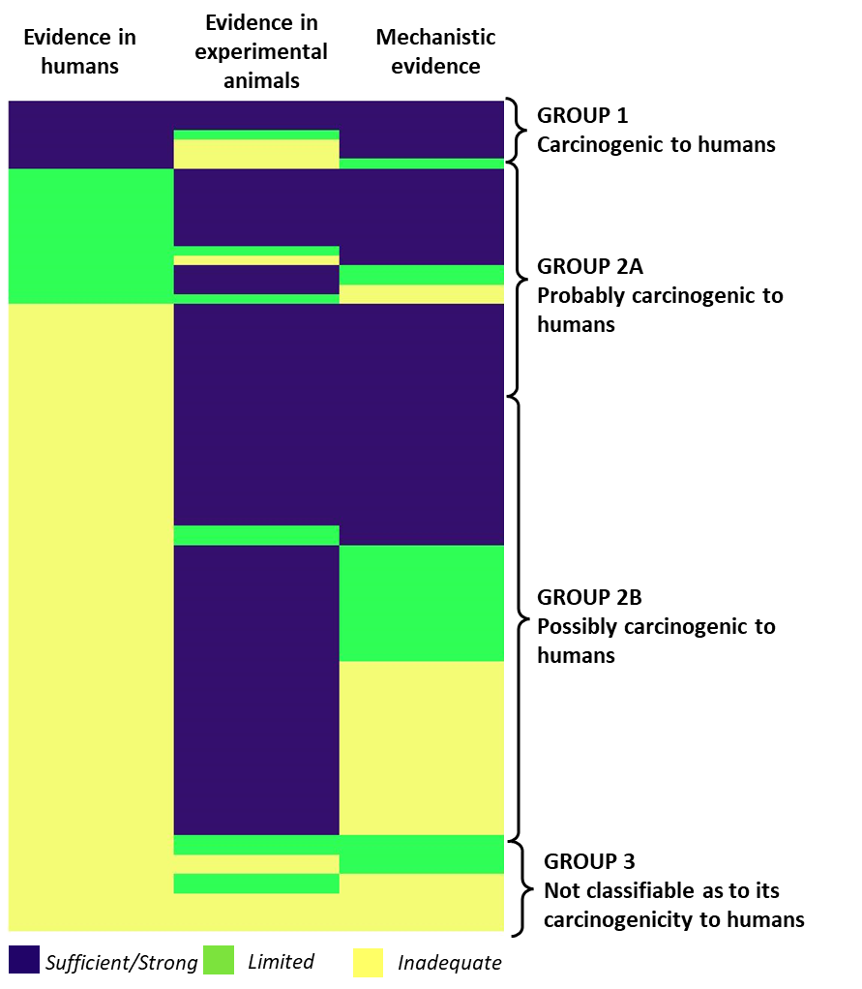
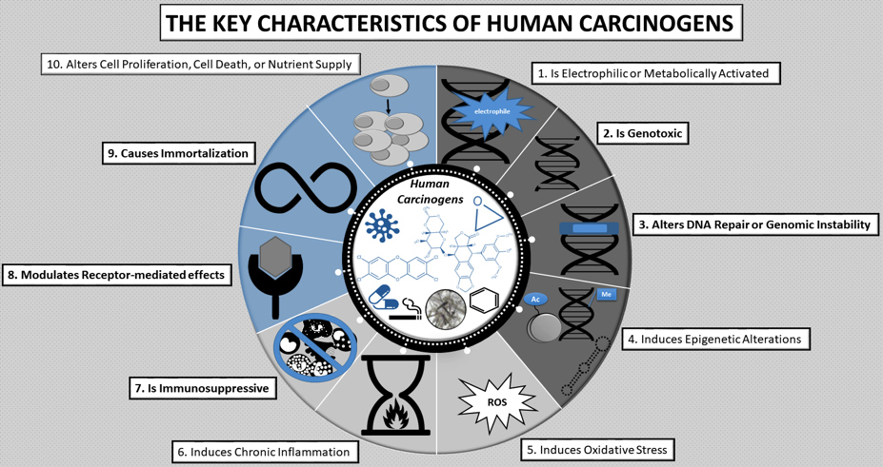
Mechanistic evidence evaluation IARC Monographs Programme
Systematic approach using the key characteristic of carcinogens
Key characteristics of carcinogens
Monographs evaluations V112-V132
Mechanistic evidence can inform cancer hazard identification even in the absence of human cancer or animal cancer evidence

Slide 3
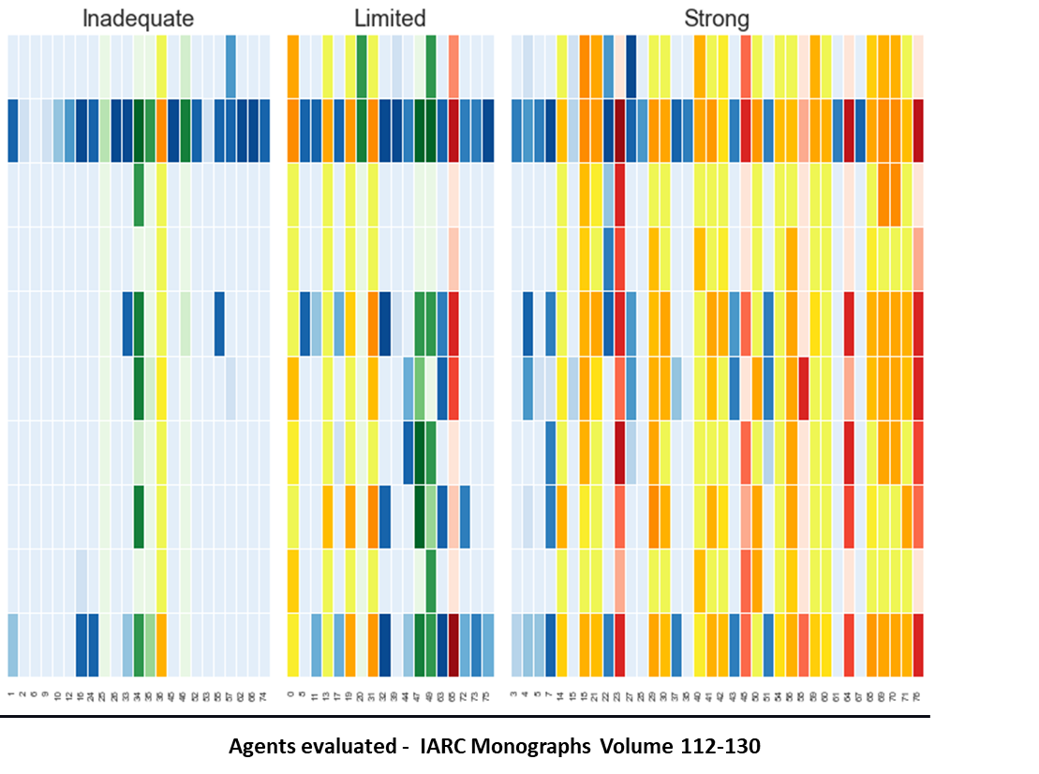
Systematic approach using the key characteristic of carcinogens
Number of mechanistic studies evaluated for each key characteristic
Studies were identified across all the 10 KCs. Most agents presented studies with toxicological endpoints related to 4 or more KCs.
Agents classified in Group 1 and 2A had generally been the subject of more extensive mechanistic research than agents classified in Groups 2B or 3.” Mechanistic evidence is not predicted by the number of studies evaluated.
KC1: is electrophilic or metabolic activated
KC2: is genotoxic
KC3: alters DNA repair or genomic instability
KC4: induces epigenetic alterations
KC5: induces oxidative stress
KC6: induces chronic inflammation
KC7: is immunosuppressive
KC8: modulates receptor-mediated effects
KC9: causes immortalization
KC10: alters cell proliferation, cell death or nutrient supply
Number of studies
51-100
1-10
21-50
11-20
>101
Group 1
Group 2A
Group 2B
Group 3

Slide 4
Conclusions
Acknowledgments
Working Groups, Advisory Groups, scientists & staff in IARC Monographs Programme, past & present
The IARC Monographs are supported by grants from:
U.S. National Cancer Institute (since 1982)
European Commission, DG Employment, Social Affairs and Inclusion (since 1986)
U.S. National Institute of Environmental Health Sciences (since 1992)
Mechanistic evidence can inform cancer hazard identification even in the absence of human cancer or animal cancer evidence
Continued experience with the systematic review of literature using the key characteristics of carcinogens has proven to be:
Applicable for the mechanistic evaluation
Useful to identify gaps in knowledge
Subscribe to our newsletter: imonews@iarc.fr
https:\\monographs.who.int

