Slide 1
ORAL CANCER PREVENTION: HANDBOOK VOL. 19 AND BEYOND
59th Session of IARC Scientific Council
Presented by:
Suzanne Nethan,
Visiting Scientist, ESC/IHB
Co-Authors & Collaborators:
Beatrice Lauby-Secretan, ESC/IHB,
CSU (IARC),
WHO HQ,
University of Sheffield, UK
University of Campinas, Brazil
Notes:
Greetings everyone!
I am Suzanne Nethan, a Visiting Scientist in the IARC Handbooks Program, and I will be talking briefly about the group’s ongoing supplemental projects to the recent handbook on oral cancer prevention. At the outset, I would like to Thank my Supervisor, Dr. Beatrice Lauby-Secretan, and all the collaborators, for their ongoing immense scientific contributions.

Slide 2
HANDBOOK 19: SUMMARY OF EVALUATIONS
Impact of quitting exposure to SLT/AN:
Effectiveness of screening:
AN (with or without tobacco): Sufficient
Smoked tobacco: Sufficient
Alcoholic beverages: Sufficient
SLT: Inadequate
Group B
The cancer screening method may reduce the incidence/mortality of oral cancer in humans
Interventions to quit consumption of Smokeless tobacco (SLT) or Areca nut (AN):
Behavioural:
Youth – Limited
Pharmacological: Limited
Combined (behavioural + pharmacological): Limited
Adults – Sufficient
Notes:
Prevention is the most effective response to the high burden of smokeless tobacco and areca nut, and thus oral Cancer, in South East Asia & the Western Pacific region and such primary and secondary prevention measures were evaluated by the volume 19 handbook. Hence, to recap, here is sufficient evidence THAT behavioural interventions are effective in smokeless tobacco use cessation in adults, quitting exposure to areca nut products with or without tobacco decreases the risk for both oral cancer & oral potentially malignant disorders while quitting smoking and alcohol use decreases the risk of oral cancer, and lastly, screening of high-risk populations by clinical oral examination may reduce mortality from oral cancer

Slide 3
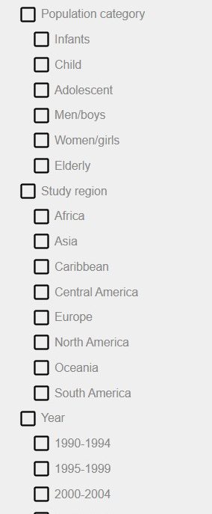
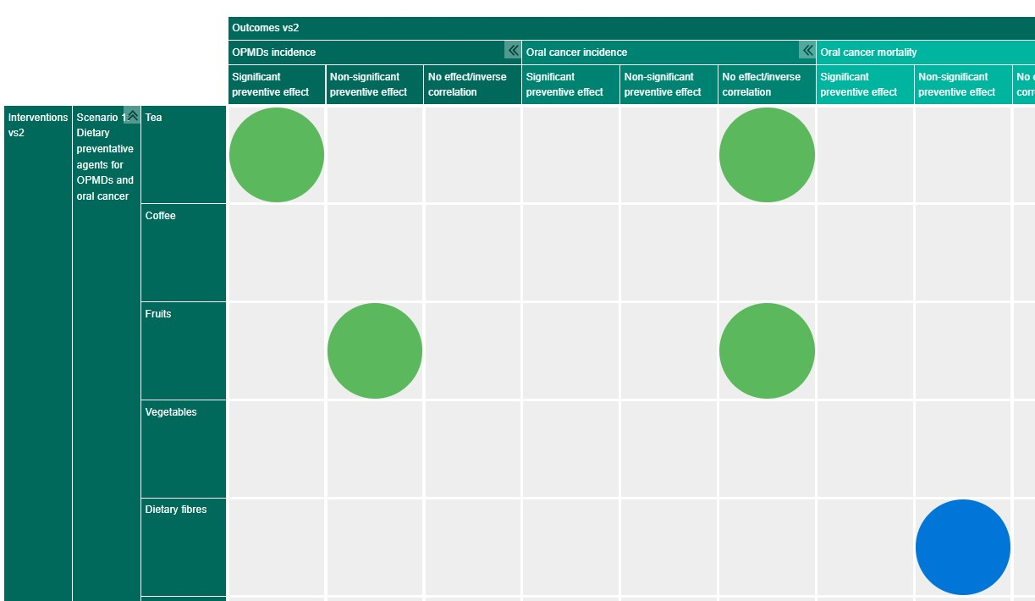
EVIDENCE & GAP MAP ON ORAL CANCER PREVENTION
(in collaboration with University of Sheffield, UK & University of Campinas, Brazil)
A visual interactive display of the available evidence and in turn the gaps in the literature on primary & secondary prevention of oral cancer, using a systematic approach.
Rows represent Intervention categories & subcategories e.g. exposure to chemopreventive agents, interventions for SLT/AN cessation, policies for SLT/AN control, oral cancer screening techniques etc.
Columns represent Outcome domains & subdomains e.g. oral cancer incidence and mortality, SLT/AN cessation, screening uptake etc.
Filters (general & specific) to select sub-groups of primary studies included in the map.
Bubbles in cells of different size and colours indicate the number and quality of the corresponding primary studies.
Notes:
So coming to the supplemental projects, the first one is about an evidence and gap map…

Slide 4
COST-EFFECTIVE INTERVENTIONS FOR ORAL CANCER PREVENTION
(in collaboration with WHO-HQ)
Modelling assumptions
The World Health Assembly resolution WHA 74.5 on Oral Health (2021) suggested to develop “best buy” interventions on oral health.
The WHO Oral Health Programme is working with IARC on aspects related to oral cancer.
The oral cancer screening intervention is defined as:
”Screening in high-risk groups linked with timely diagnostic work-up and comprehensive cancer treatment in setting where significant disease burden and programme is recommended.”
Population
Effect size of intervention
On incidence, advanced stage of cancer, and mortality (by stage)
High-risk individuals (regular users of tobacco &/or alcohol)
Outcomes
Healthy-life years gained
Summary
Notes:
The second project, in collaboration with the WHO HQ, is about the development of a cost-effective intervention model for oral cancer prevention, based on the World Health Assembly Resolution 74.5 to develop best buy interventions on oral health.
The intervention proposed is not only about the screening of oral cancer but also about providing quality care to patients which requires a resilient health system to be in place.
further details on the cost-effective analysis, and the parameters used to feed the model are given in The cancer interventions technical briefing and first WHO discussion paper of the consultation on the 2022 update of Appendix 3 of the NCD-Global Action Plan

Slide 5
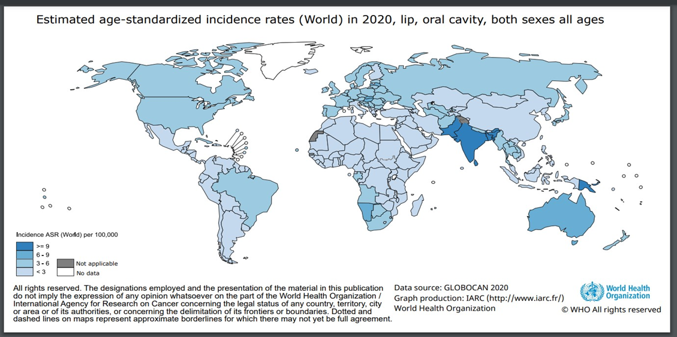
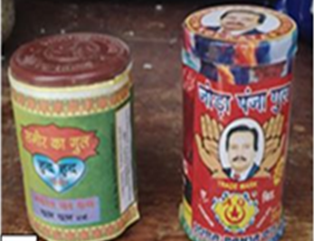
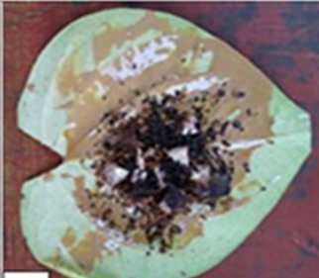
ORAL & OROPHARYNGEAL CANCER BURDEN ATTRIBUTABLE TO SMOKELESS TOBACCO & ARECA NUT USE
(in collaboration with CSU/IARC)
Use of oral SLT/AN is causally linked to the development of a number of cancer types.
Risk varies depending on the product used.
This project aims to estimate the proportion of oral and pharyngeal cancers that can be attributed to SLT/AN consumption in 2022, specifically in South Asia and the Western Pacific (with a high prevalence of use).
This will provide a valuable quantitative appraisal of its impact in national cancer burden, and help plan cancer control strategies.
Notes:
This last ongoing project is in collaboration with the Cancer Surveillance branch at IARC which aims to estimate the burden of oral and oropharyngeal cancers attributable to SLT/AN consumption in 2022, specifically in South Asia and the Western Pacific, which have both a high prevalence and a large variety of these products, and are linked with the development of a number of cancer types. We have two sets of consultation meetings in October & Apri, with global experts, to kickstart the project.
v

