Slide 1
Searching for Origins of Childhood Cancer: Mapping “Molecular Diary” of Nature and Nurture
Akram GHANTOUS
Epigenomics and Mechanisms Branch
Akram GHANTOUS*, Semira GONSETH*, Alexei NOVOLOACA, Natalia SPITZ, Farah NASSAR, Olga KRALI, Ritu ROY, Shaobo LI, Maxime CARON, Daniel SINNET, Dilys LAM, Peter FRANSQUET, John CASEMENT, Gordon STRATHDEE, Mark PEARCE, Helen HANSEN, Adam SMITH, Siri Eldevik HÅBERG, Jill MCKAY, Jessica NORDLUND, Per MAGNUS, Terence DWYER, Richard SAFFERY, Joseph Leo WIEMELS†, ‪Monica Cheng MUNTHE-KAAS† and Zdenko HERCEG†

Slide 2
Childhood Cancer: Problematics and Needs
Causes are largely unknown and mostly based on studies that begin after disease onset (subject to biases such as recall).
Studies beginning before diagnosis (ideally since the time of birth/pregnancy) with a follow-up are ideal,…
Diagnosis
… especially if they include collection of biospecimen at several critical stages of child development.
Molecular studies are based on biospecimen collected after disease onset,…
Given the rarity of childhood cancers, international collaboration and novel approaches are crucial.
…. with a risk of reverse causality (ie. are the identified biomarkers at the origin of the cancer or simply caused by the cancer?)
?
European Disability Forum
Notes:
Cancer is the primary killer among all diseases in children, but causes are not well understood. Then continue with the other facts.

Slide 3
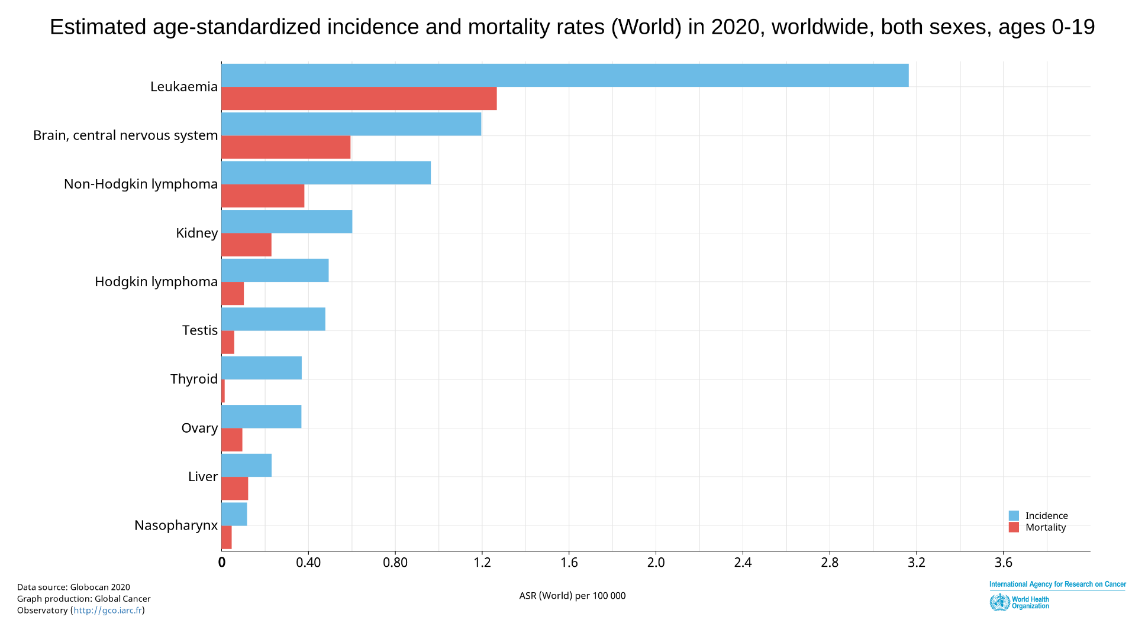
Leukemia is the most common form of cancer in children

Slide 4
A molecular imprint of the patient’s epigenome from birth to diagnosis
Objective: establish a molecular fingerprint of the patient’s genome from birth to diagnosis, using state-of-the-art technologies, in order to identify biomarkers of cancer risk that can be detected in the blood at birth.
The in utero period has a remarkable impact on human development, driven largely by epigenetic mechanisms – the molecular imprint of nature and nurture that shapes the different cells and organs. Unlike genetic mutations, epigenetic changes are potentially reversible, thus, offer interesting targets for disease prevention.
Herceg Z* & Ghantous A* et al, Int J Cancer 2018
Ghantous A et al, Mutagenesis 2015

Slide 5
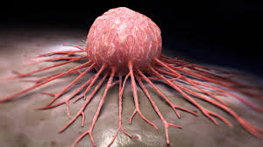
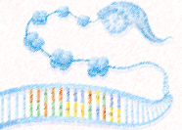
For this reason and because childhood cancer may have an in utero origin, we have decided to travel back in time and collect blood samples from babies at birth who then went on to develop leukemia later in life.
Birth
Diagnosis
Biospecimen
Time points
Birth
Diagnosis
Outcomes
ALL risk
Survival & risk of recurrence
Epigenome
Blood biomarkers and
molecular precursors
Herceg Z* & Ghantous A* et al, Int J Cancer 2018
Ghantous A et al, Mutagenesis 2015

Slide 6
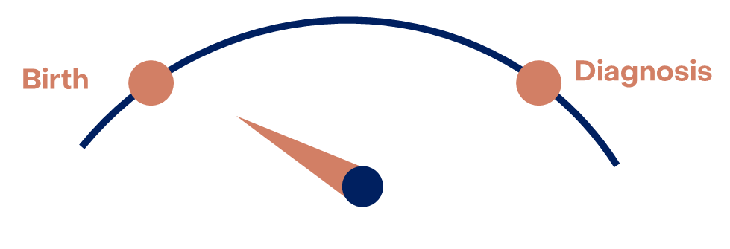
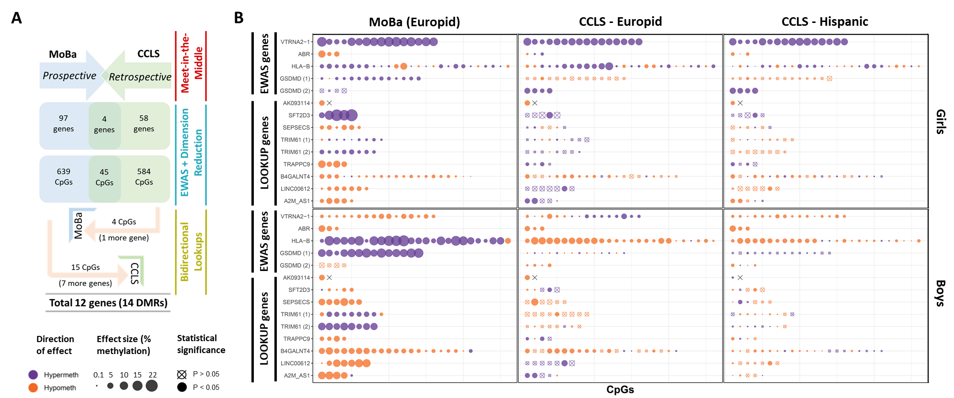
Epigenetic imprint at birth predisposing to childhood leukemia
Cohort 1 (European ancestry)
Cohort 2 (European ancestry)
Cohort 3 (Hispanic ancestry)
In collaboration with several countries worldwide, including different ethnicities, we use large collections of those samples to produce molecular (OMICs) maps of the DNA of newborn babies. Each map can enable scientists to create a molecular snapshot – sort of a diary – of early-life factors that the baby had been exposed to during pregnancy.
Genes
Ghantous A et al. In preparation

Slide 7
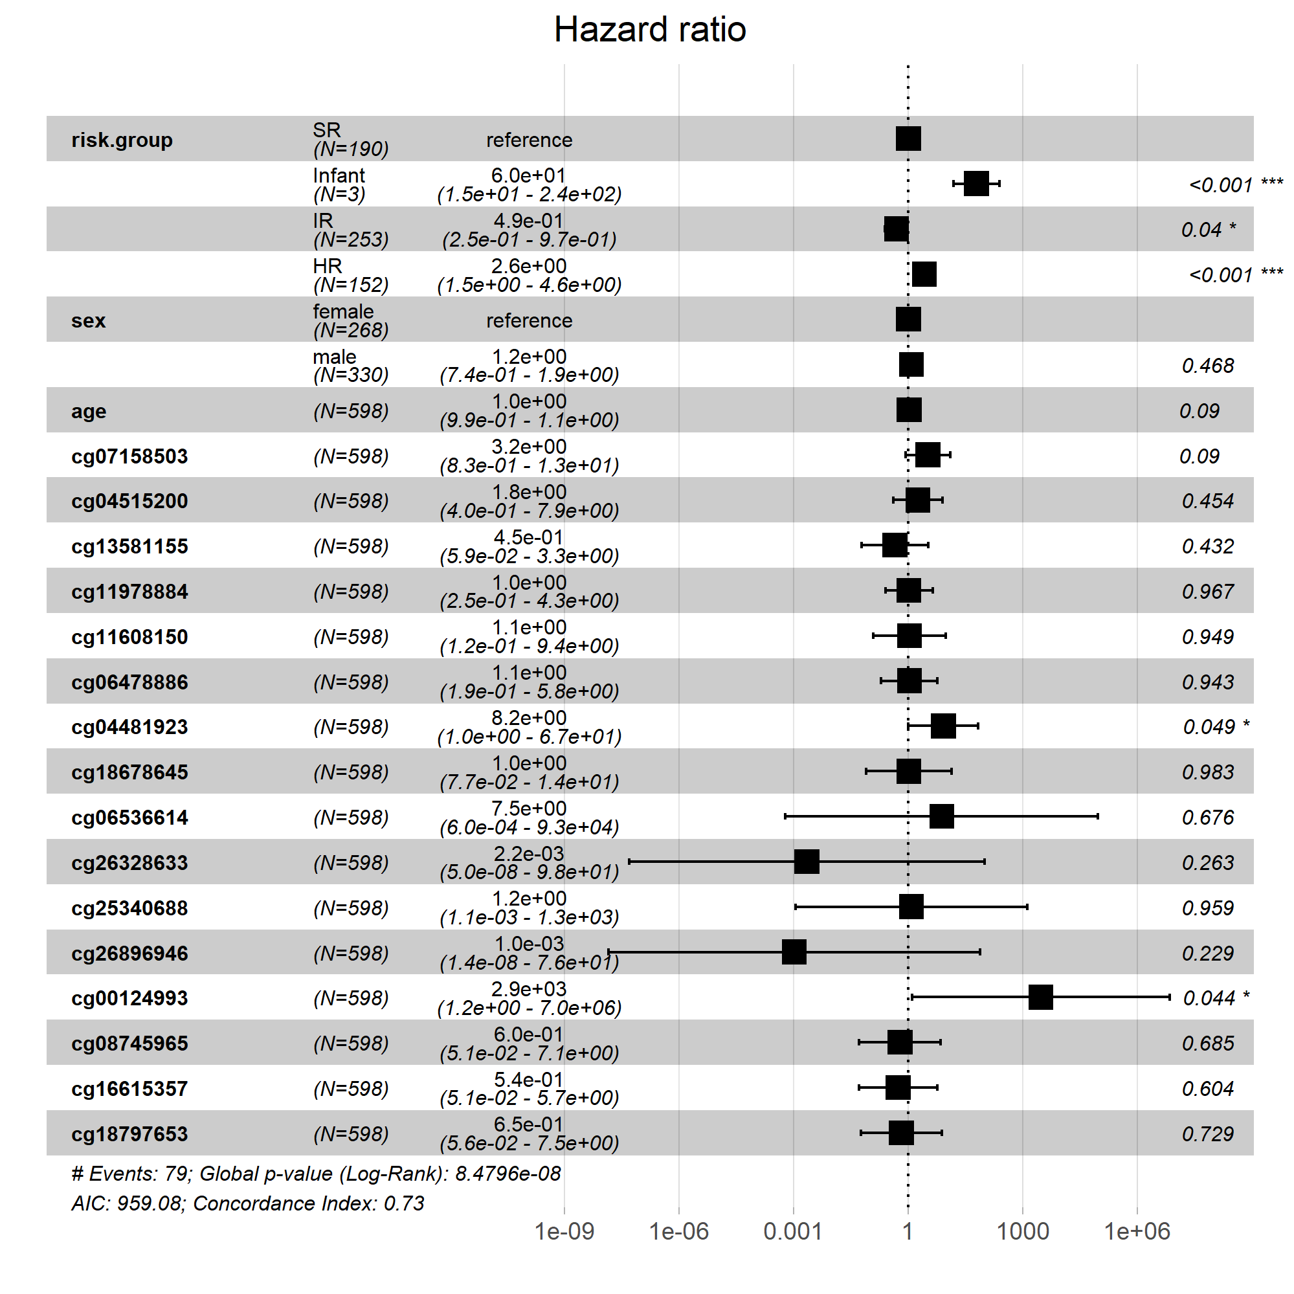
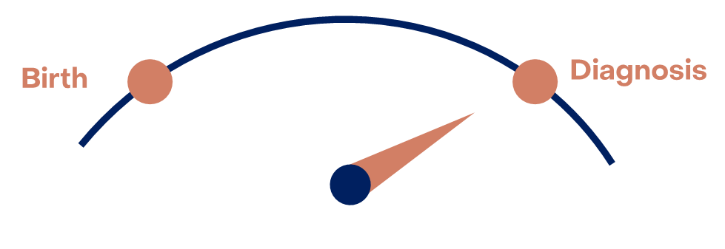
Overall Survival
When we investigate these epigenetic markers in tissue samples obtained at diagnosis, we find that some of the markers are able to predict prognosis (overall survival) of childhood leukemia patients.

Slide 8
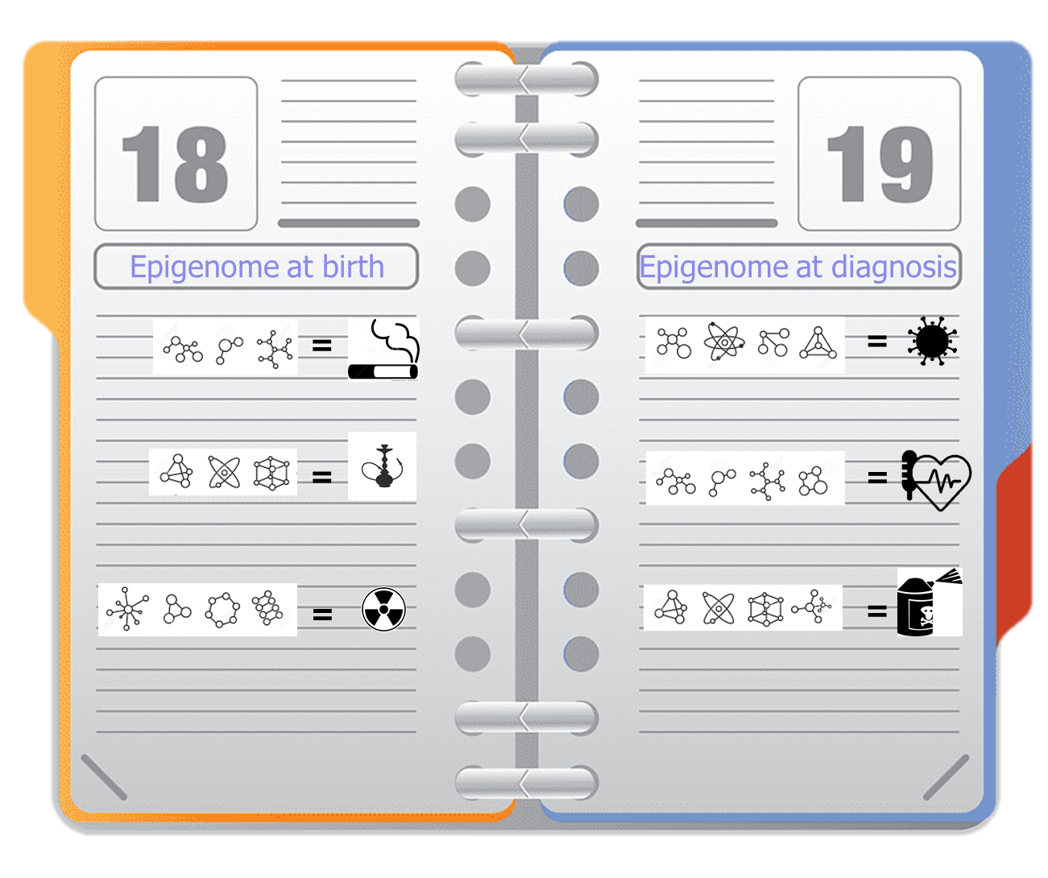
Conclusions & Future Directions
Molecular Diary of Exposure and Health Risks
This work provides a proof of concept of the ability to detect at birth epigenetic alterations predisposing to childhood leukemia and reproducible in several cohorts and two ethnicities.
DNA methylation alterations evident before diagnosis could be precursors of pediatric leukemia development and actionable targets for risk assessment and prognosis.

Slide 9
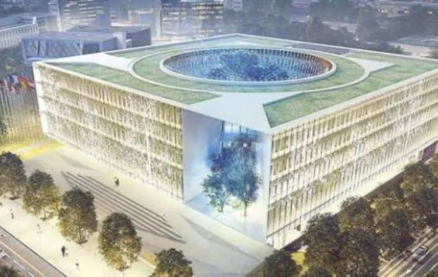
Thank you
The participants (including parents and children) of the collaborating cohorts and teams
International Childhood Cancer Cohort Consortium (I4C)
Childhood Leukemia International Consortium (CLIC/CIRCLE)
IARC ENV, GEM, LCA, Resource Mobilization & SSR branches
Epigenomics and Mechanisms Branch, IARC:
Dr. Zdenko Herceg (Branch head)
Dr. Akram Ghantous (Data Scientist)
Mr. Cyrille Cuenin (Laboratory)
Mr. Vincent Cahais (Bioinformatics)
Dr. Alexei Novoloaca (Graduated PhD student)
Dr. Natalia Spitz (Postdoctoral scientist)
Dr. Farah Nassar (Postdoctoral scientist)
Funders:
INCa-PEDIAHR
INSERM-INCa-Plan Cancer
Marie Curie Actions-People-COFUND
INCa-PEDIAC
Children with Cancer UK
IARC Postdoctoral Fellowship

Slide 10
Animation of the project in English https://youtu.be/IIF0gVyBY8o
Also translated in 11 languages
https://www.youtube.com/playlist?list=PLgDB39BFocs1HGX_S7-za4-oEPfs--9GD
https://twitter.com/IARCWHO/status/1493957753290862598
For more info:
https://epichildcan.iarc.who.int/

