Slide 1
Cutaneous and acral melanoma cross-OMICs reveals prognostic cancer drivers associated with pathobiology and ultraviolet exposure
Dr. Anna Luiza Vicente, PhD
Supervisors:
Vinicius de Lima Vazquez, MD, PhD
Zdenko Herceg, PhD
Akram Ghantous, PhD

Slide 2
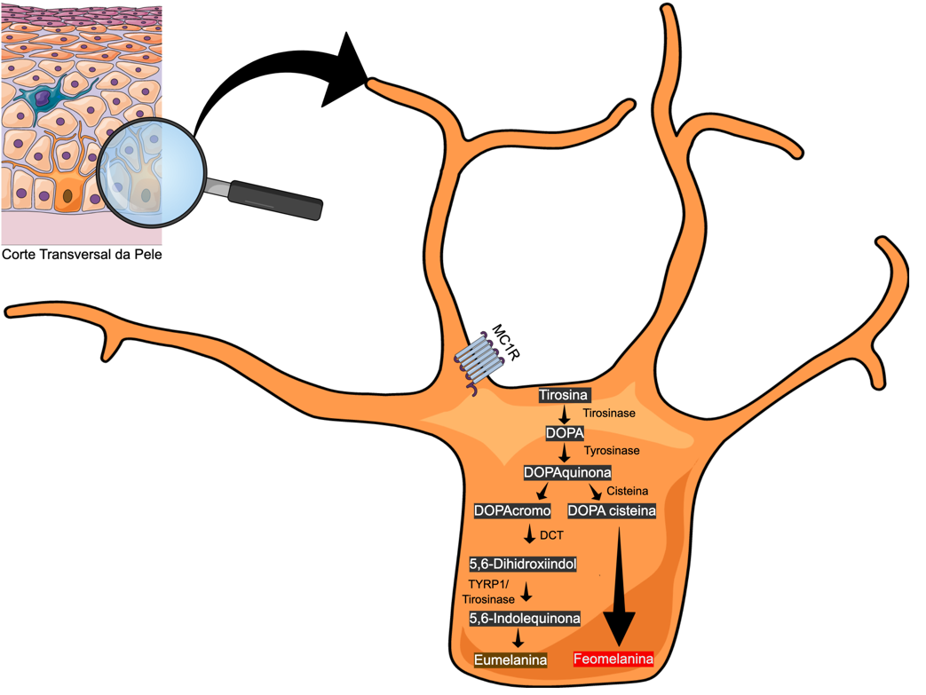
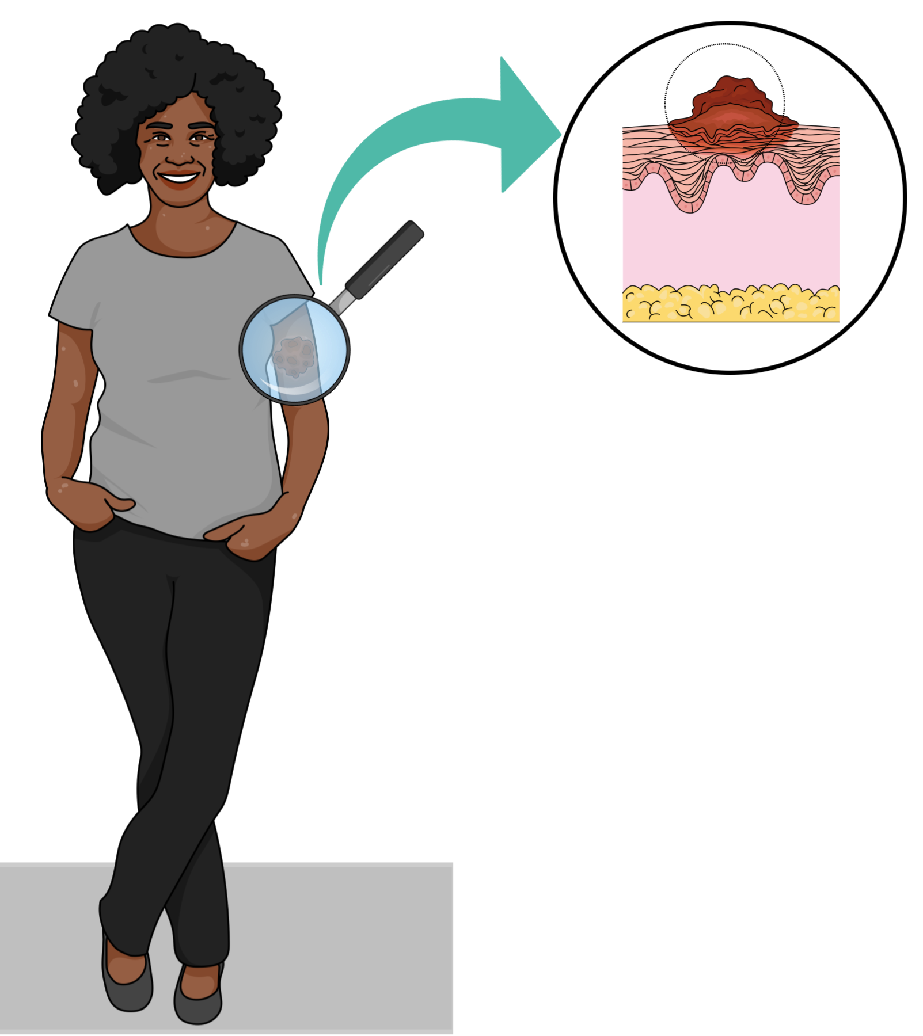
Melanoma subtypes:
C>T transitions at dipyrimidine sites accounted for more than 60% or CC>TT mutations more than 5% of the total mutation burden
Reference: Catalogue of Somatic Mutations in Cancer

Slide 3
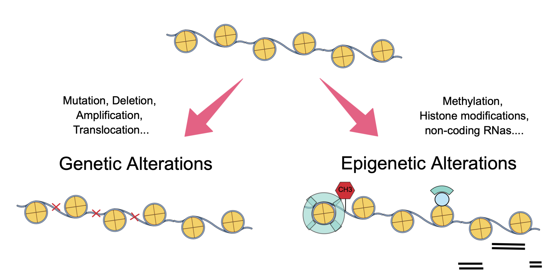
Alterations that occur in the DNA

Slide 4
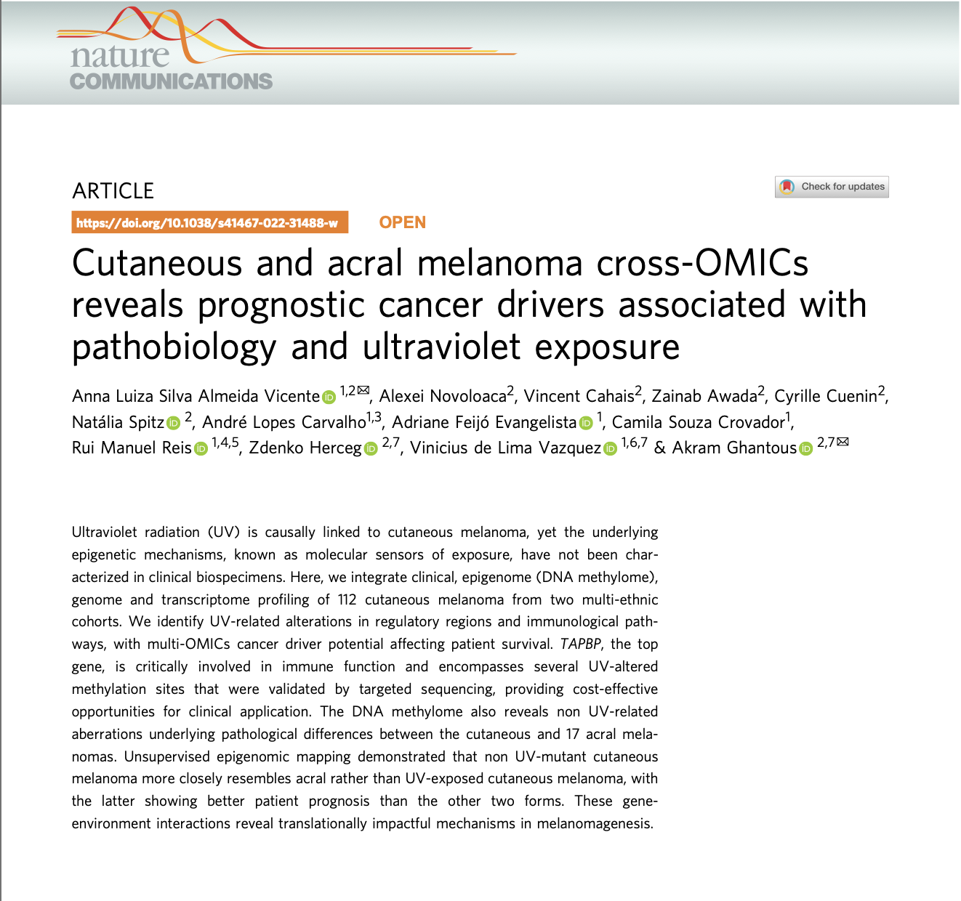
These authors jointly supervised this work

Slide 7
1
Translationally impactful mechanisms in melanomagenesis;
2
Different skin colors: we widen the resolution spectrum to various forms of melanoma
and gain a better understanding of those origins;
3
Our findings: early detection and more personalized prognosis.

Slide 8
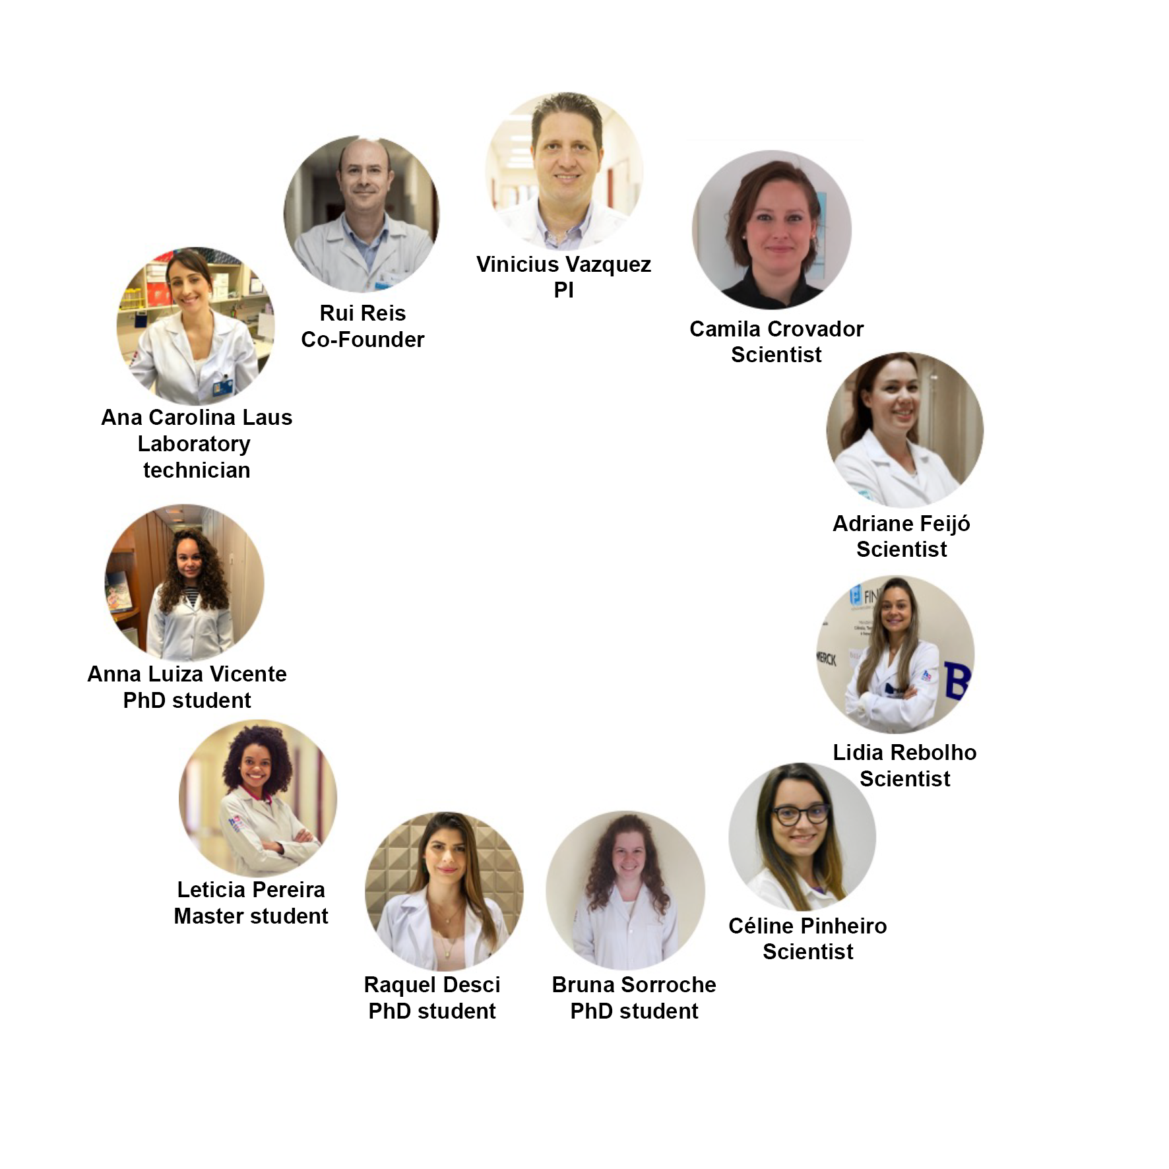
THANK YOU
annaluizaalmeida@hotmail.com
BCH Melanoma
Research Group
IARC
Members
Special Thanks
All patients with melanoma included in this work

