Slide 1
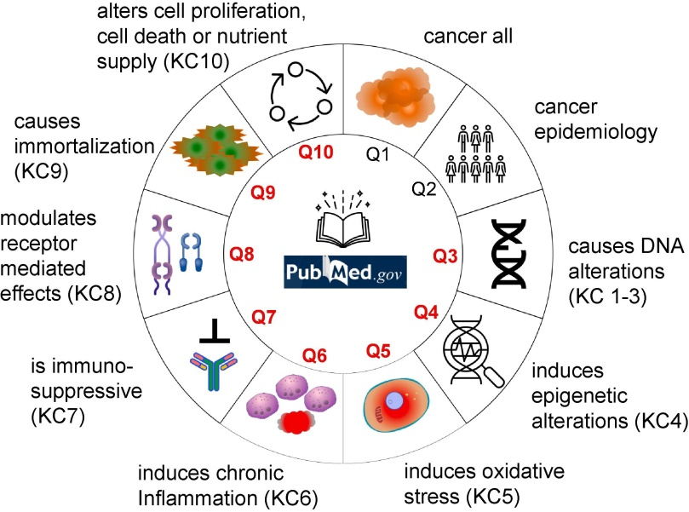


Toxicogenomic analysis of mycotoxins as candidate carcinogens
Liesel Claeys¹³ Inge Huybrechts² Marthe De Boevre³ Maria Zhivagui¹⁵ Vincent Cahais¹ Yannick Gansemans⁴ Beatrice Fervers⁶ Filip Van Nieuwerburgh⁴ Sarah De Saeger³ Michael Korenjak¹ and Jiri Zavadil¹
¹Epigenomics and Mechanisms Branch IARC; ²Nutrition and Metabolism Branch IARC; ³Cancer Research Institute Ghent Ghent University; ⁴NXTGNT NGS Core Facility Ghent; ⁵Cellular and Molecular Medicine University of California San Diego; ⁶Cancer et Environnement Centre Leon Berard Lyon
Hypothesis
What are the potential mechanisms through which mycotoxins may contribute to carcinogenesis?
Chronic intake of multiple mycotoxins is associated with an increased risk of developing cancer
Key characteristics (KC)
 | Colorectal cancer (CRC) n = 6291 cases | Liver cancer n = 834 cases
Deoxy-nivalenol (DON) | CRC 1.14 (1.04 – 1.25) p-trend < 0.01 Proximal colon 1.19 (1.00 – 1.41) p-trend = 0.04 | Liver cancer 1.48 (1.13 – 1.94) p-trend < 0.01 Hepatocellular carcinoma (HCC) 2.16 (1.38 – 3.41) p-trend < 0.001
Patulin (PAT) | Rectum 1.18 (1.05 – 1.32) p-trend < 0.01 | HCC 1.48 (1.04 – 2.12) p-trend = 0.02
Fusarium group | Proximal colon 1.20 (1.01 – 1.42) p-trend = 0.04
Multi-mycotoxin exposure | CRC 1.14 (1.00 – 1.28) p-trend = 0.06 | HCC 1.68 (1.04 – 2.70) p-trend = 0.03

Slide 2
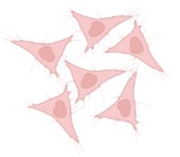



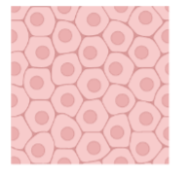
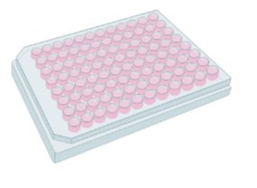
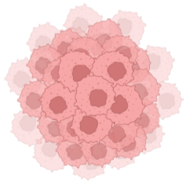
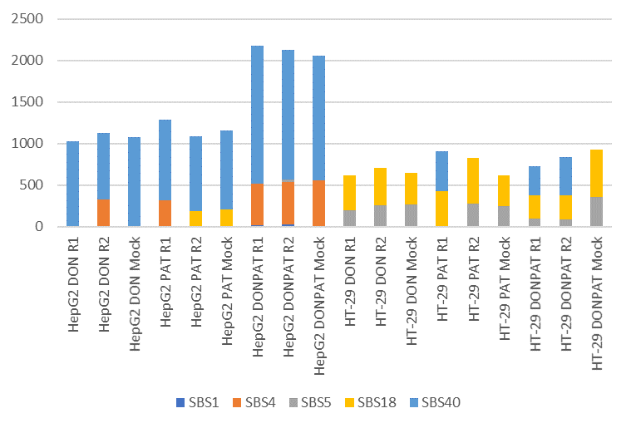
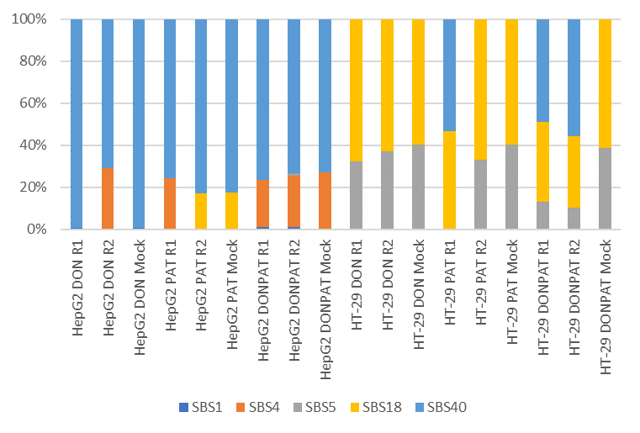
SBS mutational signatures in DON and PAT exposed liver and colorectal cell lines
Chronically treated bulk cultures
Single cell subcloning
Clonal expansion
Whole-genome
sequencing
HepG2
HT-29
SBS40
SBS18
Notes:
We used concentrations that introduced cytotoxicity (LC40) ensuring substantial damage on the cells without wiping out the culture.

Slide 3
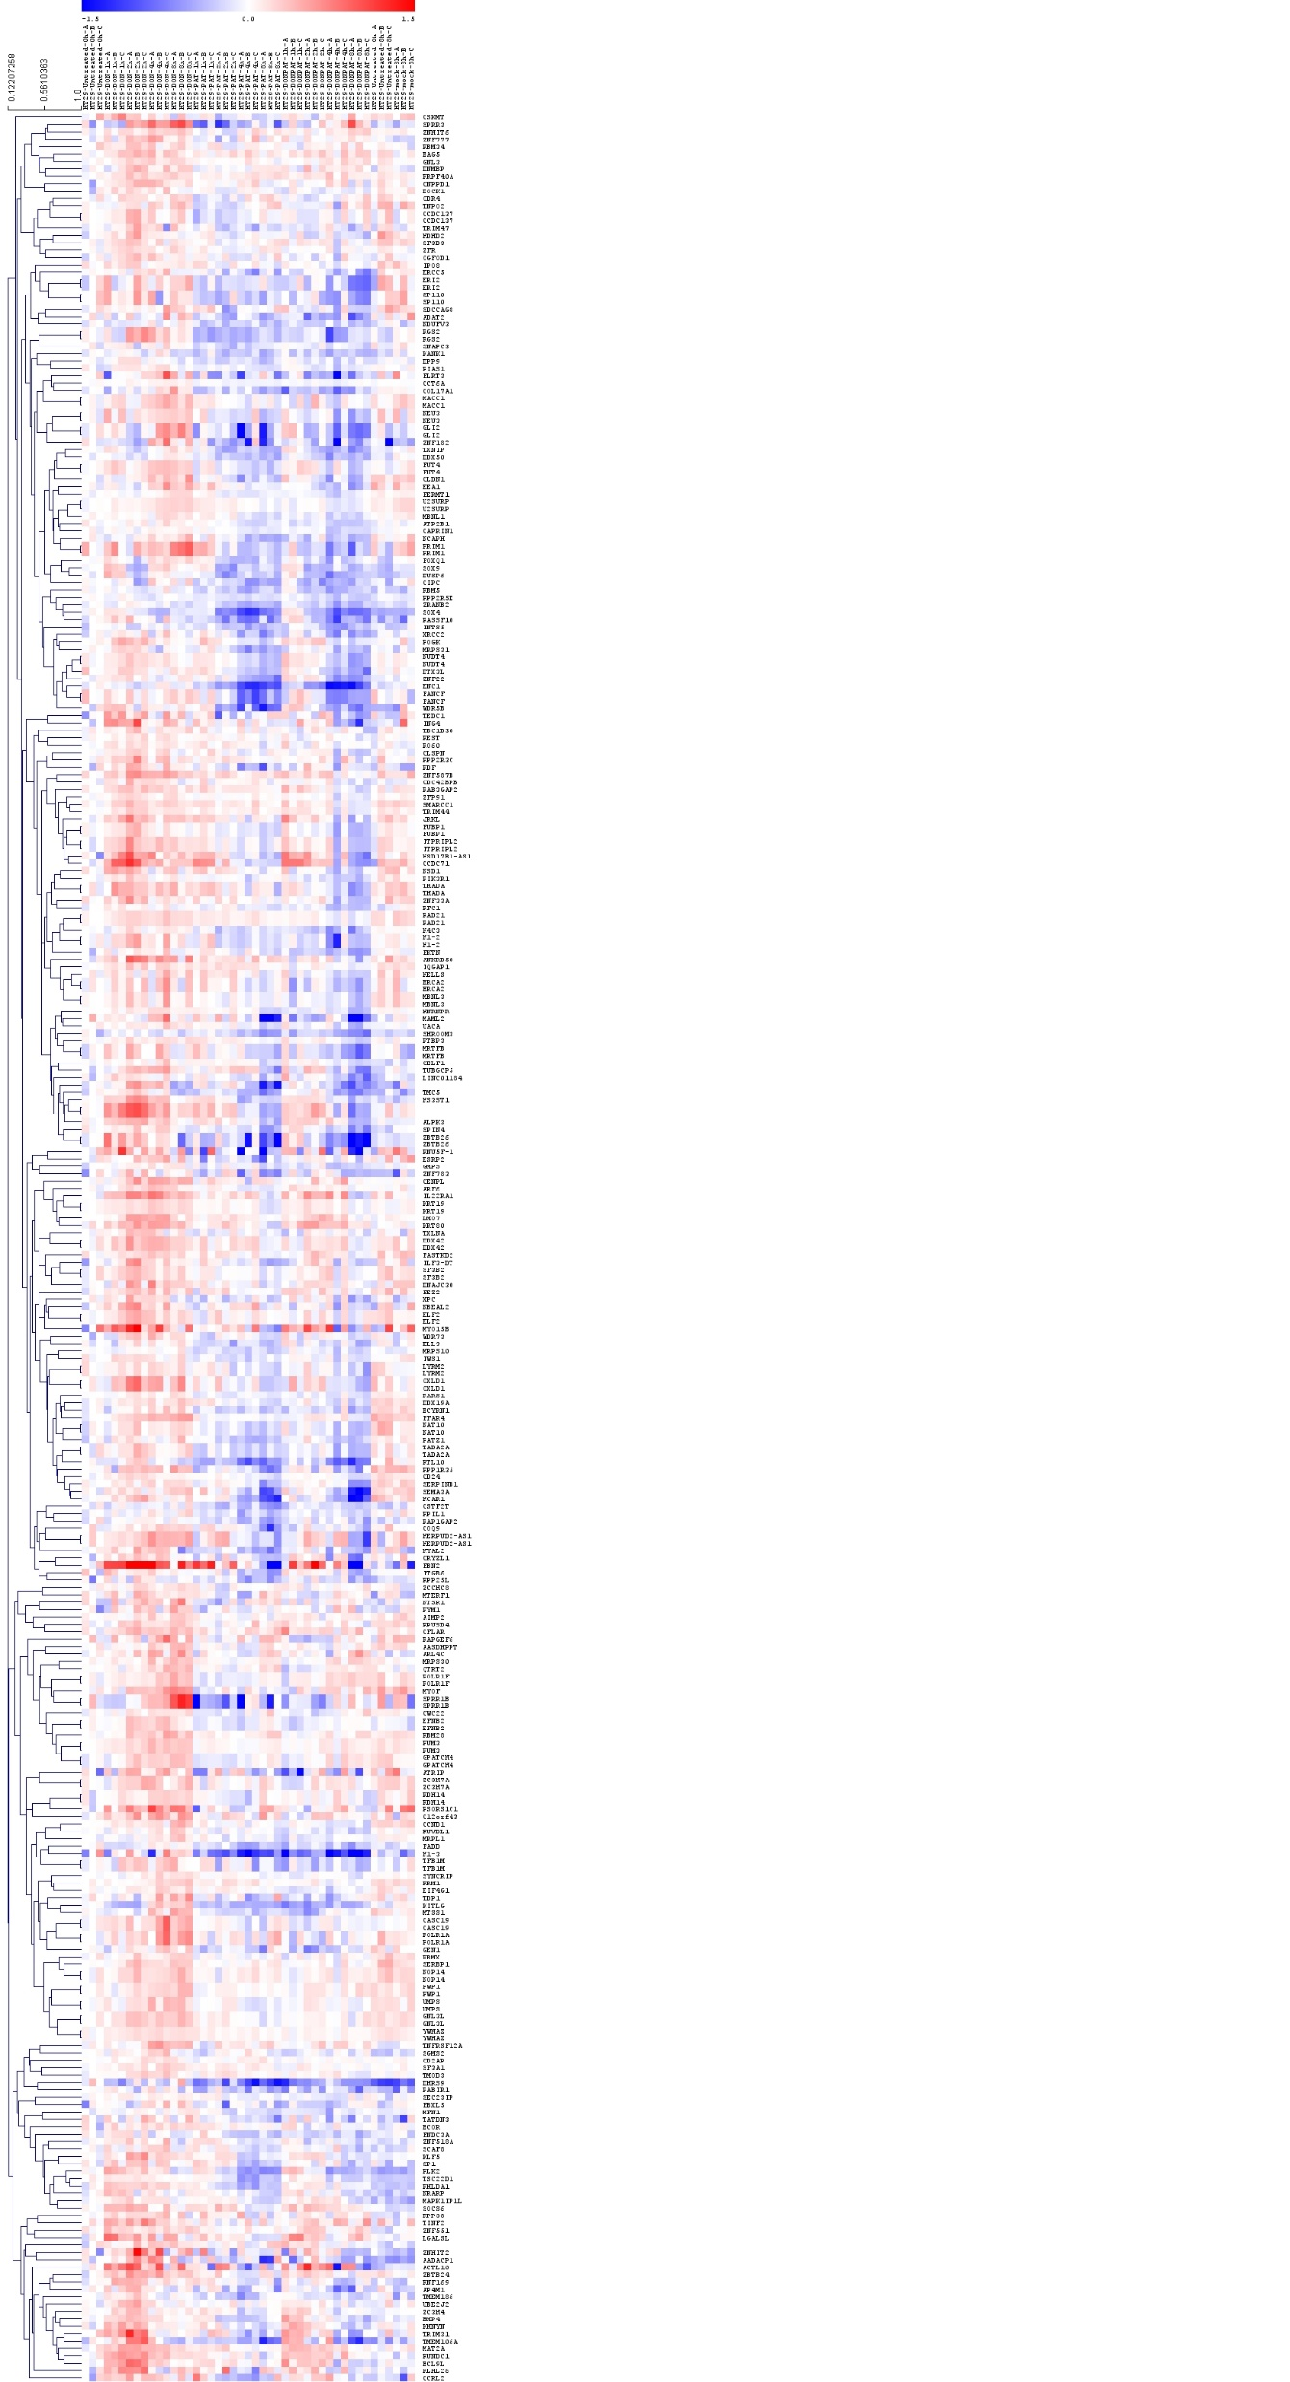
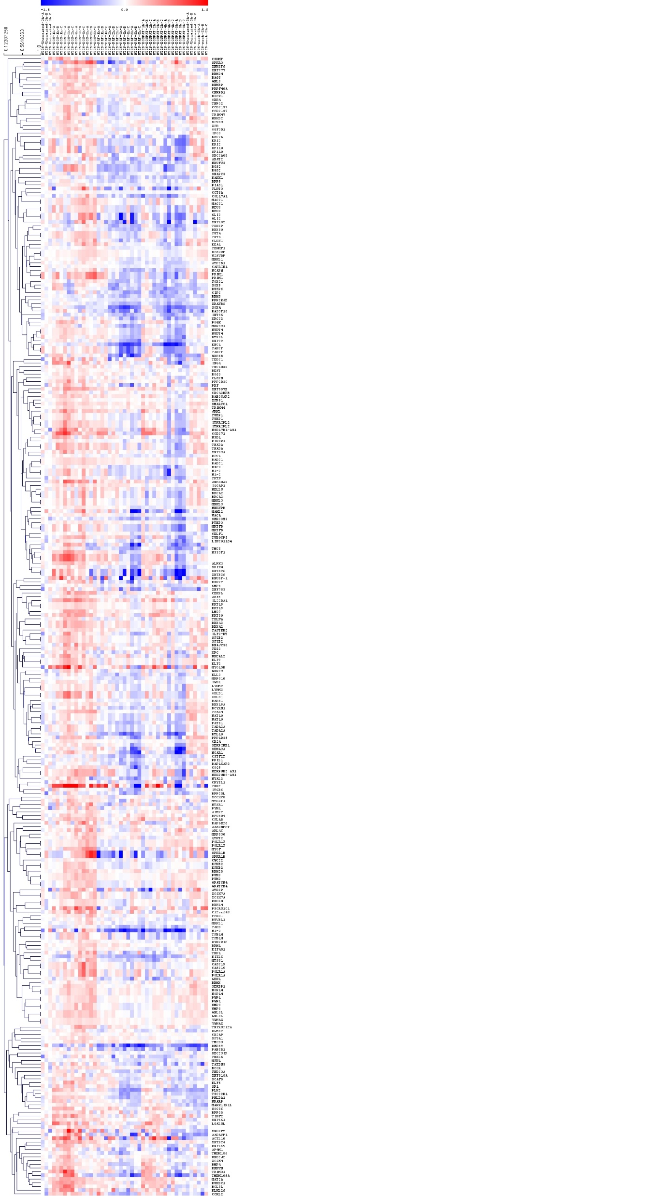


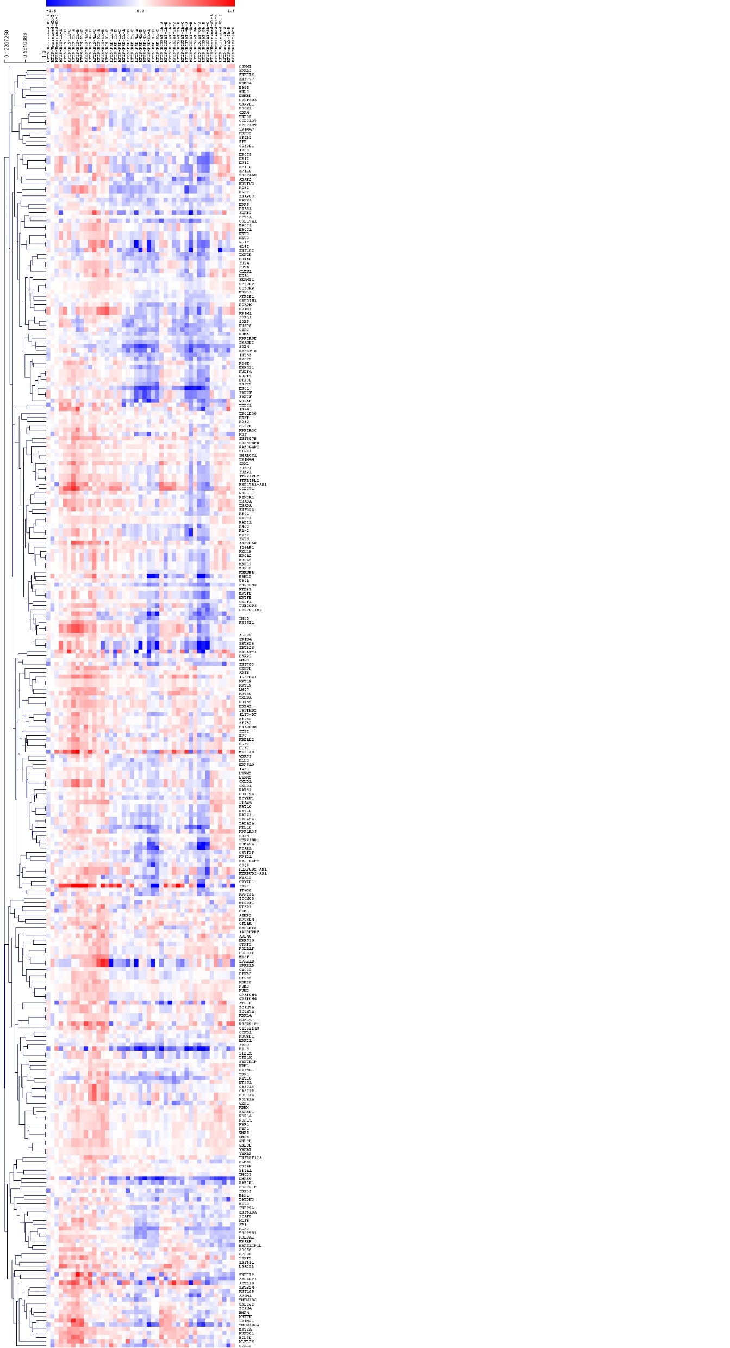
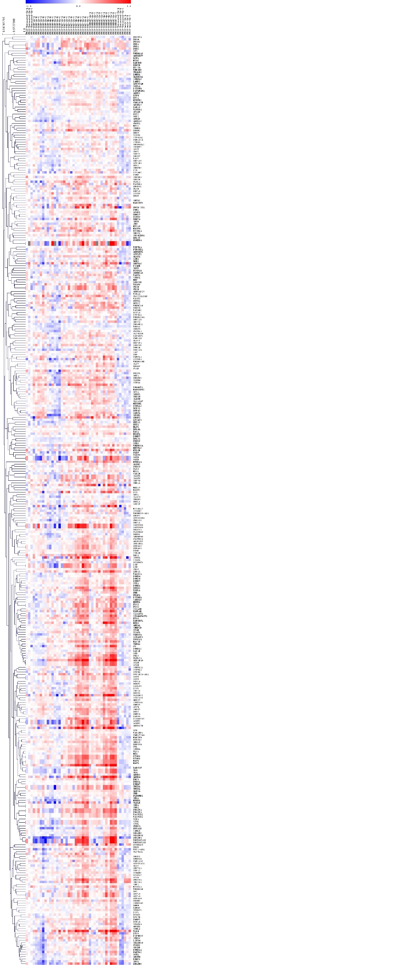

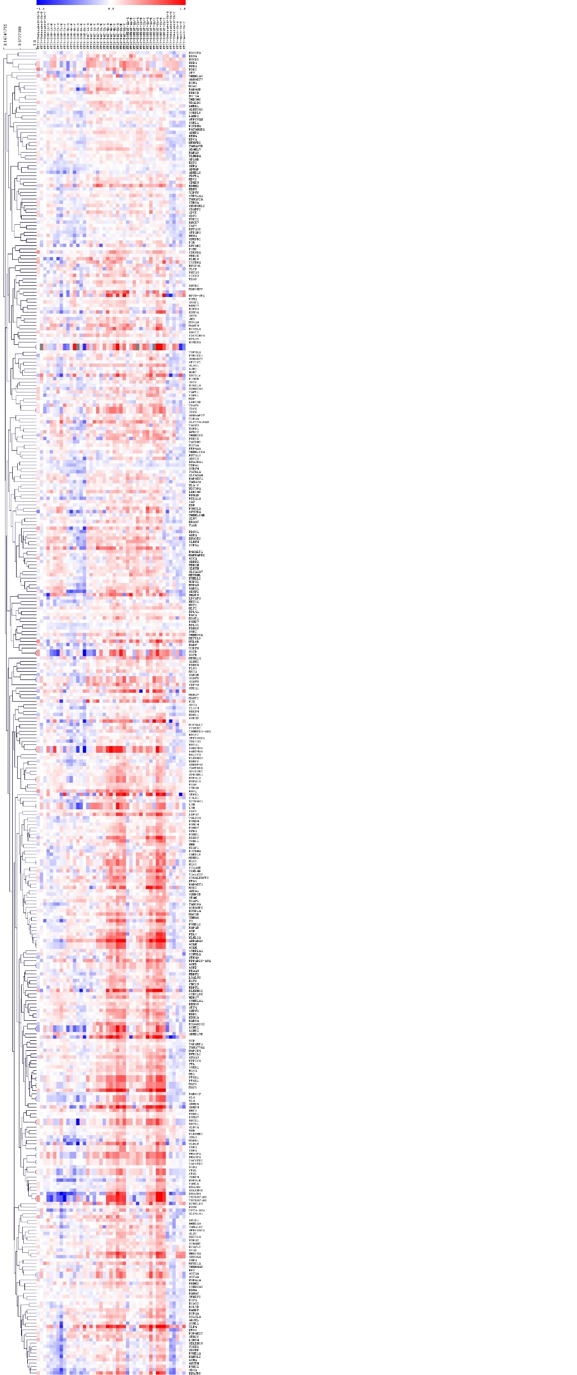
Temporal DON and PAT-specific transcriptional responses in HT-29 cells
DON-specific activation
PAT-specific activation
UNT
Mock
UNT
Mock
UNT
PAT
UNT
DON
PAT
DON+PAT
DON
DON+PAT
Top pathways Count
RNA metabolism 23
Regulation of transcription 20
Cell Cycle 17
DNA Repair 14
mRNA binding 13
RNA splicing 12
Negative regulation of apoptosis 12
Chromatin binding 11
Transcription co-activator activity 10
Chromatin organization 8
DNA Double-Strand Break Repair 8
Programmed Cell Death 7
Global Genome NER 5
Top pathways Count
Stress response 55
Innate Immune System 45
RNA Polymerase II Transcription 41
ATP binding 40
Mitochondrion 39
Metabolism of lipids 33
Golgi apparatus 30
Cytokine Signaling in Immune system 30
Cellular response to chemical stress 30
Signaling by Rho GTPases 27
Cell Cycle 25
Transcriptional Regulation by TP53 19
Programmed Cell Death 17
Mitotic G1 phase and G1/S transition 16
MAPK1/MAPK3 signaling 16
G2/M Transition 16
Signaling by NOTCH 15
Positive regulation of cell migration 10
Proteasome 10
Chemical carcinogenesis - ROS 10
p53-Dependent G1 DDR 10
Negative inflammatory response 8
Cellular senescence 8
307 genes
398 genes
Time (hr): 0 1 2 4 8 1 2 4 8 1 2 4 8 8 8
Time (hr): 0 1 2 4 8 1 2 4 8 1 2 4 8 8 8

Slide 4
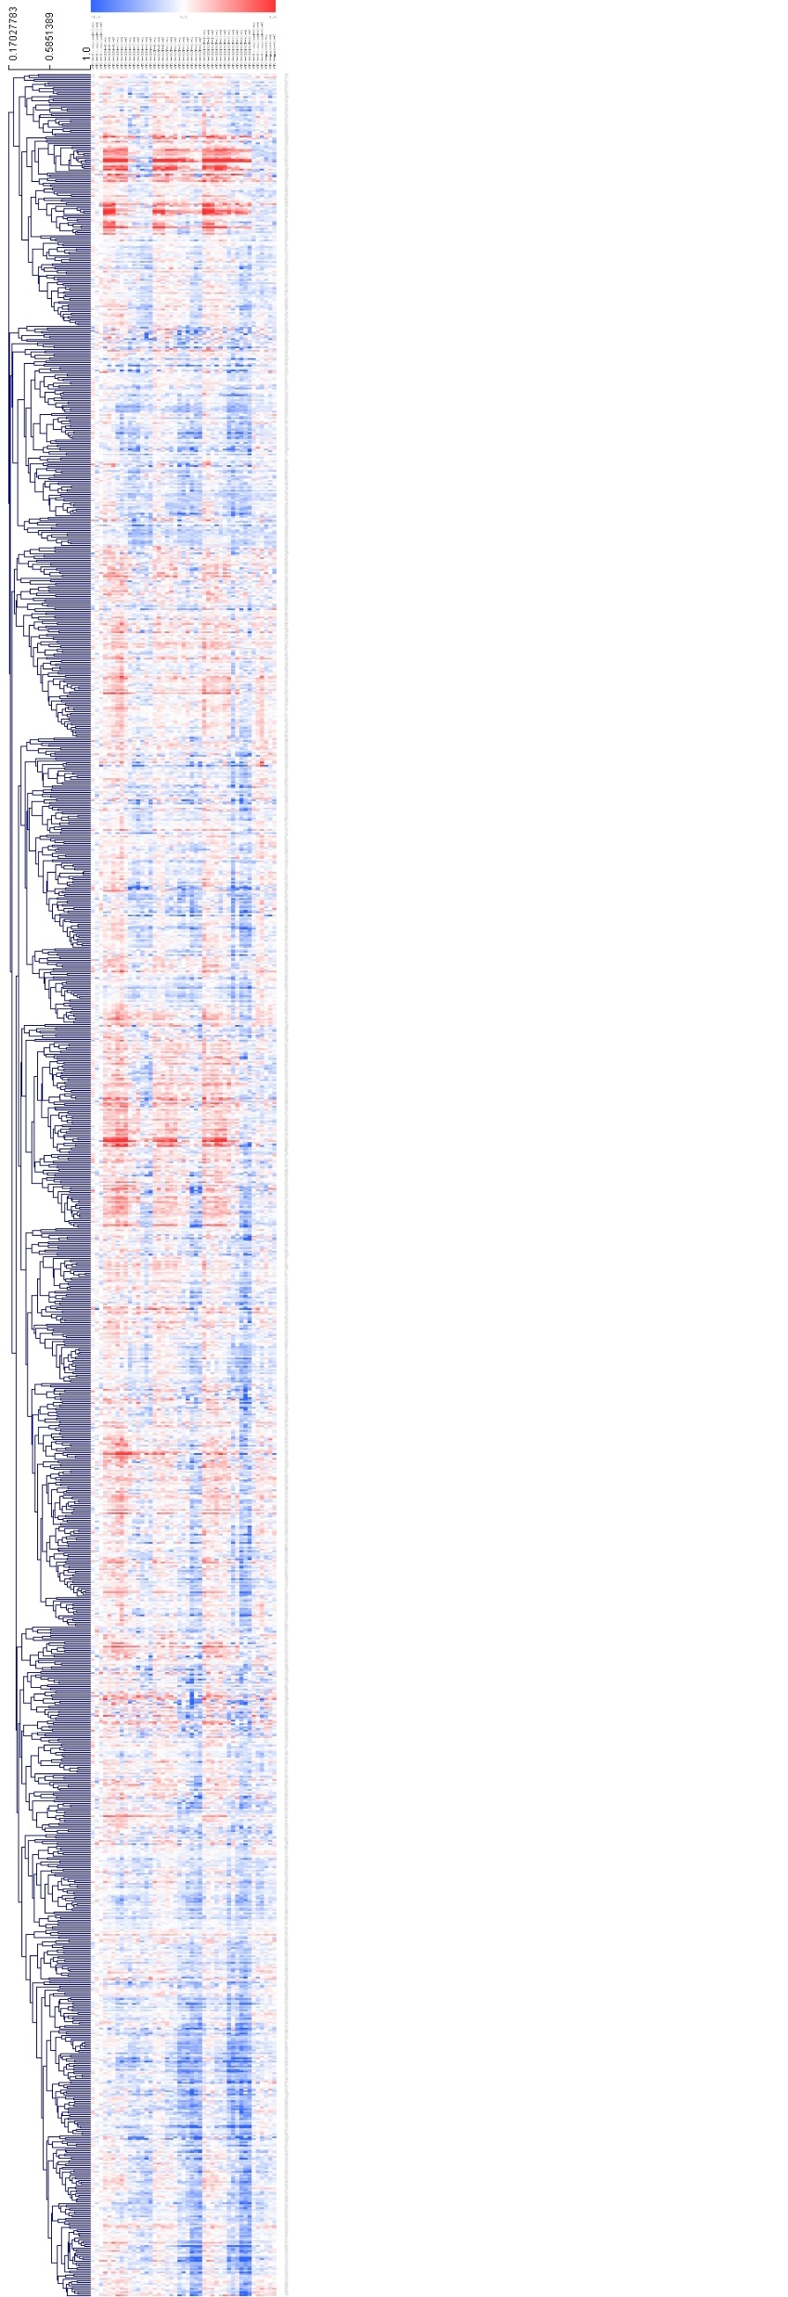
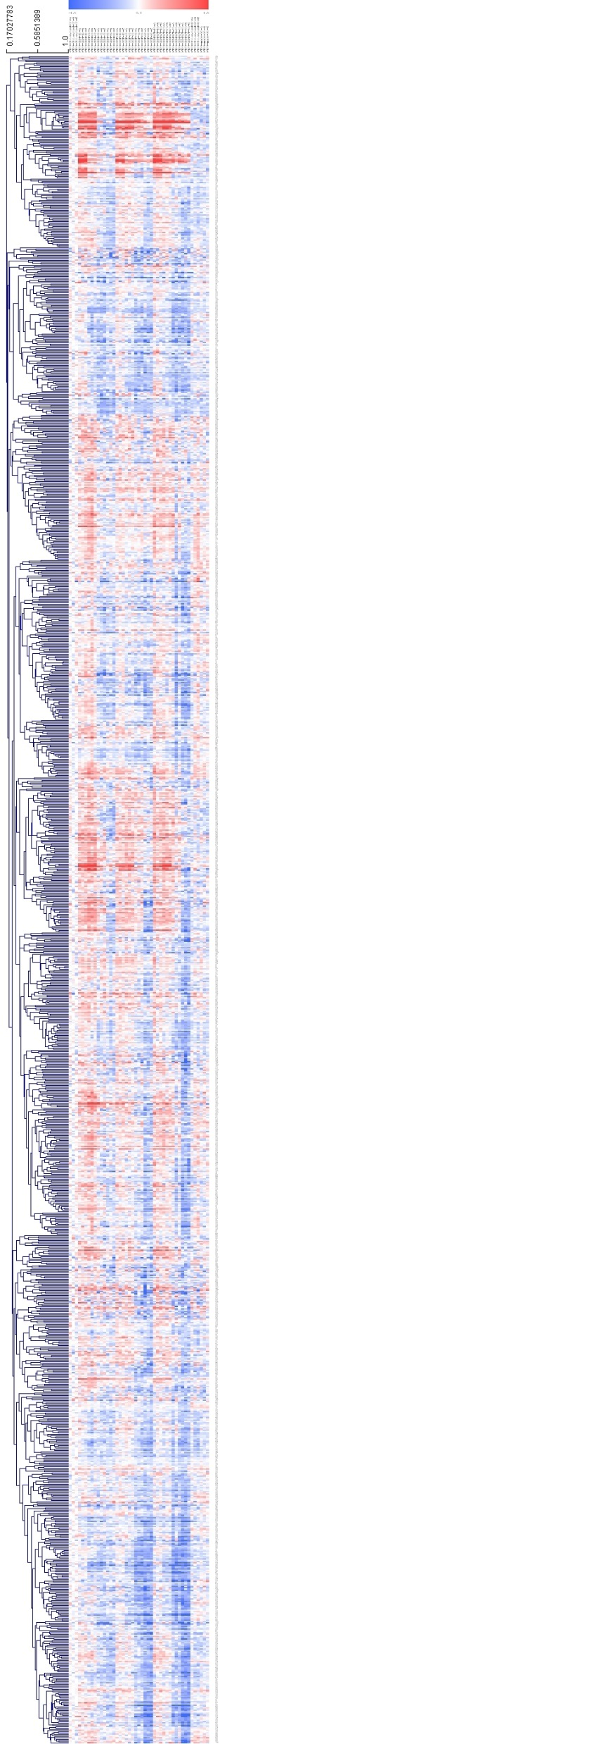



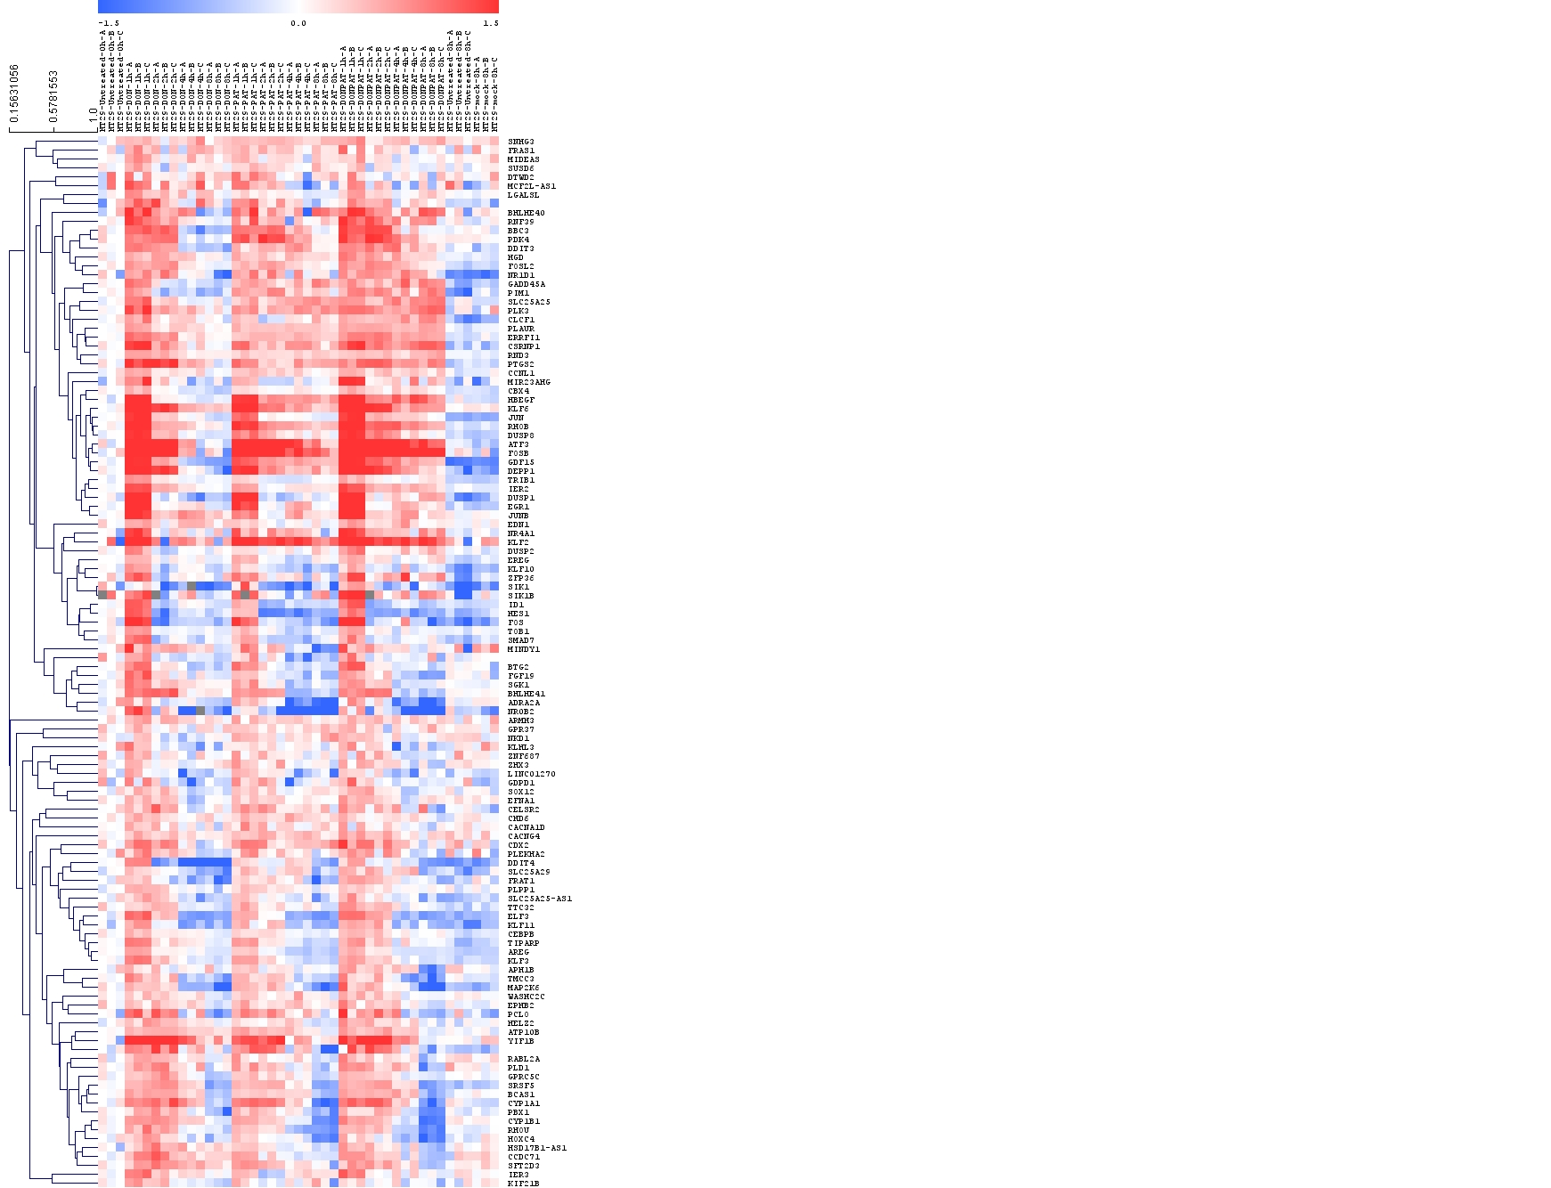
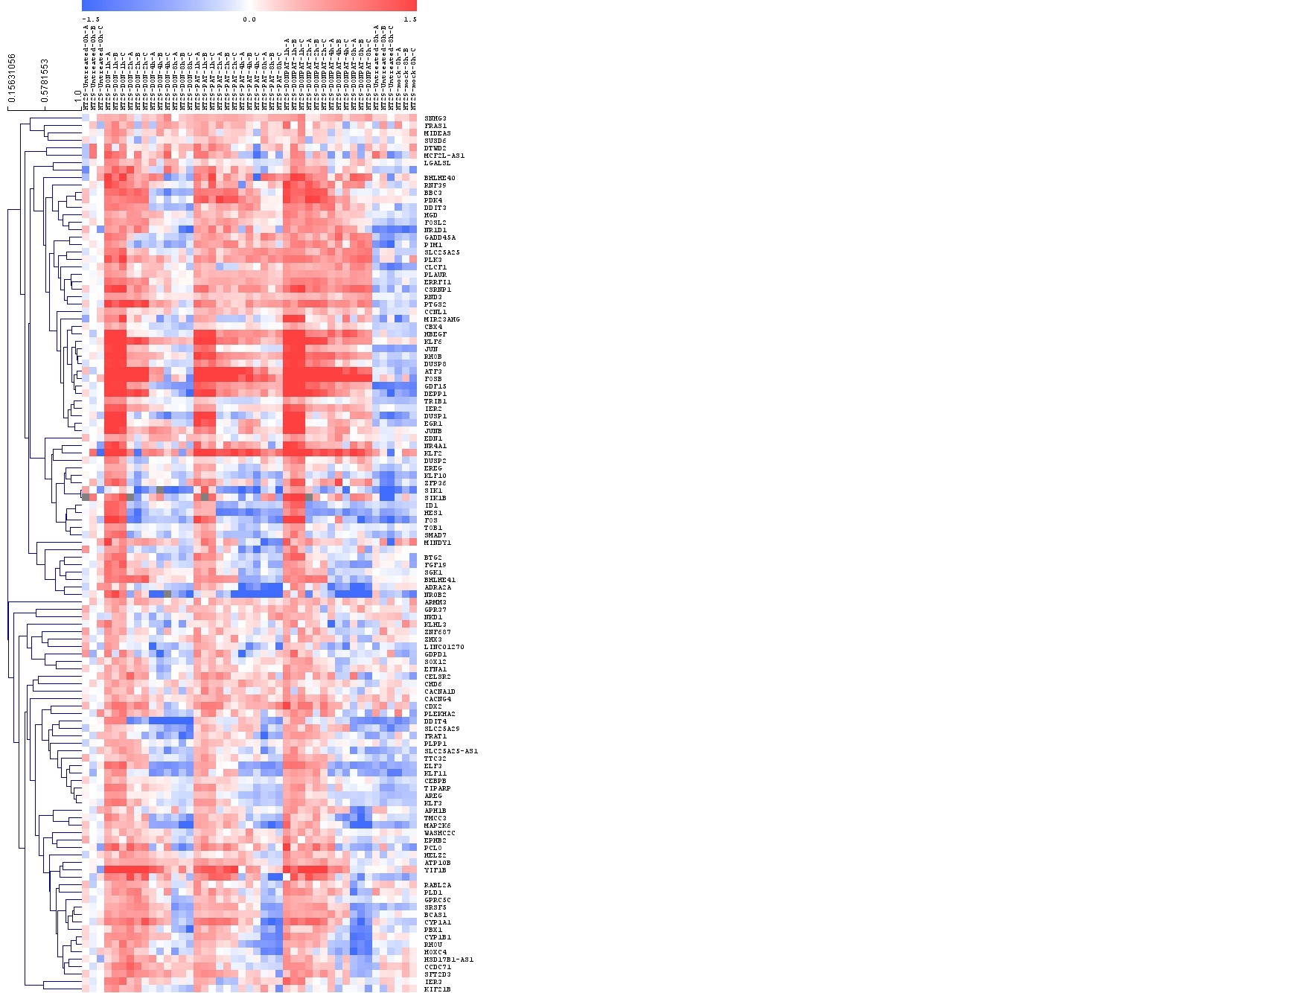
Common rapid-onset transcriptional responses in HT-29 cells
IER programs I.
IER programs II.
UNT
Mock
DON
PAT
DON+PAT
UNT
Top pathways Count
Signal Transduction 32
Chromatin 29
Transcription from RNA Pol II promoter 27
DNA binding 25
RNA Polymerase II Transcription 19
MAPK signaling pathway 15
Endoplasmic reticulum membrane 12
Apoptotic process 12
Positive regulation of cell proliferation 11
Pathways in cancer 11
Cellular responses to stress 10
Cellular responses to stimuli 10
PIP3 activates AKT signaling 9
Transcription Regulation by TP53 9
PI3K-Akt signaling 7
TNF signaling 7
RAF/MAP kinase cascade 7
MAPK1/MAPK3 signaling 7
Cellular response to DNA damage stimulus 6
Cellular senescence 6
Response to xenobiotic stimulus 5
Chemical carcinogenesis - ROS 5
Top pathways Count
Signal Transduction 191
Metabolism 172
Transcription from RNA Pol II promoter 148
Mitochondrion 107
Golgi apparatus 105
Endoplasmic reticulum 98
Metabolism of lipids 73
Cellular responses to stimuli 73
Cellular responses to stress 72
Signaling by Rho GTPases 69
Vesicle-mediated transport 57
RHO GTPase cycle 47
Apoptotic process 44
Cell cycle 36
DNA repair 31
Cell migration 31
Endocytosis 24
Chromatin remodeling 22
Chemical carcinogenesis - ROS 22
Transcriptional misregulation in cancer 20
Integration of energy metabolism 13
Notch signaling pathway 12
UNT
Mock
DON
PAT
DON+PAT
UNT
118 genes
1350 genes
Time (hr): 0 1 2 4 8 1 2 4 8 1 2 4 8 8 8
Time (hr): 0 1 2 4 8 1 2 4 8 1 2 4 8 8 8

Slide 5
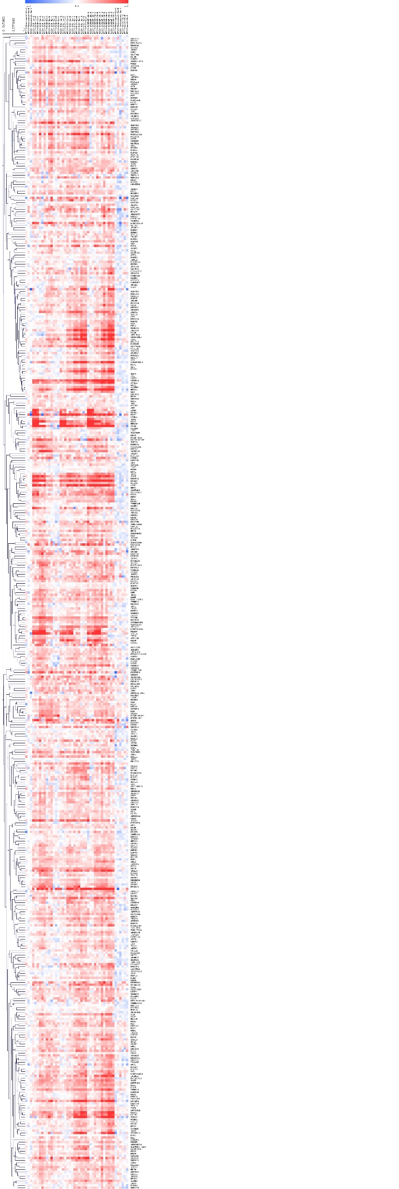


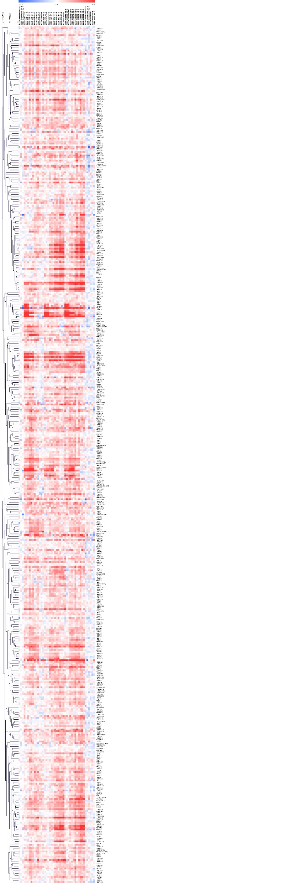
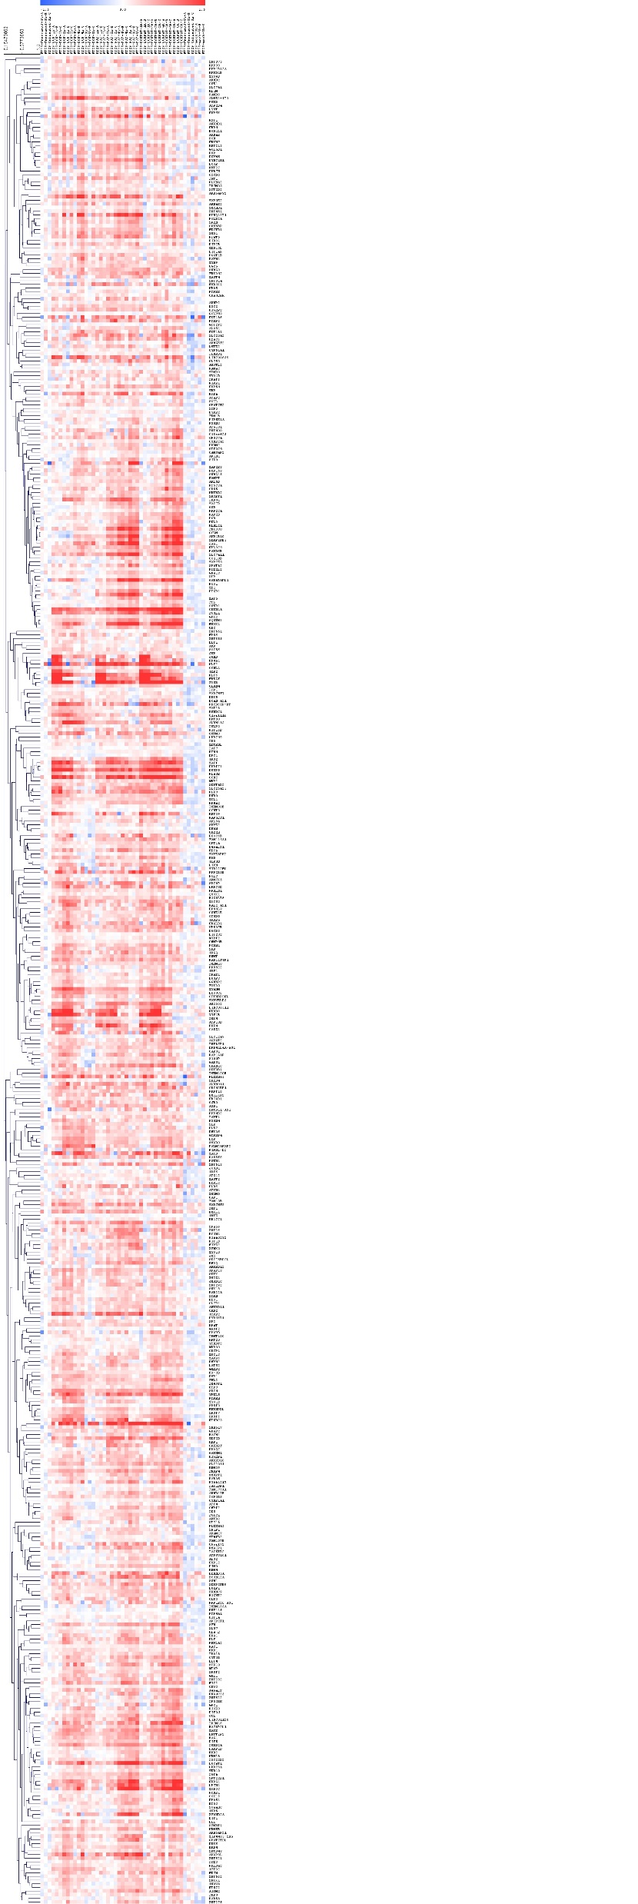
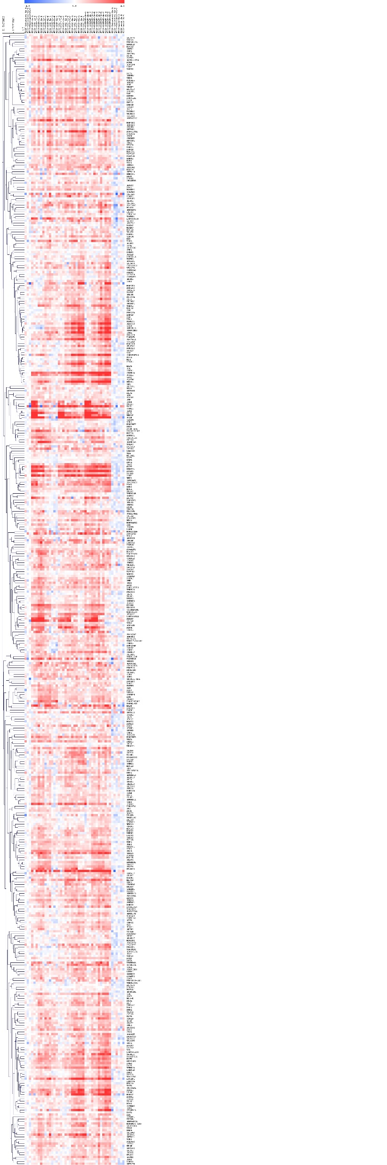
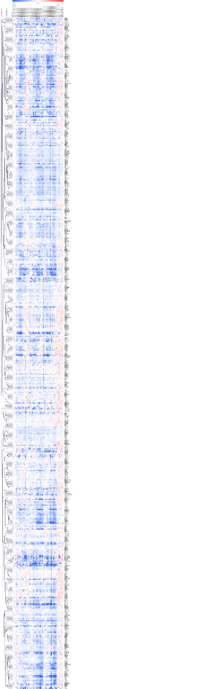
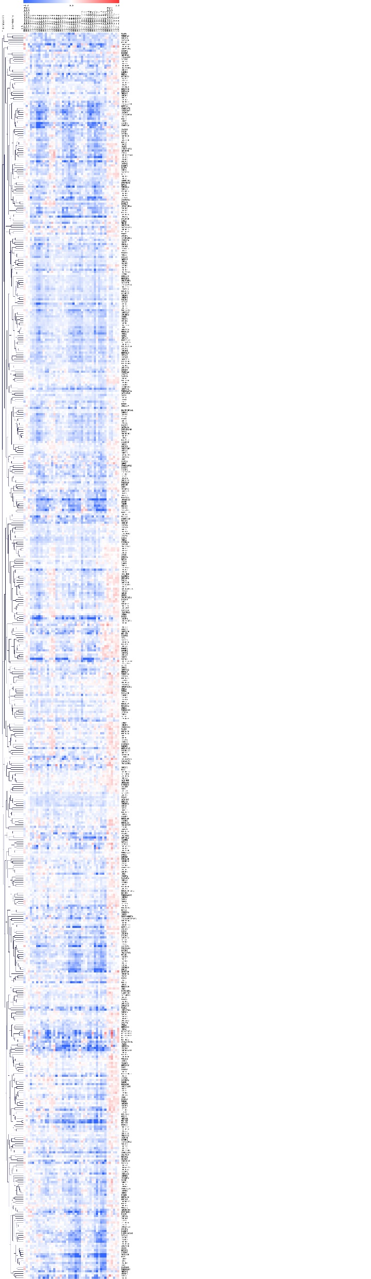

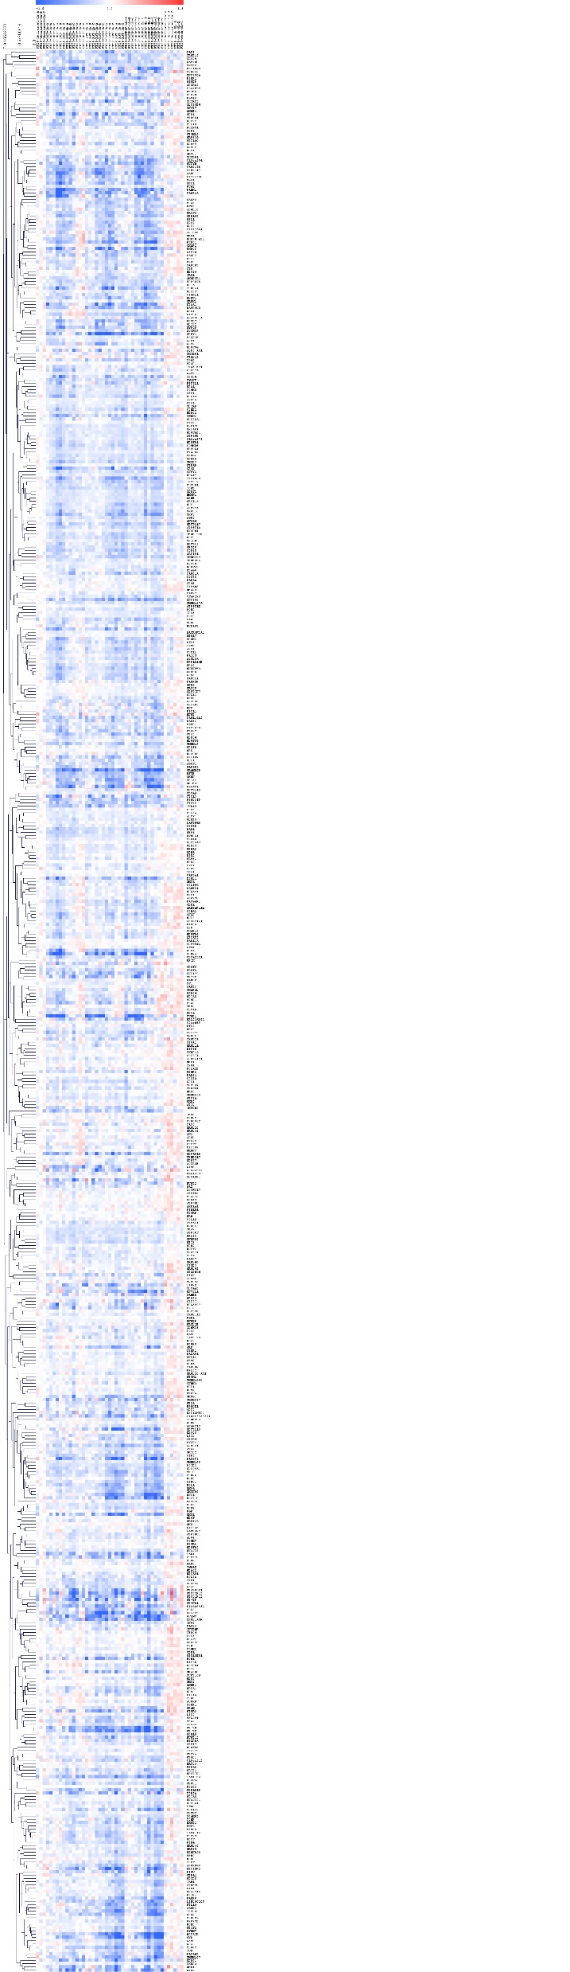
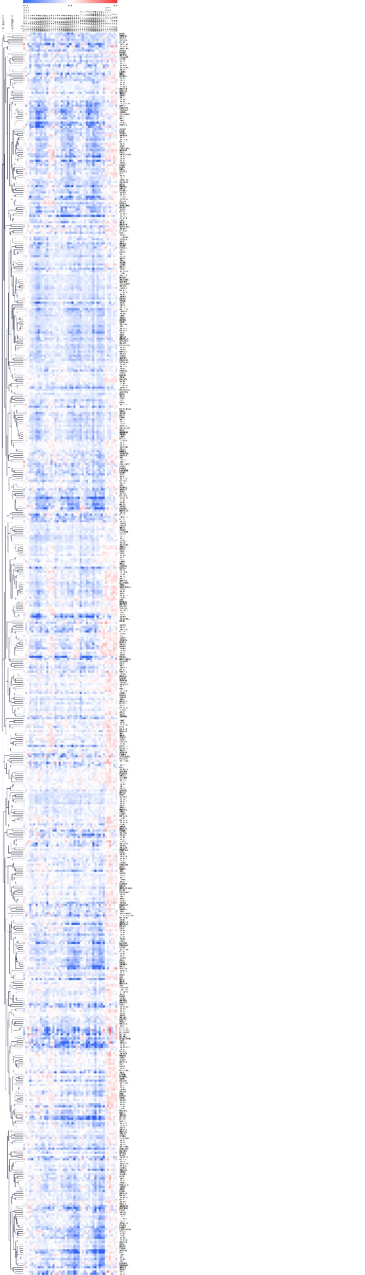

Common DON and PAT-specific transcriptional responses in HT-29 cells
Upregulated - common
Downregulated - common
UNT
Mock
UNT
Mock
PAT
UNT
UNT
DON
DON+PAT
DON
PAT
DON+PAT
Top pathways Count
Golgi membrane 103
MAPK cascade 75
ATP binding 73
Transcription from RNA Pol II promoter 72
Apoptotic process 63
Cellular response to DNA damage stimulus 54
Cell cycle 51
Actin cytoskeleton 44
Cell migration 43
Cellular response to oxidative stress 41
Ubiquitin protein ligase activity 41
Extracellular exosome 31
Cellular senescence 26
Wnt signaling pathway 25
Signal Transduction 22
Innate Immune System 21
Immune System 18
Signaling by Rho GTPases 18
Cellular responses to stress 17
Transcriptional Regulation by TP53 17
Post-translational protein modification 17
RNA Polymerase II Transcription 11
Metabolism of RNA 10
Cellular responses to stimuli 10
Cellular response to chemical stress 9
Top pathways Count
Chromatin binding 91
Mitochondrial respiratory
chain complex I 68
Mitochondrial matrix 59
Oxidative phosphorylation 53
Cell cycle 42
Cell division 41
Oxidative phosphorylation 39
Spliceosome 39
p53 signaling pathway 36
Cellular senescence 35
Chemical carcinogenesis - ROS 32
Cell Cycle 28
Cellular responses to stress 27
SUMOylation 27
Transcriptional Regulation by TP53 25
Metabolism of proteins 23
Chromatin organization 22
TP53 Regulates Metabolic Genes 21
Regulation of TP53 Activity 20
Nucleotide Excision Repair 19
Respiratory electron transport 17
G1/S Transition 15
Cell Cycle Mitotic 15
mRNA Splicing 14
Translation 10
RNA Polymerase II Transcription 9
DNA Repair 9
Metabolism of RNA 6
Cellular responses to stimuli 5
506 genes
586 genes
Time (hr): 0 1 2 4 8 1 2 4 8 1 2 4 8 8 8
Time (hr): 0 1 2 4 8 1 2 4 8 1 2 4 8 8 8

Slide 6
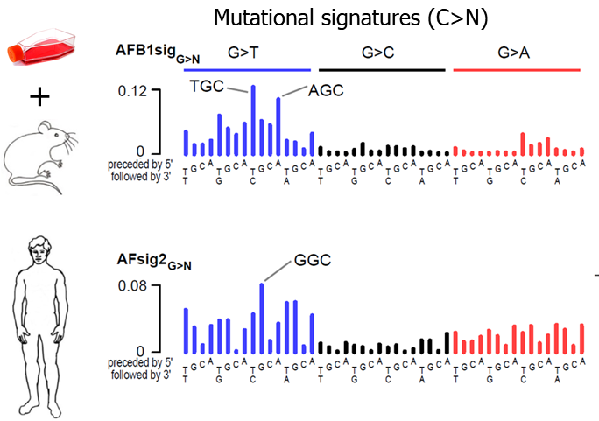
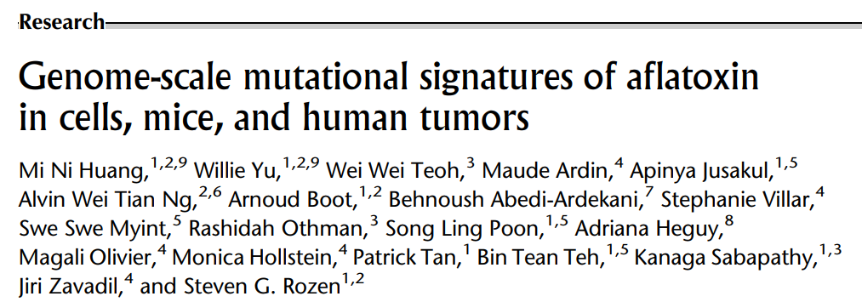
Summary
- Chronic intake of deoxynivalenol and patulin is associated with increased risk
of colorectal and liver cancer
Key characteristics (KC)
- DON and PAT are not strongly mutagenic and do not result in a
characteristic SBS mutational signature indicative of direct DNA damage
- Patulin exposure may indirectly contribute to the accumulation of a mutational
signature caused by an endogenous mutational process of unknown etiology
(SBS40)
- Acute DON and PAT exposure deregulate transcriptional programs linked to
additional key characteristics of carcinogens
- In conjunction with epidemiological evidence experimental models can be utilized to study the potential mechanisms
through which mycotoxins can contribute to carcinogenesis
Notes:
Genomic changes related to alterations in cell cycle progression/cell division – CNVs

Slide 7









Acknowledgments
The Team
The Funders
Liesel Claeys
Inge Huybrechts
Corinne Casagrande
Genevieve Nicolas
Ghislaine Scelo
Samrat Das
Marie-Pierre Cros
Priscilia Chopard
Gertrude Tchoua
Cecilia Sirand
Aurelie Salle
Maria Zhivagui
Vincent Cahais
Marc J. Gunter
Marthe De Boevre
Sarah De Saeger
Leonie Decock
Fien Yu
Christ’l Detavernier
Frédéric Dumoulin
Mario Van De Velde
Béatrice Fervers
Steve Rozen
Filip Van Nieuwenburgh
Yannick Gansemans
Sarah De Keulenaer
Ellen De Meester
For questions, contact korenjakm@iarc.who.int

