Slide 1

Laboratory tools for epidemiological studies on virus-induced cancers
Tarik Gheit (gheitt@iarc.fr)
Epigenomics and Mechanisms (EGM) Branch, International Agency for Research on Cancer, Lyon, France

Slide 2
SCIENTIFIC BACKGROUND
Need of sensitive and robust assays for detection of infectious agents applicable to cancer epidemiology
OBJECTIVE
Novel molecular assays for viral and bacterial DNA detection:
High sensitivity, specificity and throughput
Archived material (FFPE) for retrospective studies

Slide 3
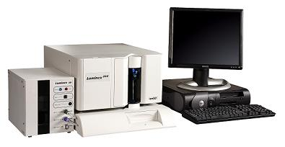
METHODOLOGY
Development of Luminex bead-based assays
(i) multiplex PCR using type-specific primers amplifying viral and bacterial DNA
(ii) typing assays using bead-based hybridization (LUMINEX® technology).
Multiplex PCR
Hybridization
bead
A
bead
Sp. specific probe
B
C
D
E
F
100 bead sets
biotinylated
primers
100 bead sets
Ultrasensitive and specific detection of > 250 infectious agents

Slide 4

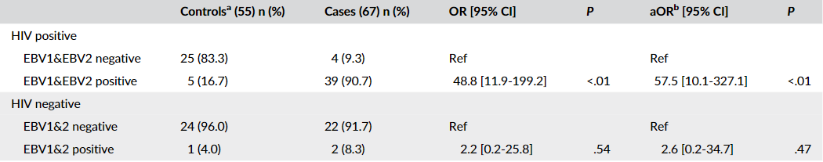
Examples of ultrasensitive detection of viral DNA
Cancer sites :
      head and neck, oral samples
      anogenital tract
      vulvar intraepithelial neoplasia
      breast
      skin
      conjunctiva
Head and neck cancer in India and Europe, Iran, Ireland, etc.
Conjunctival cancer from HIV-positive and HIV-negative patients enrolled in Southern Uganda and Zimbabwe (NIH R21 grant 2021-2023)
Galati et al., 2020. Int J Cancer
Oesophageal cancer (Collaboration with the ENV Branch / IARC).
Sharkey Ochoa et al., 2022 Cancers
Karimi et al., 2022 Microbiol Spectr.
Chiocca et al., 2020 Cancers
Simoens et al., 2021 Cancer Epidemiology
Simoens et al., 2022 BMC Infect Dis.
Galati et al., 2020. Int J Cancer

Slide 5
Examples of ultrasensitive detection of viral DNA
Monitoring the efficacy of HPV vaccines: Bhutan, Rwanda, Armenia, and India (Collaboration with the EPR Branch / IARC)
A single dose of HPV vaccine provides similar protection against persistent infection from HPV 16 and 18 as two or three doses
One HPV vaccine dose may be less efficient in preventing oral HPV infection.
Non-invasive molecular-based screening and early diagnosis of HPV-driven cancers
  Body fluids biomarkers (e.g., circulating HPV DNA) for detection of HPV-driven cancers
  (Collaboration with the European Institute of Oncology (Milan, Italy), and the GEM Branch)
Investigate the effect of EBV infection and mycotoxins exposure on the epigenome / endemic Burkitt’s Lymphoma (EPI_EBVMYCO project / EGM branch)
Basu et al., 2021 Lancet Oncol
Galati et al., 2022 Microbiol Spectr.
Gheit et al., 2022 Oral Oncol. Under revision

Slide 6


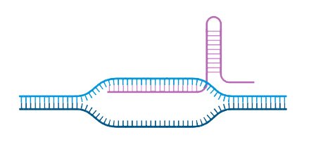


CONCLUSION
Versatile and powerful molecular tools to study the relationship between infections and cancers
PERSPECTIVES
Viral and host biomarkers for early cancer detection
Development and sharing of robust and affordable molecular tools that can be used in LMICs (e.g., CRISPR-based technology)
Q
F
Guide RNA
F
Viral genome
Cas 12a

Slide 7
Acknowledgments
Epigenomics and Mechanisms (EGM) Branch, IARC
Sandrine Chopin, Luisa Galati, Grace Akinyi Odongo, Fazlur Rahman Talukdar, Francesca Manara, Rita Khoueiry, Jiri Zavadil, Zdenko Herceg
Main collaborators
Partha Basu, Gary Clifford, Iacopo Baussano, Jean-Damien Combes (EPR Branch / IARC)
Valerie McCormack, Joachim Schuz (ENV Branch / IARC).
Florence Le Calvez (GEM Branch / IARC)
Susanna Chiocca (European Institute of Oncology (Milan, Italy)
Abbas Karimi, Kazem Zendehdel (University of Medical Sciences, Tehran, Iran)
Cara M Martin, Imogen Sharkey Ochoa (The Coombe Women and Infants University Hospital, Dublin, Ireland)
Ongoing Grants
NIH R21 (2021-2023): “The role of Epstein-Barr-Virus and Human Papilloma Virus co-infection in Conjunctival Cancer”
Project acronymes
HPV AHEAD, IROPICAN, HPV/EBV co-infection, ESCCAPE, EPI_EBVMYCO

