Slide 1
Revealing epigenetic drivers (Epidrivers) of cancers and their link to environmental exposures.
Epidriver Project:
Khoueiry Rita, Mariana Araujo, Francesca Manara, Grace Odongo, Aurélie Sallé, Cahais Vincent, Cuenin Cyrille, Tariq Gheit, Ghantous Akram and Herceg Zdenko
Epigenomics and Mechanisms Branch

Slide 2
Epidriver Project:
High frequency of deregulations in epigenetic regulator genes (ERGs) in tumours.
Epigenetic mechanisms, regulated by ERGs, are key link between the genome and the environment
Epigenetic regulator genes may act as drivers («epidrivers») of cancer onset and progression
&
Deregulations of ERGs result in chromatin rearrangements enhancing carcinogenic potential of environmental exposures.
Objective
Identifying and characterising epidrivers of cancer and testing their role in potentiating genotoxic and non-genotoxic agents in tumorigenesis.

Slide 3
Development of a conceptual framework allowing the identification of candidate epidrivers across different cancer types
Characterization of the epidriver potential
(Pan and Per-Cancer)
In Silico Data Curation in Clinical Samples of
Expression, (epi)Genetic and deregulation in 426 ERGs
Intra & Pan-Cancer investigation
Intra & cross-omics analyses
Orthogonal Validation in in vitro models
(CRISPR Cas9 screenings &
CRISPR activation)
CRISPR/Cas9 screening
Identification of candidate epidrivers of cancer hallmarks
Normal and
cancer cells
Halaburkova et al, Genome Research 2020

Slide 4
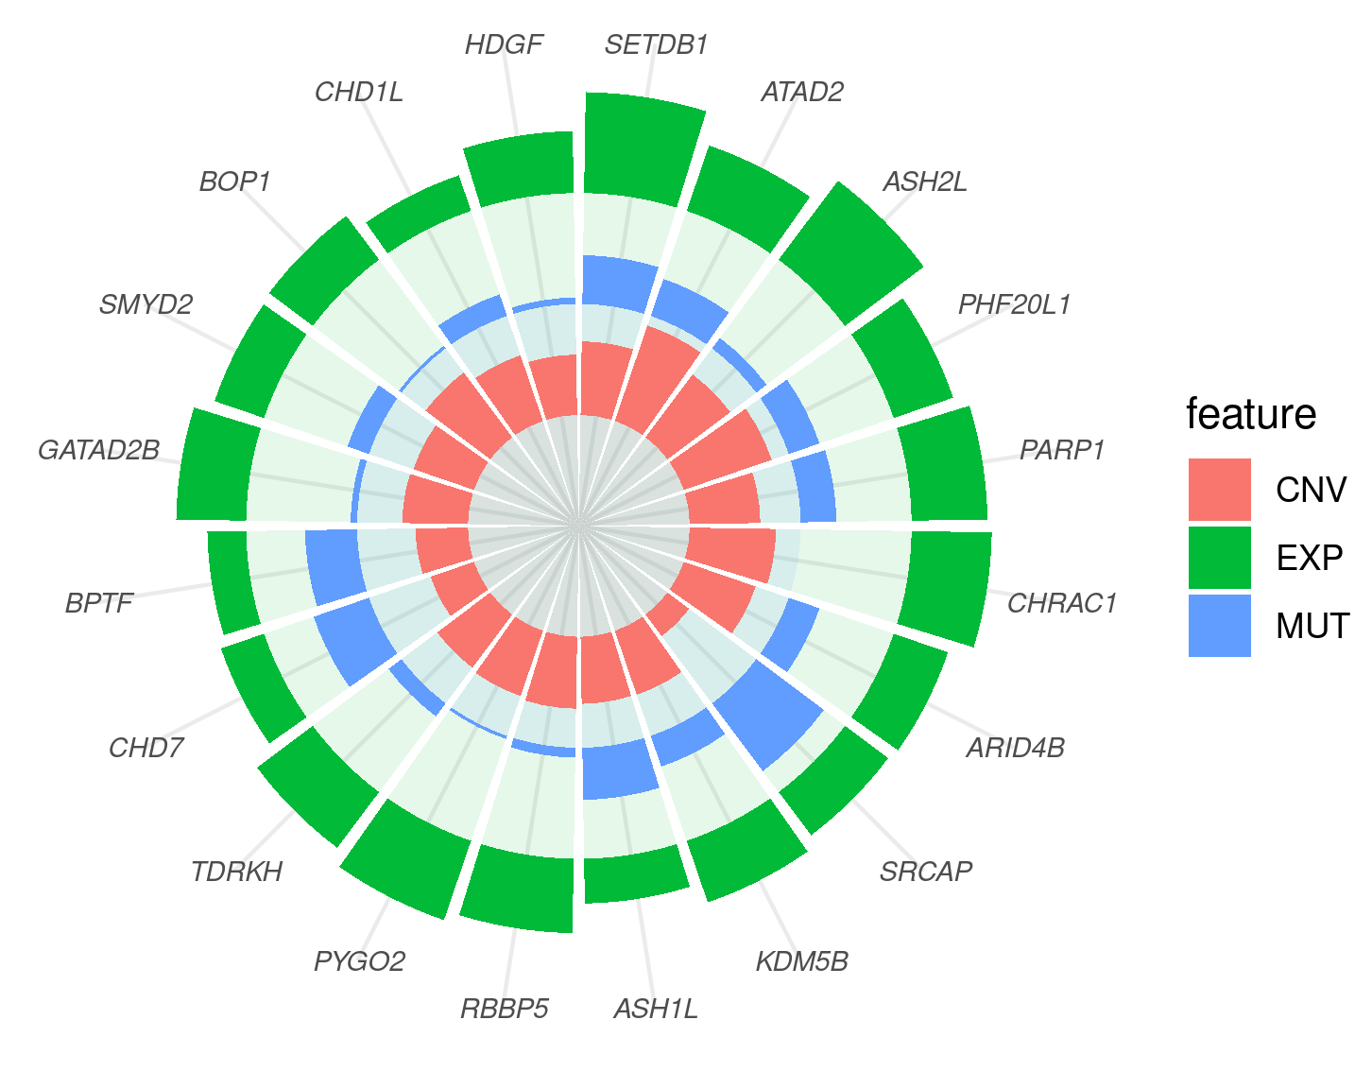
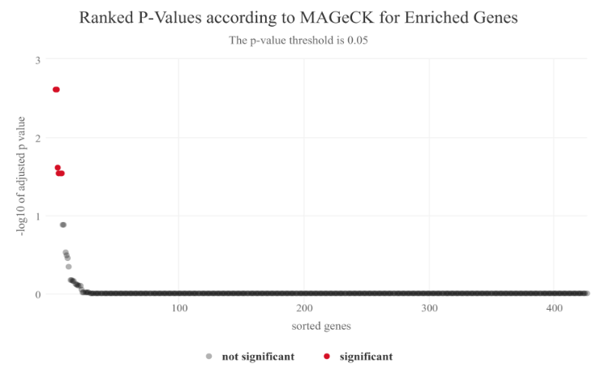
Epidrivers of Breast Cancer Development and their link to Endocrine disruptors
1- Characterization of the epidriver potential of ERGs in
Breast cancer
2- in-vitro orthogonal validation with CRISPR Cas9 screenings and cancer modelling in organoids
Endocrine
disruptors
Epidriver alteration
(CRISPR loss-of-function or activation)
Mammary
Cell lines
CRISPR/Cas9
screening
KDM6A
Organoids
ASXL2
BAP1
PRDM9
KAT6B
CBX4
Endocrine disruptors
Araujo et al, in prep

Slide 5
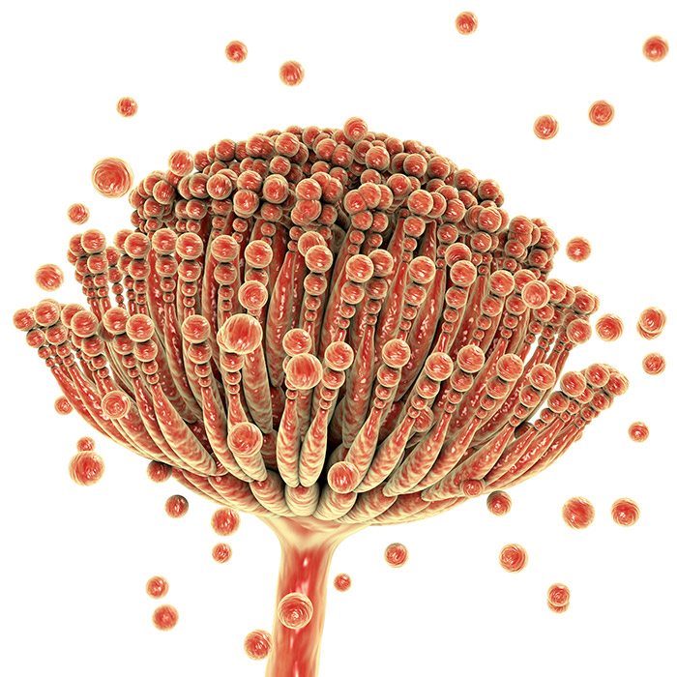
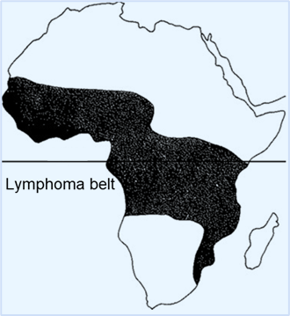
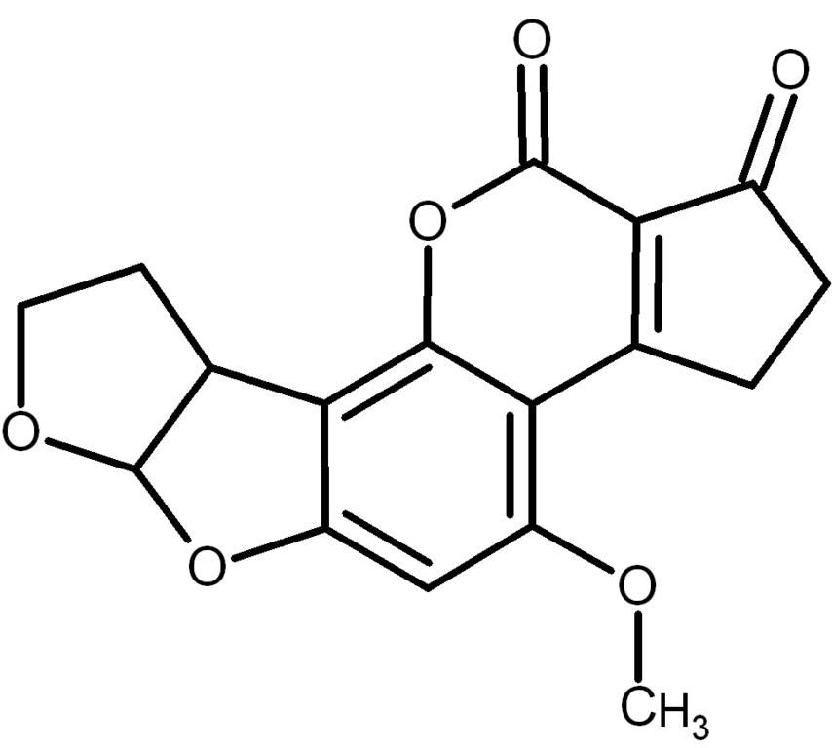
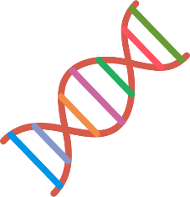
Epidrivers of EBV-induced Burkitt’s Lymphoma and their link to mycotoxins
Interplay Exposome - Epigenome
Burkitt’s Lymphoma
EBV infection
Mycotoxins
Mycotoxins
Infectious
agents
Epidriver deregulation
Epigenetics
CRISPR screening
Sub-Saharan Africa
Primary B cells
Lymphomagenesis
Manara et al, in prep

Slide 6
Outcomes
Identifying biomarkers
New strategies for carcinogen evaluation
New strategies for epigenetics-based early detection, prognosis and personalized prevention.
Acknowledgements
ENV/IARC
J. Schuz
Ghent U
M. De Boevre/S. de Saeger
Univ. of Zagreb
V. Zoldos, N. Sincic
CeMM, Vienna
Christoph Bock
CRCL Lyon
M. Ouzounova

