Slide 1
Parental occupational exposure to combustion products, metals, silica and asbestos and the risk of childhood leukaemia in their offspring
Presented by Felix Onyije, post-doctoral scientist in ENV

Slide 2
Rationale
Parental occupational exposures around conception (father) or during pregnancy (mother) have been hypothesized as potential predisposing factors for childhood leukaemia
Aim
To study the association between parental occupational exposure to Polycyclic Aromatic Hydrocarbons (PAH), Diesel Engine Exhaust (DEE), Metals (chromium and nickel), crystalline silica and asbestos, and the risk of childhood leukaemia in their offspring using data of the Childhood Cancer and Leukaemia International Consortium (CLIC)
2

Slide 3
Methods
Study design and participants
The current pooled analysis included four case–control studies
France, ESCALE (2003–2004)
Germany, GCCR (1988–1994)
Greece, NARECHEM (1996–2011) and
Italy , SETIL (1998–2001)
Population included : Childhood leukaemia cases = 3362 Controls = 6268
Exposure assessment & statistical analysis
Linking job titles (ISCO-68) around the time of conception for fathers and during pregnancy for mothers to an existing semi-quantitative job-exposure matrix (DOM-JEM)
We estimated odd ratios (ORs) and 95% confidence intervals (CIs) using unconditional logistic regression models for all childhood leukaemia combined, by leukaemia type (ALL and AML) and by ALL subtype (B-lineage and T-lineage)
2

Slide 4
Results
Pooled analysis for parental exposure and childhood acute lymphoblastic leukemia (ALL)
Paternal exposure around conception
Maternal exposure during pregnancy
Exposures | OR* | 95%CI | OR** | 95%CI
Chromium
Low | 1.04 | 0.88-1.23 | 0.98 | 0.82-1.16
High | 1.32 | 0.84-2.09 | 1.23 | 0.77-1.96
Nickel
Low | 0.88 | 0.69-1.11 | 0.84 | 0.66-1.06
High | 1.22 | 0.77-1.92 | 1.12 | 0.70-1.78
PAH
Low | 1.03 | 0.87-1.22 | 1.00 | 0.84-1.19
High | 0.72 | 0.46-1.14 | 0.71 | 0.45-1.12
DEE
Low | 1.07 | 0.94-1.20 | 1.03 | 0.91-1.16
High | 1.24 | 0.85-1.82 | 1.21 | 0.82-1.77
Silica
Low | 1.11 | 0.94-1.33 | 1.04 | 0.87-1.24
High | 2.29 | 1.67-3.12 | 2.20 | 1.60-3.01
Asbestos
Low | 1.11 | 0.97-1.27 | 1.06 | 0.93-1.21
High | 0.89 | 0.65-1.21 | 0.84 | 0.61-1.15
Exposures | OR* | 95%CI | OR** | 95%CI
Chromium | 1.07 | 0.45-2.50 | 1.01 | 0.43-2.37
Nickel | 1.01 | 0.41-2.46 | 0.96 | 0.39-2.35
PAH | 1.19 | 0.89-1.61 | 1.13 | 0.84-1.53
DEE | 0.97 | 0.74-1.28 | 0.92 | 0.70-1.22
Silica | 1.08 | 0.73-1.60 | 1.00 | 0.67-1.48
Asbestos | 1.20 | 0.85-1.70 | 1.17 | 0.83-1.66
*Adjusted for child's age and sex, and study
**Adjusted for child's age and sex, study and highest level of education of either parent
3

Slide 5
Pooled analysis for parental exposure and childhood
acute myeloid leukemia (AML)
Paternal exposure around conception
Maternal exposure during pregnancy
Exposures | OR* | 95%CI | OR** | 95%CI
Chromium
Low | 1.46 | 1.03-2.07 | 1.29 | 0.89-1.86
High | 1.19 | 0.37-3.88 | 1.13 | 0.35-3.71
Nickel
Low | 1.13 | 0.68-1.88 | 0.96 | 0.55-1.65
High | 1.06 | 0.32-3.45 | 0.93 | 0.28-3.08
PAH
Low | 0.97 | 0.63-1.49 | 0.86 | 0.55-1.35
High | 0.90 | 0.32-2.51 | 0.61 | 0.19-1.99
DEE
Low | 1.21 | 0.91-1.61 | 1.08 | 0.80-1.45
High | 0.81 | 0.25-2.59 | 0.76 | 0.24-2.46
Silica
Low | 1.51 | 1.04-2.20 | 1.38 | 0.94-2.03
High | 2.27 | 1.17-4.39 | 2.03 | 1.04-3.97
Asbestos
Low | 0.85 | 0.59-1.21 | 0.75 | 0.52-1.09
High | 1.28 | 0.68-2.42 | 1.12 | 0.57-2.18
Exposures | OR* | 95%CI | OR** | 95%CI
Chromium | 1.97 | 0.43-8.98 | 0.97 | 0.12-7.67
Nickel | 2.07 | 0.45-9.54 | 1.01 | 0.12-8.08
PAH | 1.75 | 0.94-3.25 | 1.54 | 0.81-2.94
DEE | 0.89 | 0.45-1.78 | 0.86 | 0.43-1.72
Silica | 1.54 | 0.69-3.42 | 1.42 | 0.63-3.17
Asbestos | 1.20 | 0.85-1.70 | 1.17 | 0.83-1.66
*Adjusted for child's age and sex, and study
**Adjusted for child's age and sex, study and highest level of education of either parent
3

Slide 6
Conclusion
Results suggest an association between paternal occupational exposure to high levels of crystalline silica and the risk of childhood leukaemia
However, these results should be interpreted with caution
First study showing this association
There is no plausible hypothesized mechanism
Result driven by few specific jobs e.g., agricultural field crop workers and miners
It could still be other exposures occurring simultaneously creating a spurious association with silica exposure
If confirmed, this is highly relevant for primary prevention measures, as occupational exposures can often be reduced either through regulations or advice to parents preparing for conception to avoid exposures to hazardous chemicals.
Low prevalence of maternal exposures precluded informative risk estimates for maternal exposures in this study
5

Slide 7
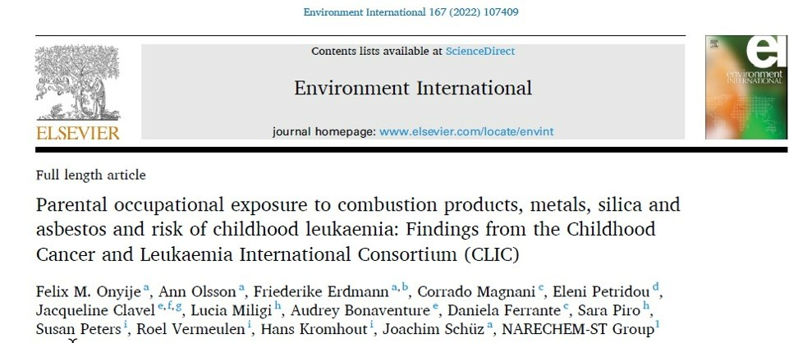
Acknowledgements
PIs of the participating studies and their teams, IRAS for use of DOM-JEM, and ENV

