Slide 1
Risk of Haematological Malignancies in the Residents of Chernobyl-contaminated areas
Ostroumova Evgenia, Scientist
Environmental and Lifestyle Epidemiology Branch

Slide 2
Study Rationale
Lack of consistency regarding the risk of leukaemia following exposure to long-lived radionuclides from the Chernobyl radioactive fallout, especially in people exposed in utero and early life
Some findings suggest that prolonged exposure to very low dose of ionizing radiation (IR) may increase the risk of childhood leukaemia as much as or even more than acute exposure to IR (Davis et al., 2006)
Little information on incidence trends of lymphoid malignancies, multiple myeloma and leukaemia in the most radioactively contaminated areas

Slide 3
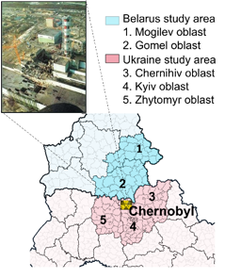
Study Methods
An ecological study design based on the haematological malignancy incident cases from population-based cancer registries in Belarus & Ukraine
Five oblasts (regions) most heavily contaminated with long-lived radioisotopes of caesium (Cs-134 & 137) and strontium (Sr-90)
Belarus (BY): Gomel, Mogilev
Ukraine (UA): Chernihiv, Kyiv, Zhytomyr
Population size tabulated over gender, age, rural/urban
status, calendar year categories
Follow-up period of 32 years, 1986 – 2018
Raion (district)-average absorbed bone marrow doses
from external (Ɣ-emitting radionuclides) and internal
(ingestion with foodstuff) irradiation

Slide 4
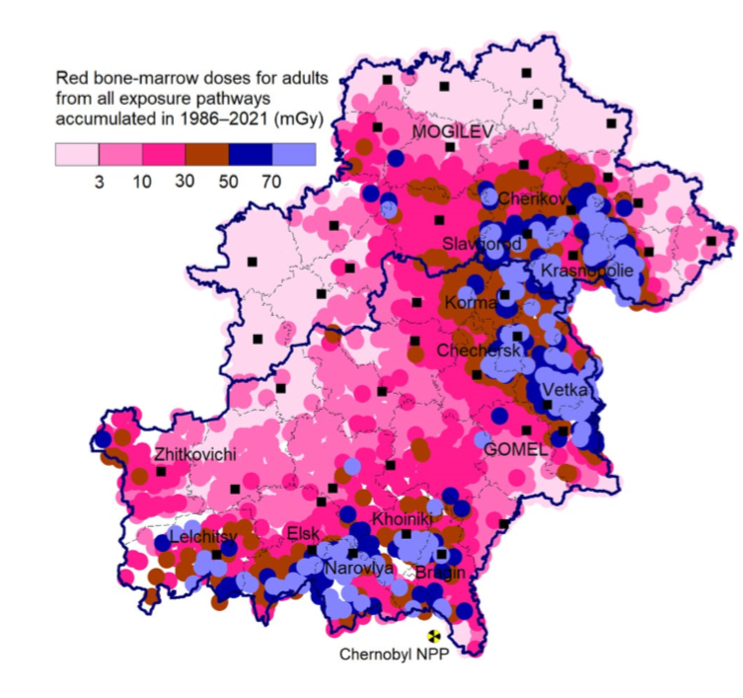
Study Results
Total bone marrow dose (mGy) accumulated by 2018
in residents of the most contaminated areas in Belarus
Characteristics | Median | Mean | Range
Region
- Gomel | 11.7 | 19.7 | 1.8 – 60.1
Mogilev | 2.5 | 8.3 | 1.2 – 36.9
Age at exposure, yrs
<10 | 4.7 | 11.4 | 0.5 – 52.0
10-19 | 5.5 | 13.5 | 0.7 – 59.6
>=20 | 5.8 | 14.3 | 1.2 – 61.6
62% of the total dose was accumulated during first five years after the accident
Drozdovitch et al., 2022

Slide 5
Study Results (cont’d)
Disease (ICD-10 code) | Region |  | Gender |  | Age at diagnosis, yrs |  |  | Calendar period
 | Gomel | Mogilev | M | F | <10 | 10-19 | 20+ | 1986 -89 | 1990-99 | 2000 -09 | 2010-18
Lymphoid Leukemia (C91) | 2413 | 2300 | 2486 | 2227 | 51 | 71 | 4591 | 556 | 1390 | 1447 | 1320
Myeloid Leukemia (C92) | 1651 | 1207 | 1407 | 1451 | 7 | 52 | 2799 | 227 | 770 | 1010 | 851
Hodgkin’s Disease (C81) | 1132 | 894 | 1001 | 1025 | 18 | 175 | 1833 | 285 | 750 | 595 | 396
Non-Hodgkin’s Lymphoma (C82-85) | 2491 | 1888 | 2162 | 2217 | 38 | 54 | 4287 | 316 | 1087 | 1388 | 1588
Multiple Myeloma (C90) | 1000 | 753 | 757 | 996 | 0 | 0 | 1753 | 31 | 374 | 604 | 744
Total | 8687 | 7042 | 7813 | 7916 | 114 | 352 | 15263 | 1415 | 4371 | 5044 | 4899
Population size (individuals):
Gomel region = 1,683,871
Mogilev region = 1,280,190

Slide 6
Summary
Ongoing analysis of haematological malignancies incidence trends and risks in relation to bone marrow exposure dose accumulated over 32 years of follow-up
More evidence-based insights into potential effect of low-dose environmental exposure to IR on haematological malignancies incidence in the residents of radioactively contaminated areas
Importance of cancer monitoring in the areas contaminated with long-lived radionuclides to inform the national authorities and to address the concerns of the affected people.

