Slide 1

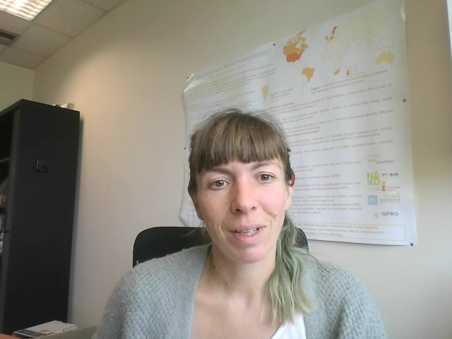
Breast cancer treatment completion in sub-Saharan Africa
SC / 59 - Flash Presentation
Dr Milena Foerster
foersterm@iarc.who.int
Environment and Lifestyle Epidemiology Branch

Slide 2
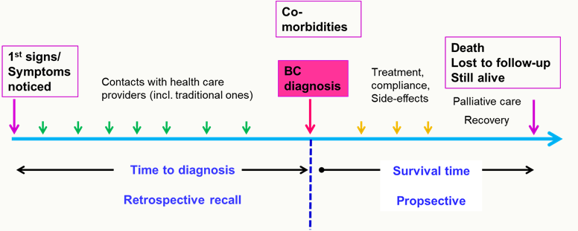
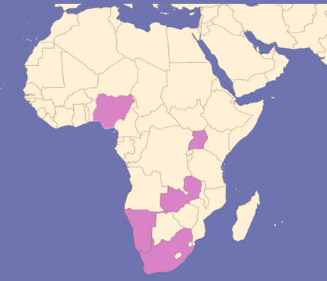
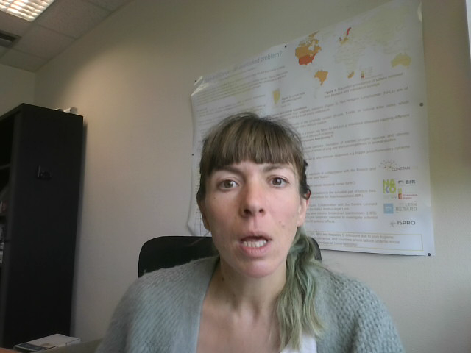
The African Breast Cancer – Disparities in Outcomes study (ABC-DO)
Prospective cohort of >2000 women diagnosed with invasive breast cancer in five countries in sub-Saharan Africa, followed from diagnosis in 2015-17 to date.
Nigeria
Uganda
Zambia
Intentionally observational: aim to provide as-is data on the disease journey of women diagnosed with breast cancer in the worlds most underserved areas
Unique contribution on understanding on breast cancer in SSA with already >20 articles published in high impact journals
Namibia
South Africa

Slide 3
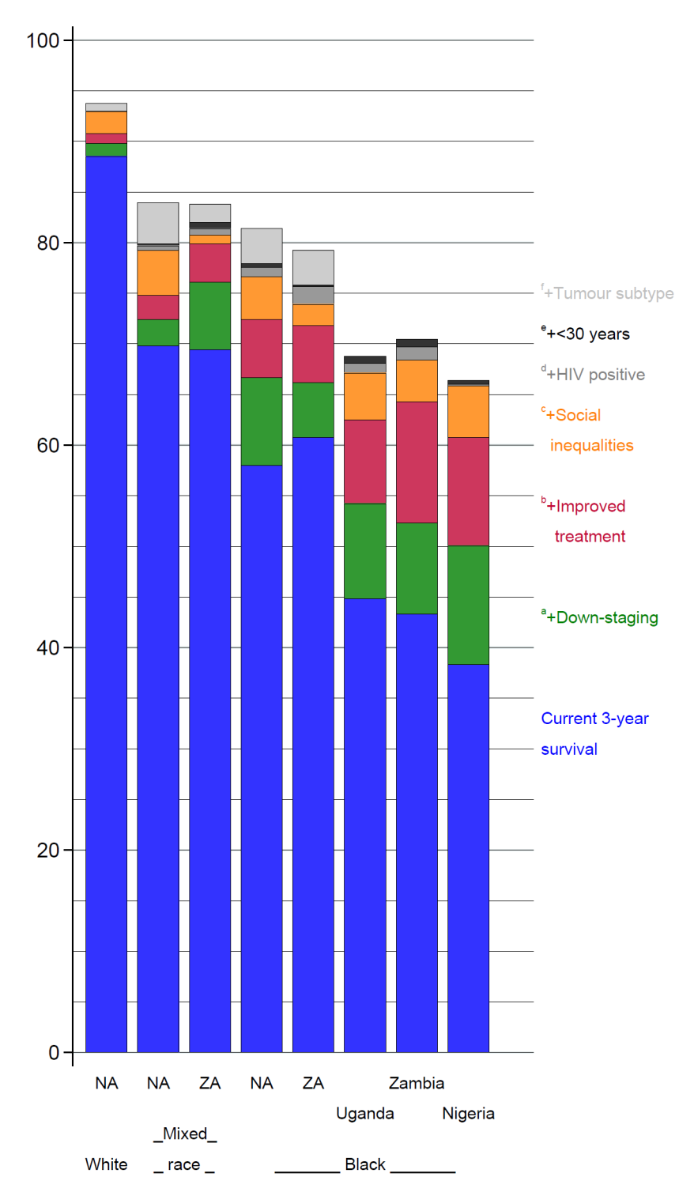
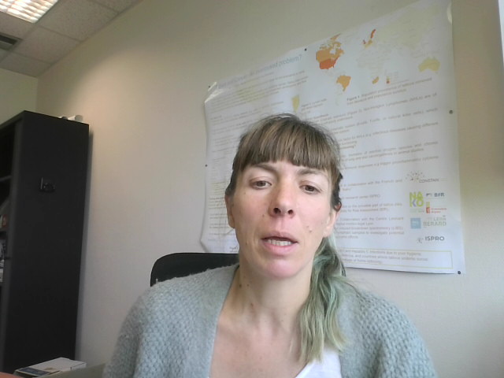
Survival gaps identified in ABC-DO
Breast cancer survival in ABC-DO
Overall survival was 50% after three years (McCormack, 2020)
  From 18% in private clinics in Nigeria to 90 % in Namibian white women
Low survival is largely modifiable, through near equal contributions of down-staging and treatment access
Aim
To inform priorities for WHO Global Breast Cancer Initiative Pillar 3:
Improving comprehensive breast cancer management.
In particular, to describe initiation, completion and abandonment of guideline-concordant breast cancer treatment.
  McCormack et al (2020), The Lancet Global Health , Vol 8 (9), 1203-e1212

Slide 4

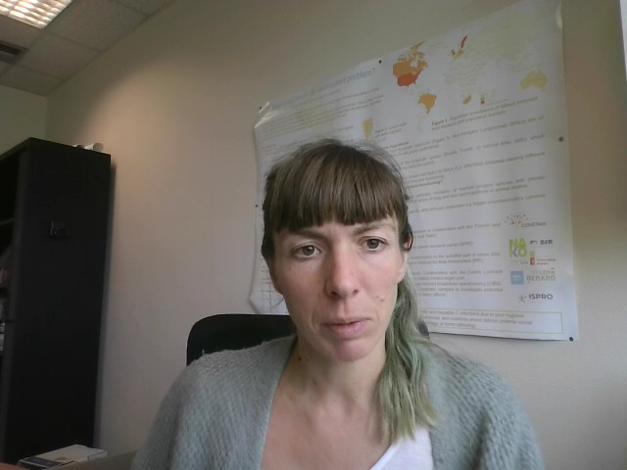
Treatment profile
N = 1716 women diagnosed with non-metastatic breast cancer
Median FUP time: 5.2 years
Multimodality treatment initiation (at least surgery and systemic therapy): 88% in Namibian non-black women vs 41% in Nigeria
68% (1163/1716) women underwent breast cancer surgery, many of them were diagnosed in early stages
Of 1530 patients requiring chemotherapy, 66% (n=1013) initiated treatment of neoadjuvant chemotherapy or surgery within 3 months after baseline,
  Of these:
  35% (359/1013) adequately completed therapy
  28% (284/1013) marginally completed
  20% (200/1013) abandoned
  15% completion unknown
Improved access to potentially curative guideline concordant breast cancer treatment and its completion is needed to prevent premature breast cancer deaths in Sub-Saharan Africa.
  Foerster et al (2022), The Lancet Oncology , Vol 23 (6), 729-738

