Slide 1
The Latin American and the Caribbean Code Against Cancer in the World Code Against Cancer Framework
SC/59 - Flash talk videos
Carolina Espina, PhD/MPH

Slide 2
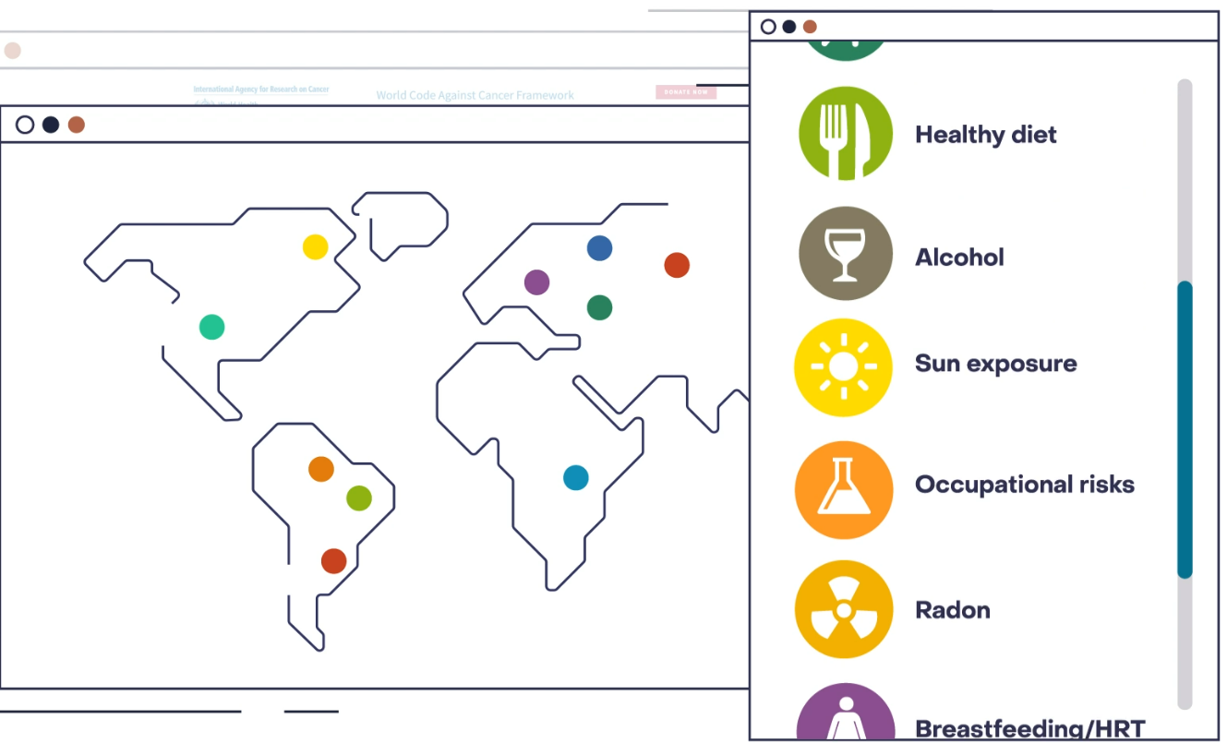
World Code against Cancer Framework
Notes:
In early 2022, IARC launched the World Code Against Cancer Framework, a multi-stakeholder initiative to develop and disseminate Regional Codes Against Cancer to promote cancer prevention globally.
Its aim is transforming the knowledge from cancer research into actionable information and evidence base for cancer prevention
The Framework provides an umbrella strategy, based on a common and rigorous methodology, to develop region-specific cancer prevention recommendations while maintaining the coherence of the different Regional Codes.
Each Regional Code will be developed independently and will be based on reviewing and summarizing the latest scientific evidence on risk factors and cost-effective interventions
The framework has taken the model of the 4th edition of the European Code against Cancer and it is currently being applied to the Latin America and the Caribbean
In addition, we are now in conversations with Asian countries and the Gulf Region to further expand the Code to those regions of the world.

Slide 3
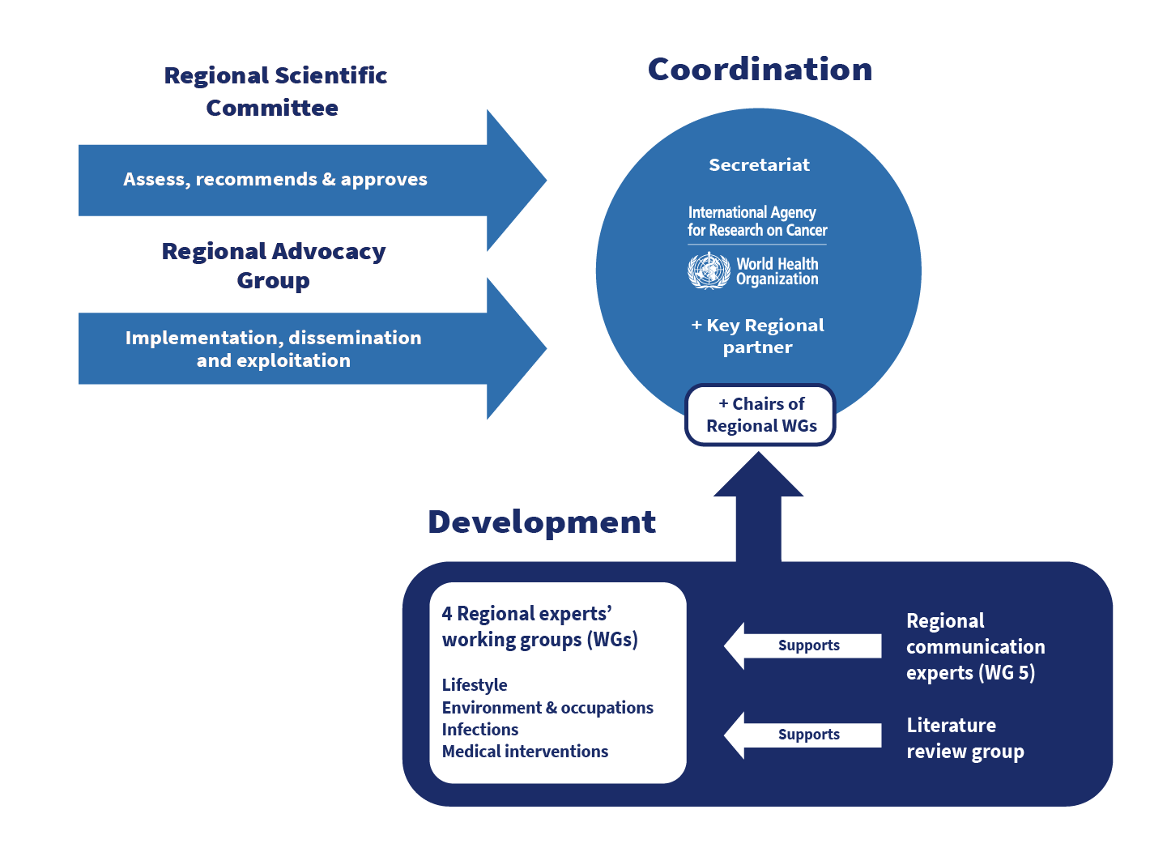
Framework
Governance
Notes:
Each Regional Code will consist in a set of cancer prevention recommendations, suited to the epidemiological, socio-economic, cultural and health systems conditions.
It will be adapted to different audiences, focusing on the individual, but also specifically targeting frontline health professionals and policy-makers, since the Codes will include recommendations on polices and capacity building for primary care professionals.
A large number of independent experts from the region are carefully selected, with expertise in epidemiology, public health, policies and communication, who will propose the recommendations following a rigorous methodological process; and a regional Scientific Committee, who oversees the process, will revise and eventually approve the recommendations
Advocates and disseminators from the region will be instrumental in the implementation of the corresponding Regional Code in their respective countries.
Each WG will propose recommendations following a rigorous methodological process, supported by experts in systematic literature reviews for updating the evidence.
And by a communication working group with expertise in psychology, health promotion and behavioural change, that advises on the communication aspects of each recommendation and their coherence as a set.
A regional Scientific Committee assess and approves the recommendations, and an advocacy group will promote and disseminate the Regional Code in the respective countries.

Slide 4
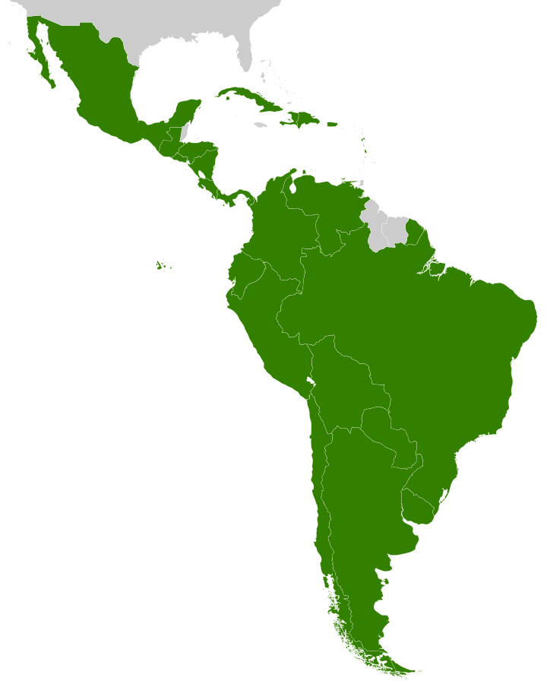
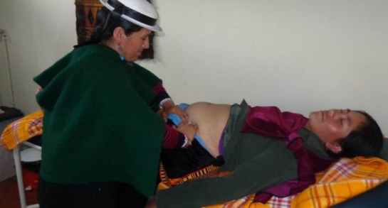
The Latin American and the Caribbean Code Against Cancer
The first regional adaptation of the European Code Against Cancer, under the umbrella of the World Code Against Cancer Framework
Highest rates of gallbladder cancer in the world; stomach cancer
Environmental & occupational risks (pesticides, mining, etc.)
Millions exposed to indoor air pollution
Notes:
Some risk factors are common worldwide, however, other are specific of certain areas.
For example, important exposures to certain environmental and occupational risks occur in Latin America, or certain infections, such as from Helicobacter pylori, are quite prevalent
But also, and more importantly, differences in socio-economic and cultural factors, and unequal access to health programmes, need to be taken into account when recommending preventive effective cancer prevention interventions.

Slide 5
Methodology: process
WG1) Lifestyle
- Tobacco
- Alcohol
- Diet & non-alcoholic drinks
- Obesity & overweight
- Physical activity
- Hormonal factors (i.e., breastfeeding)
WG2) Environmental risks
- Air, water &soil
- Food contaminants
Radiation (UV exposure & medical raditions)
Occupational
“Top-down” strategy
- Evaluation of the messages by communication experts
- Testing of the messages (pilot study in several countries)
Code
Against
Cancer
- Evidence evaluation by regional experts
- Literature reviews
- Consensus
WG3) Infections
- Vaccination
- Intervention infectious agents (i.e., H. Pylory, HIV)
WG4) Medical interventions
- Screening
- Drugs (hormonal treatments, chemoprevention)
WG5) Comunication & education
- Messages WGs 1-4
- Pilot study testing messages in the population
Universal evidence-based cancer prevention messages (“toolbox”):
Local adaptations [implementation research]
Influence on cancer policies in the long-run
Notes:
More than 60 experts across the region are currently involved in the development, implementation, and dissemination of the first Code for Latin America and the Caribbean, which is expected to be launched in early 2023.
A pilot in the general population of the region is testing the communication aspects of the draft recommendations

Slide 6
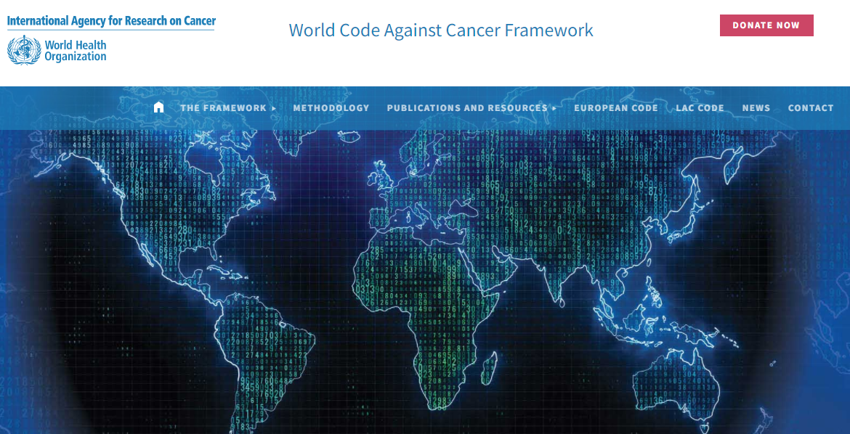
Take-home message
The Codes against Cancer translates the latest science on risk factors and preventive interventions into straightforward recommendations for people to follow
Regional Codes comprise the priorities for a region, such as in Latin America and the Caribbean, and recommendations that are feasible and implementable
Future Regional Codes should enable governments to provide and commit to the recommendations while empowering the individual to subscribe to them
Regional multi-stakeholder alliances and networks are key to support Ministries of Health in the implementation of cancer prevention recommendations
By following the Code’s recommendations, lower risk of developing cancer can be guaranteed!
Notes:
The Codes against Cancer translate the latest science on risk factors and preventive interventions into straightforward recommendations for people to follow
Regional Codes comprise the priorities for a region and recommendations that are feasible and implementable
Future Regional Codes should enable governments to provide and commit to the recommendations while empowering the individual to subscribe to them
Regional multi-stakeholder alliances and networks are key to support Ministries of Health in the implementation
By following the Code’s recommendations, lower risk of developing cancer can be guaranteed!

