Slide 1
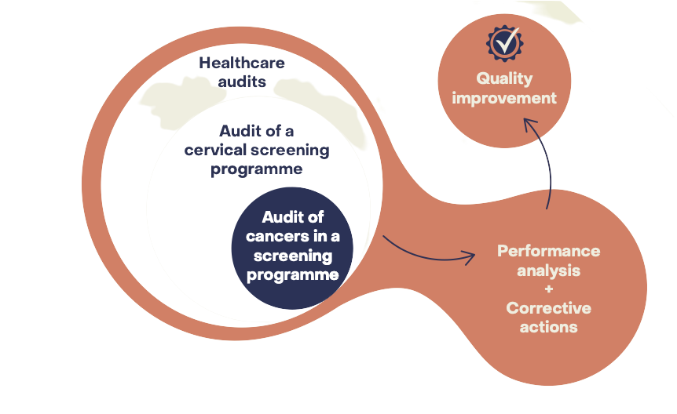
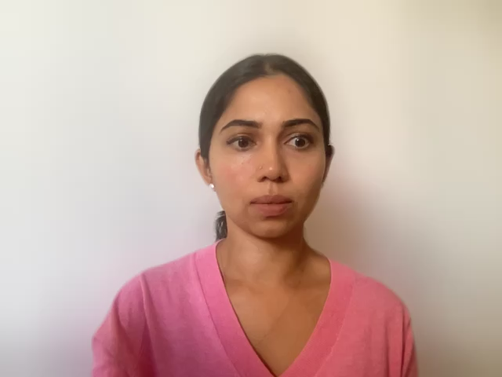
CervScreen Project
Audit of Cancers
Arunah Chandran
Early Detection, Prevention and Infections Branch

Slide 2



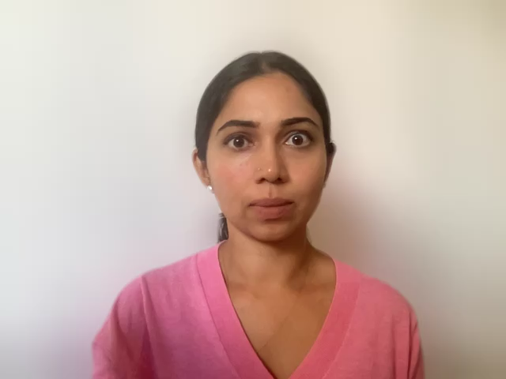
CervScreen project
Objective:
  to identify current global best practices for cancer audit, communication and legal and ethical framework for cervical screening programme
  Methodology:
  scoping reviews
  followed by a consensus of key questions addressed in a series of three technical working groups
2
Notes:
Essentially, CervScreen aims to support Ireland in delivering an exemplar Cervical Cancer Screening Programme for their population and to identify global best practices for audit, communication and legal framework for cervical screening programme.

Slide 3
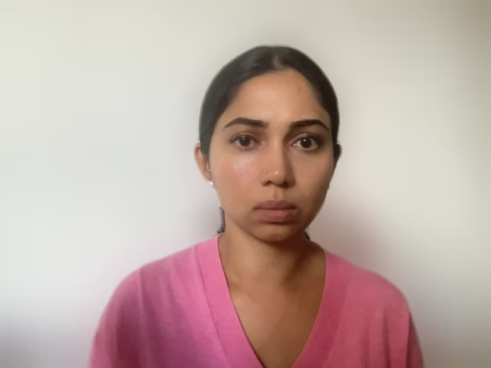
Key Findings
3

Slide 4
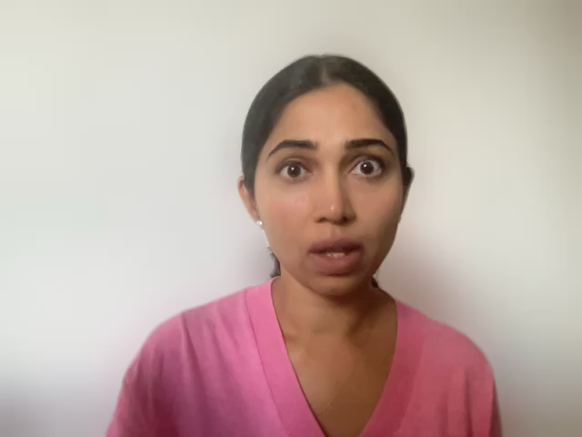
What is the difference between audit of cancers and individual case review?
Cancer Audit | Individual Case Review
Core objective of evaluating the system to find opportunities for improvement | Core objective is to investigate and evaluate what happened to a particular patient
Audit looks at the system as a whole although that may entail reviewing individual patient data in some detail. | A programme may offer personalised case review to any woman who develops cancer and requests such a review.
The results of cancer audit should not appear in the woman’s medical record; disclosure is optional | For individual reviews, a woman’s consent is needed; and the results should be disclosed to her.
4

Slide 5
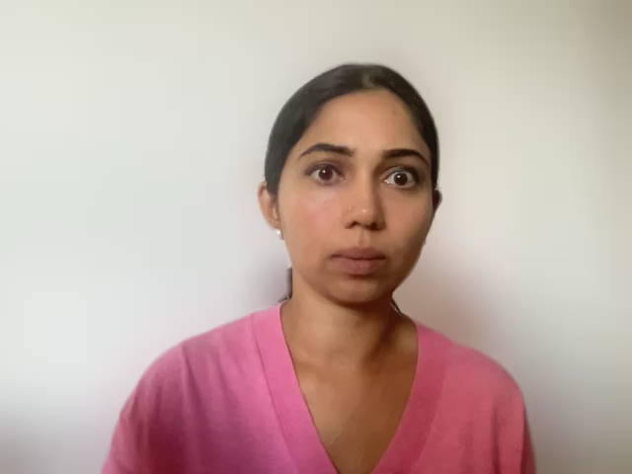
Why is consent important in screening and how to obtain consent?
Consent in Screening
Opt-out
Opt-in
In an opt-out model, an agreement with recording of data is assumed unless the individual objects against actively against registration of their data.
In an opt-in model, personal medical data can be recorded if the informed person agrees and signs a paper or electronic document.
The information on what the patients’ consent to when they are participating in a screening programme should be provided before screening. For eg, how their data can be used and possibly reused
5

Slide 6





How to communicate with different stakeholders in a screening programme?
High Power, Low Interest | High Power, High Interest
Low Power, Low Interest | Low Power, High Interest
Stakeholder Mapping
Stakeholder Analysis
Develop stakeholder engagement strategy
Communication and engagement
Monitoring and re-evaluation of communications strategy
Power of Stakeholders
Stakeholder Mapping
Interest of Stakeholders
Stakeholder Analysis
Using community juries to support decisions on screening
Community or citizens’ juries and other forms of deliberative democracy can support policy decisions by gathering informed public responses about disputed issues in public policy, such as the values and trade-offs involved in decisions about screening programmes
6

Slide 7

How to communicate in a screening crisis?
Preparedness Phase
Create Stakeholder
Network
Establish Coordination
Mechanism
Create a crisis plan
Monitor public opinion
Prepare messages
Communicate with the public
Response
Phase
Coordinate and engage
Design Communication Response
Implement crisis plan
Monitor public opinion and media
Inform the public
Evaluation Phase
Conduct a review
Share lessons learned
Revise crisis communication based on lessons learned
7

Slide 8

Final Takeaway
While we discussed many pertinent issues regarding cervical cancer audits, legal and ethical framework and communication in screening, there are still many unresolved issues surrounding these areas.
Legal and ethical framework is very country-specific, difficult to come out with general consensus for screening programmes.
Our findings are mostly related to organized programmes. There is a need to think about the applicability of these best practices to LMICs.
8

