Slide 1
Branch of Epigenomics & Mechanisms (EGM) Introduction to e-Posters
Zdenko HERCEG, PhD
Head, Branch of Epigenomics and Mechanisms
IARC Scientific Council SC/60 Session
IARC, 7 February 2024

Slide 2
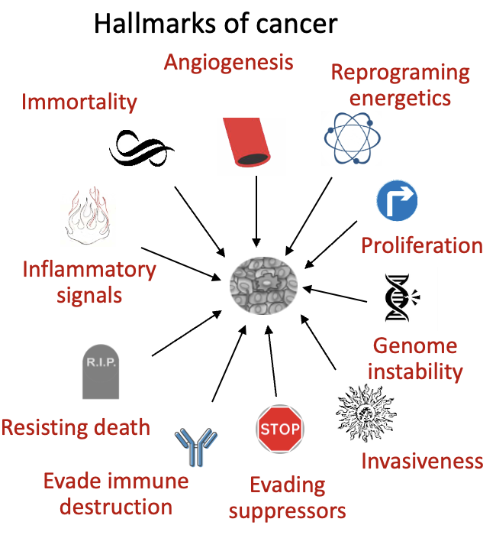
Vision
Exposures
Timing
Responses
Consequences
Outcome
External exposures
Smoking
Air Pollution
Nutrition
- Biol. Agents
- Endocrine disrupt.
In utero life
Epigenome
Birth
Cancer
Childhood
Genome
Endog. processes
- Hormones
- Microbiome
- Metabolome
Aging…
Causality
Adulthood
Epigenetic changes as “sensors” of exposure & “mediators” of outcomes
Identifying causal pathways linking environ. exposures to cancer (biological plausibility)

Slide 3
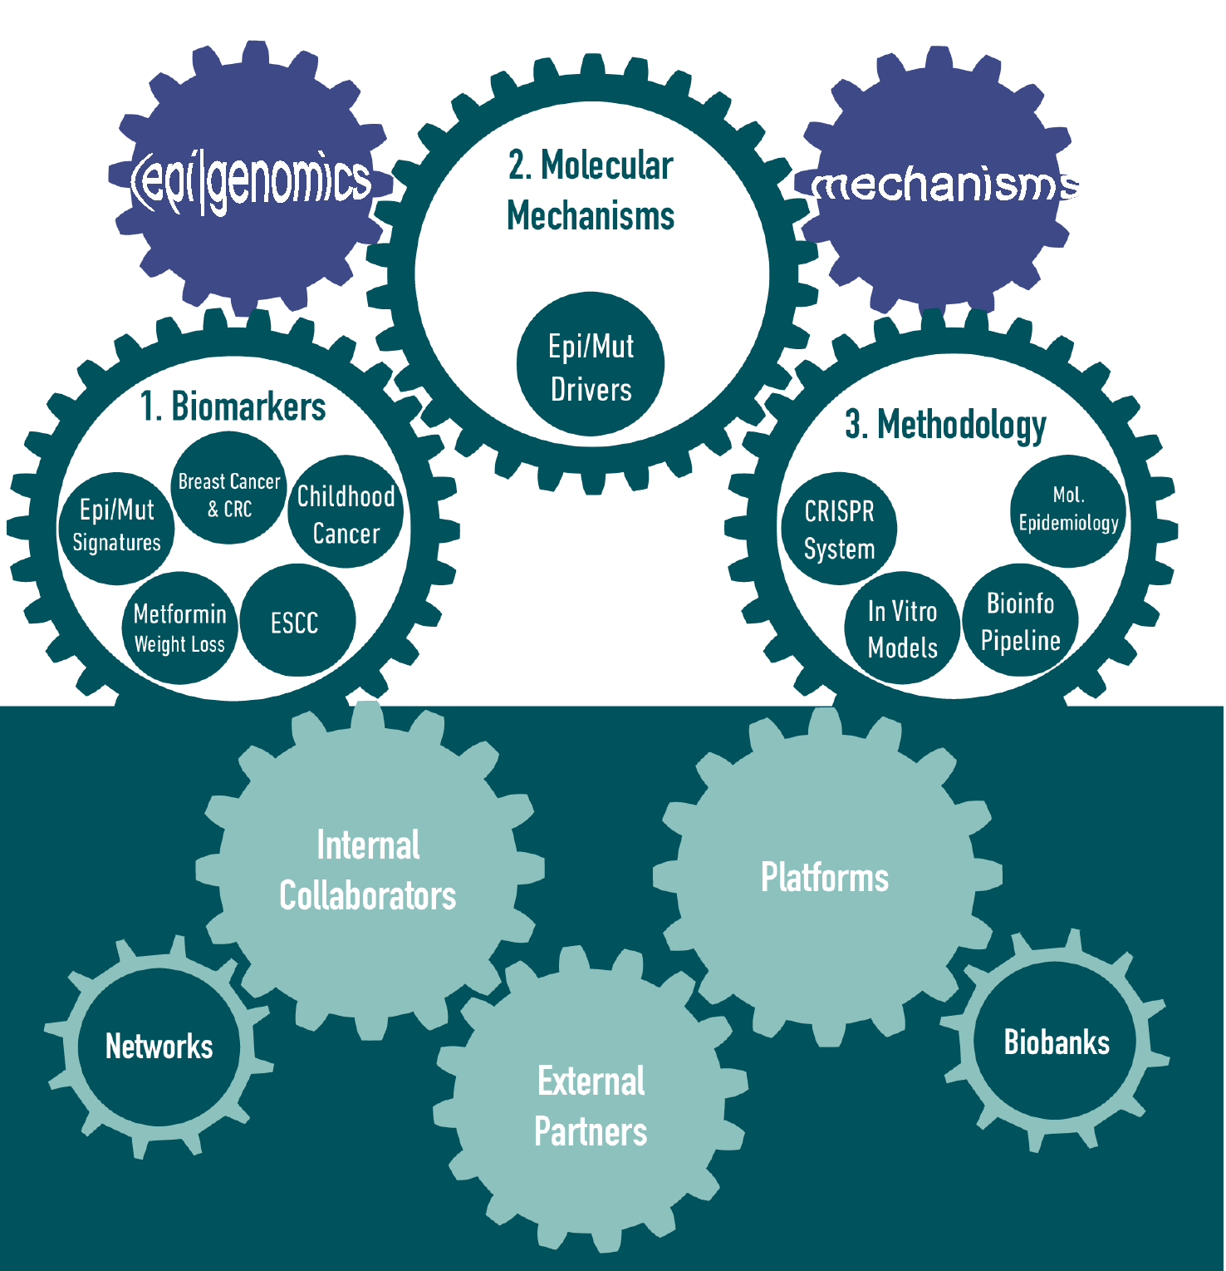
Principal aims, resources and collaborators of EGM
Interdisciplinarity
Synergy
Added value
Principal aims:
Identify signatures of exposure to environmental exposures and biomarkers of cancer risk
Identify causal pathways linking environmental/lifestyle exposures to tumorigenesis underlying the associations observed in epidemiological studies (reinforce biological plausibility)
Develop (epi)genomic methodologies and profiling strategies & tools applicable to biobanks and population-based studies (relevant, but not exclusive, to LMICs)

Slide 4
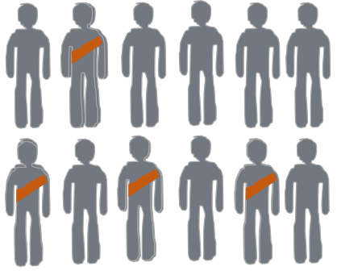
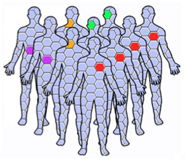
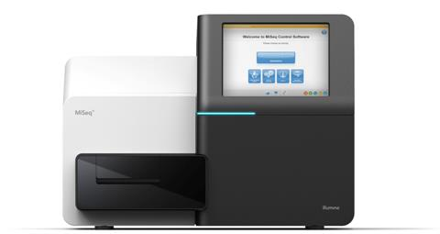
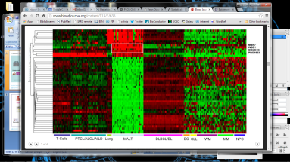
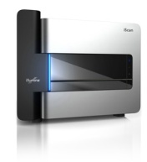
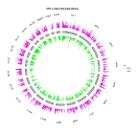
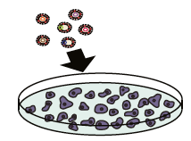
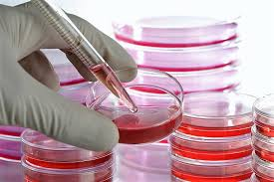
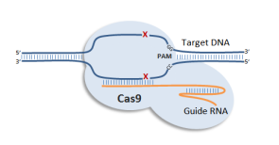
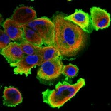
Research strategy
Epidemiol/Mol. Epi. associations
Validation
Biological plausibility
Biomarkers
Outcome
Advance understanding causes of cancer
Reinforce causal inferences and biological plausibility
Biomarkers of exposures and cancer risk
Support carcinogen evaluation programme
Training cancer researchers (incl. LMICs)
Population-based cohorts
Intervention studies
(Epi)genome profiling
Murine models
Functional screens
Mechanistic assays
Data repositories
Cell systems
TCGA

Slide 5
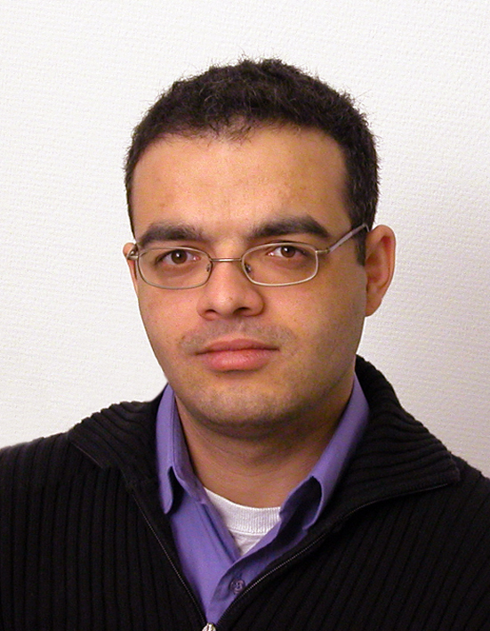
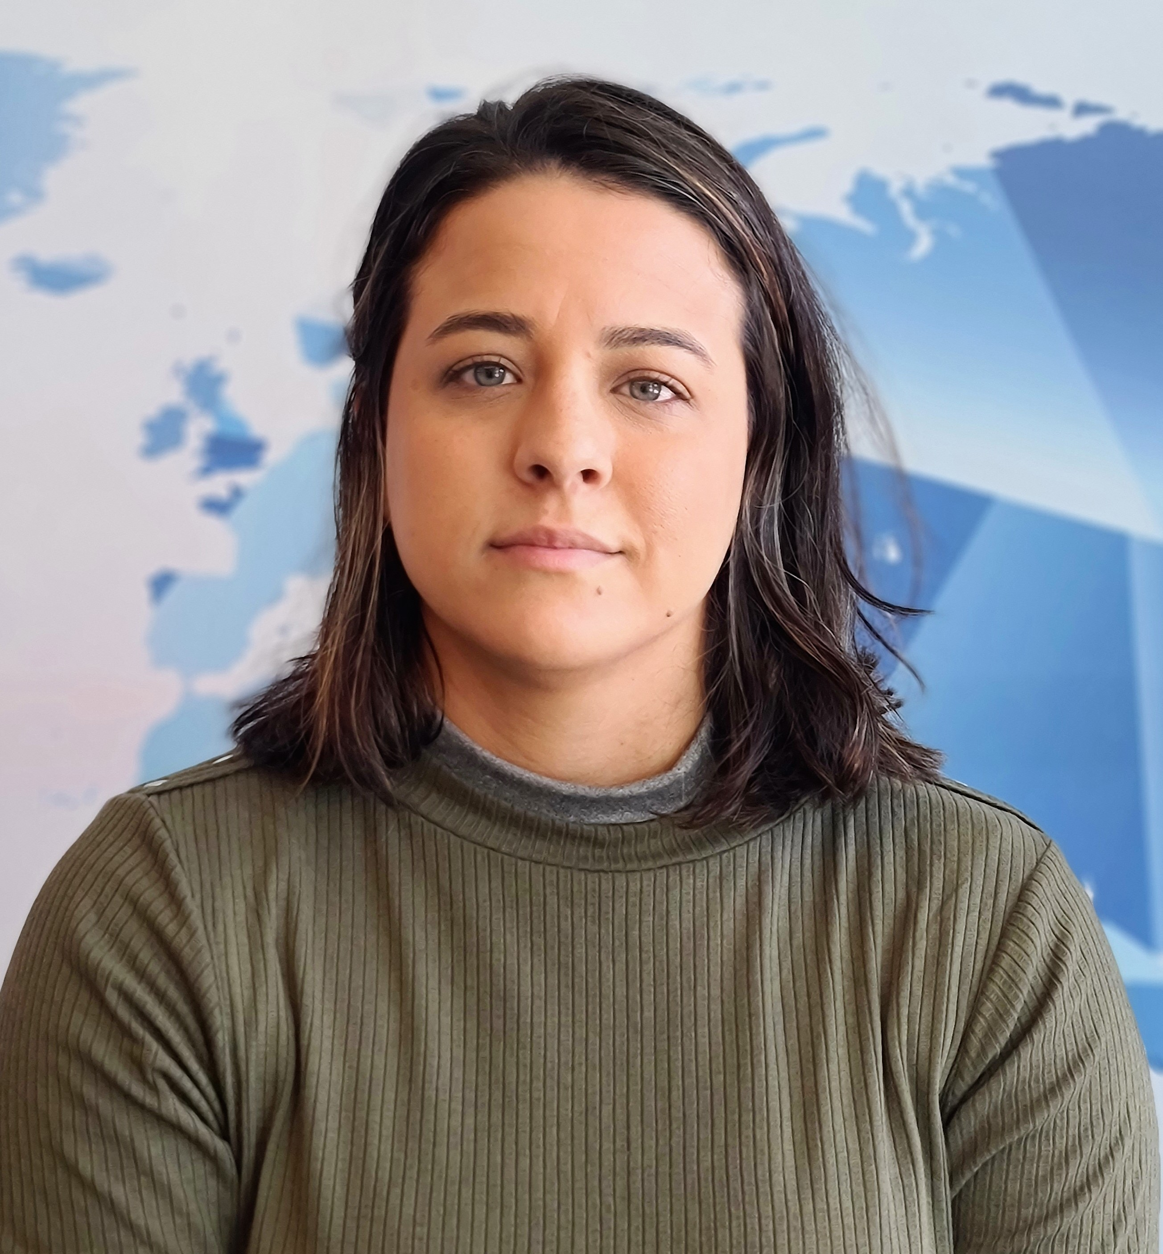
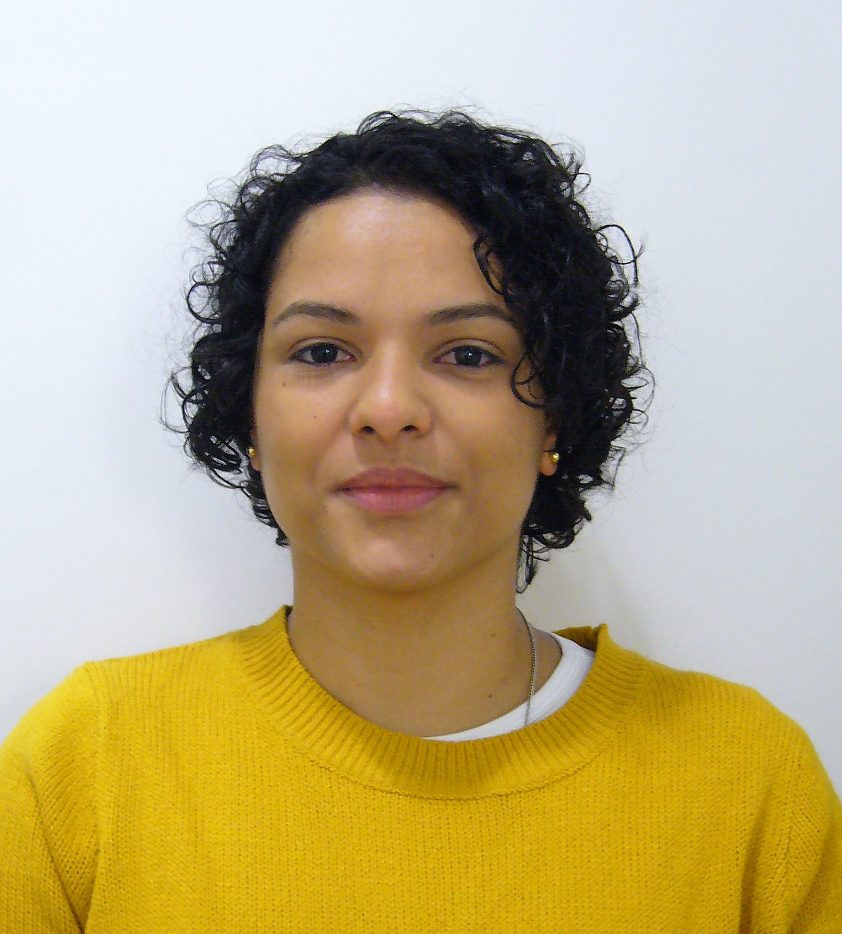
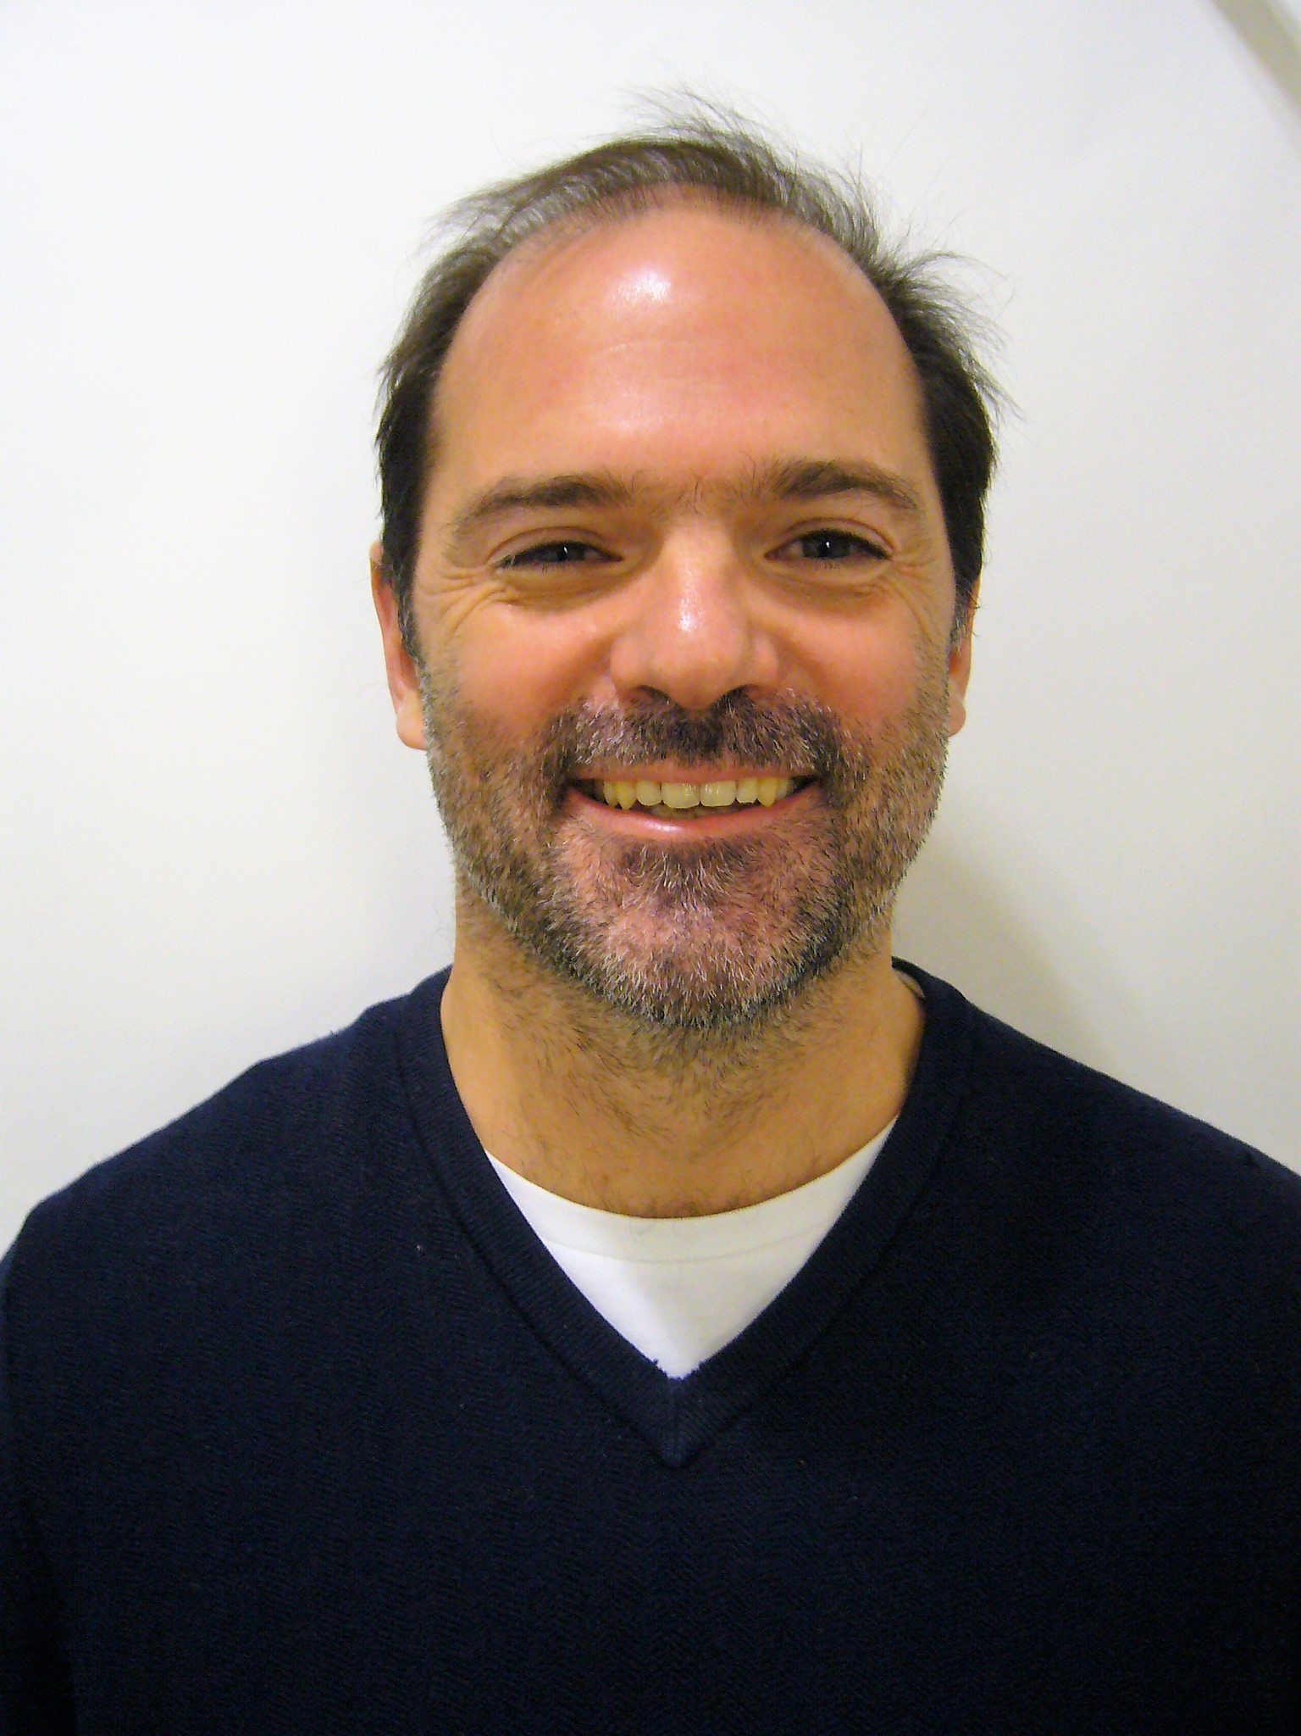
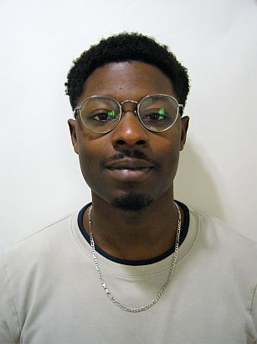
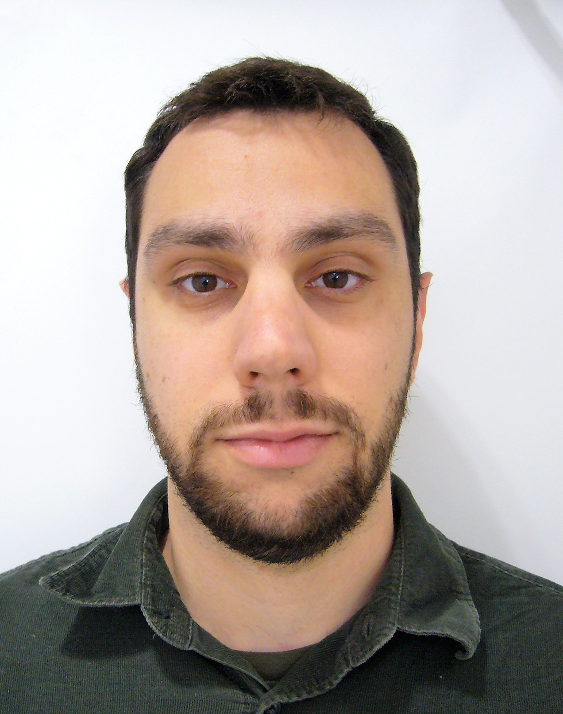
EGM Branch - personnel and structure
EGM Branch Head
Zdenko Herceg
EGM Branch Deputy Head
Jiri Zavadil
Secretary
Elizabeth Page
Scientist
Tarik Gheit
Secretary
Nicole Suty
Postdoc
Caroline de Aguiar Pires Poubel
Natalia Spitz Toledo Dias
Scientist
Michael Korenjak
Research Assistant
Sandrine Chopin
Postdoc
Samrat Das
Grace Odongo
Bioinformatician
Claire Renard
Doctoral student
Zhiyuan Fan (1 Nov 23)
Research Assistant
Cécilia Sirand
Scientist
Akram Ghantous
Scientist
Rita Khoueiry
Visiting Scientist
François Virard
Postdoc
Julia Bruno
Consultant
Assunta Venuti
Research Assistant
Aurélie Salle
Bioinformatician
Vincent Cahais
Consultant
Stéphane Keita
Doctoral student
Bérénice Chavanel
Foster Jacobs (2 Nov 23)
Doctoral students
Mariana Araujo
Thanos M. Michailidis (1 Nov 23)
Alessia Fiore (Nov 23)
Research Assistant
Cyrille Cuenin
Laboratory research
Postdoc
Farah Nassar
Bioinformatics / Biostatistics
Administrative support
November 2023

Slide 6
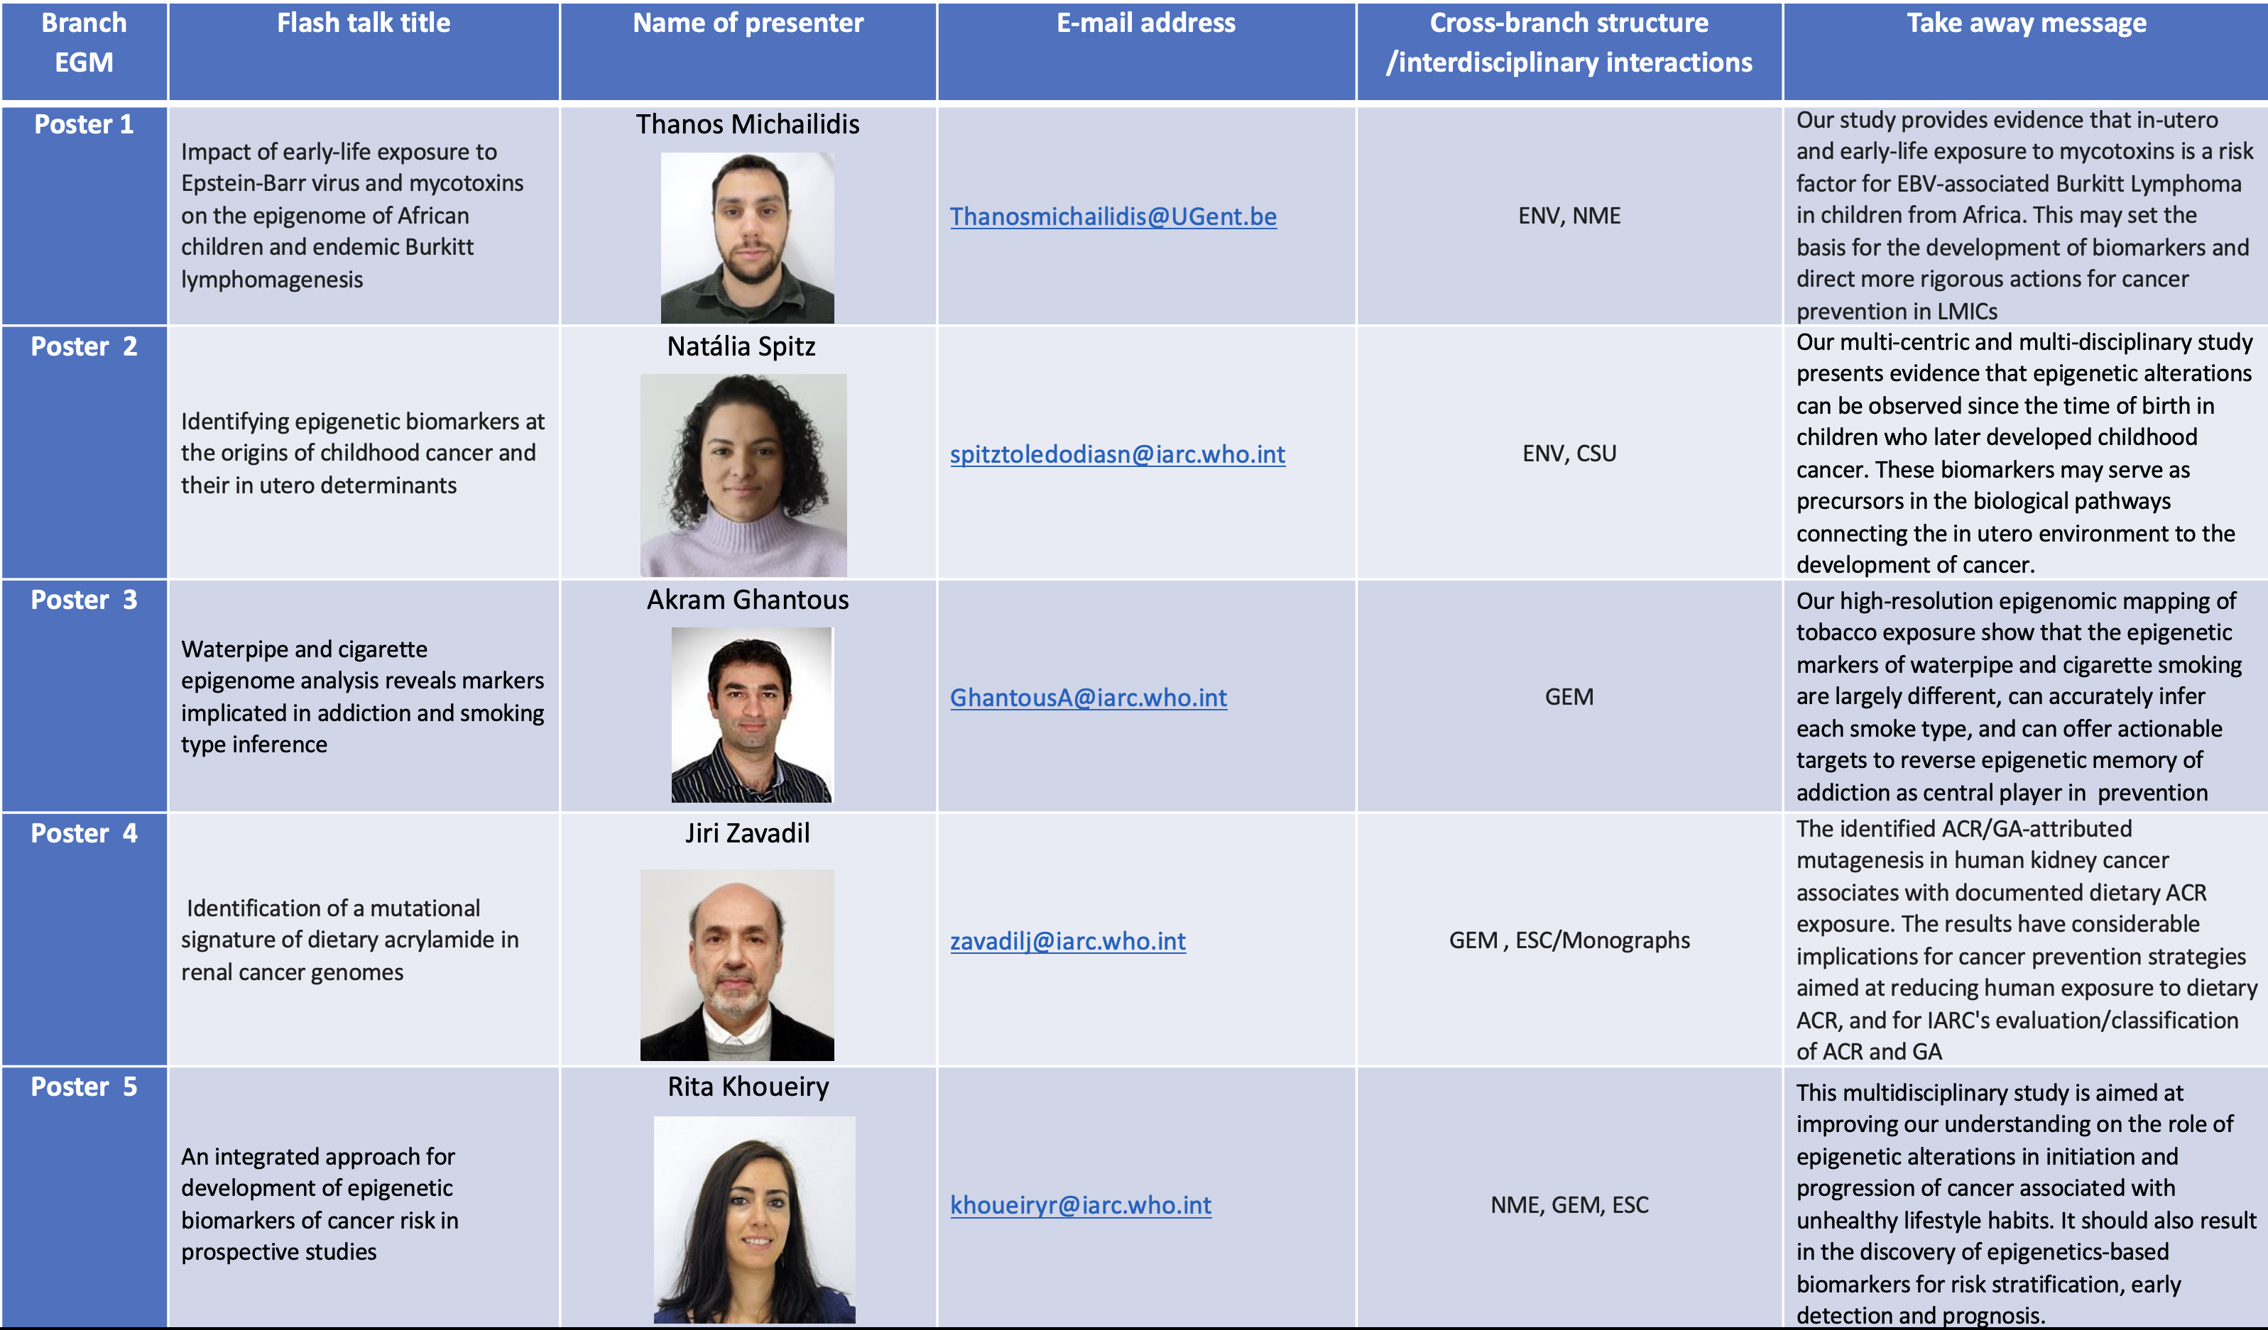
EGM Posters

Slide 7
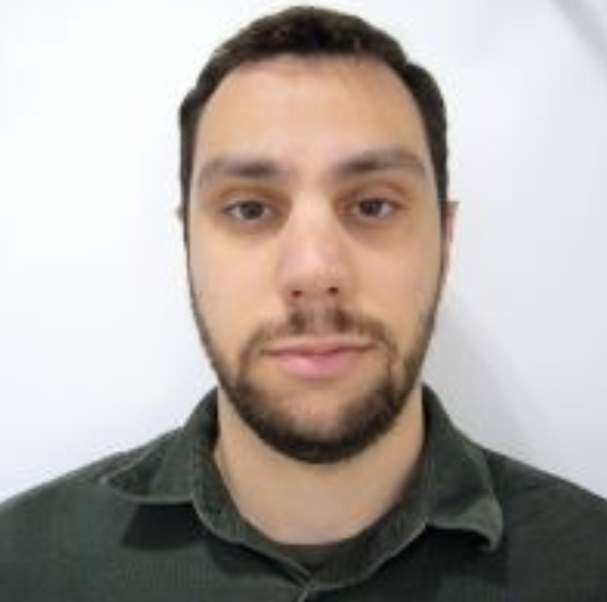
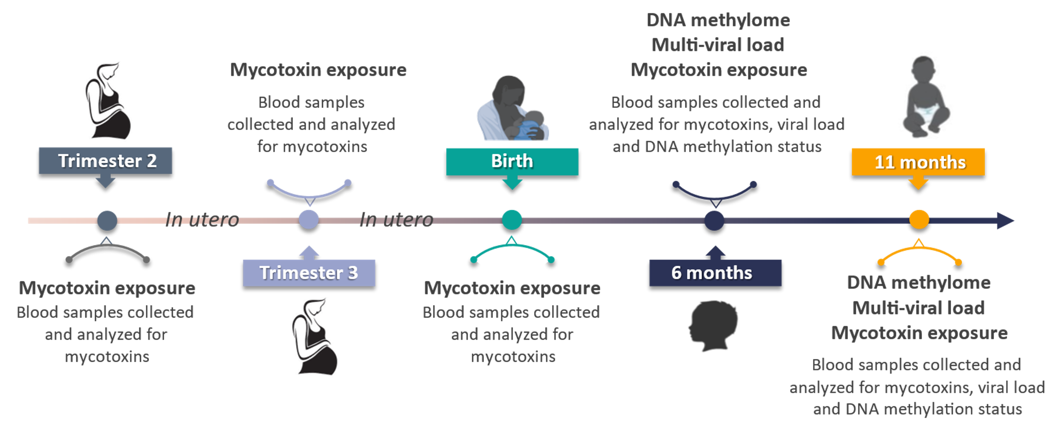
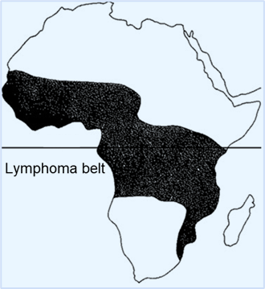
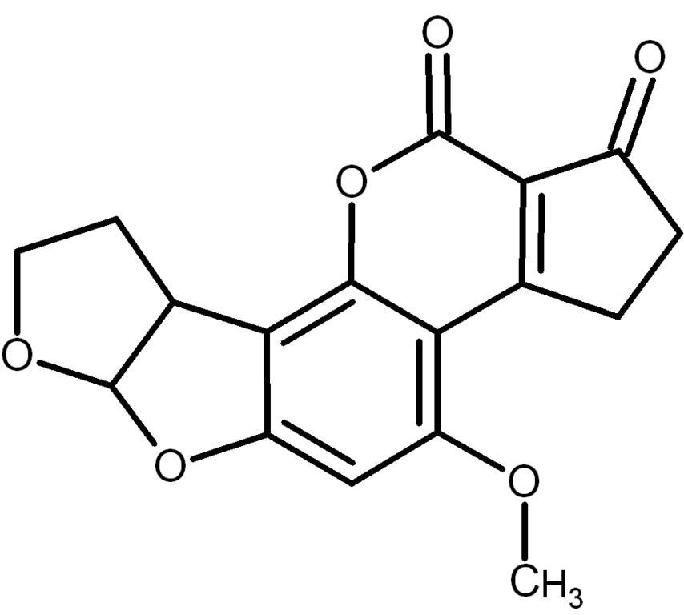
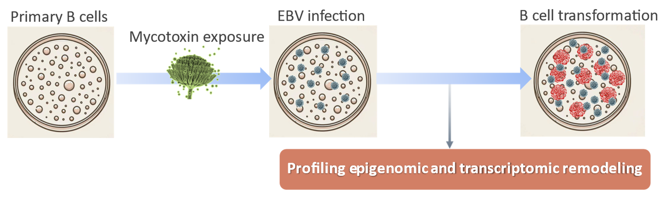
e-Poster #1 Early-life exposure to EBV and mycotoxins on epigenome and Burkitt Lymphome in African children
Cohort Study
Burkitt Lymphoma
Mycotoxins
Infectious
agents
Thanos Michailidis
Epigenetics
Subsaharan africa
In-Vitro Study
Outcomes
Identification of risk factors of endemic Burkitt Lymphoma
Mechanisms of carcinogenesis
Biomarkers of exposures
Basis for prevention studies
Maroui, Odongo et al 2023 PNAS in revision
Notes:
.

Slide 8
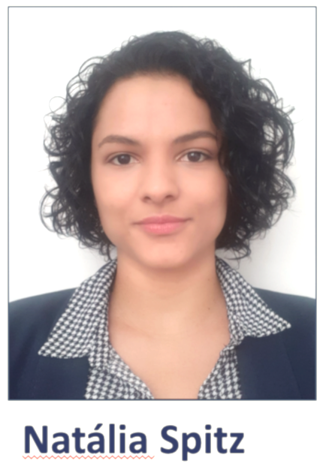
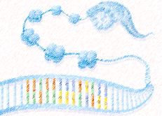
e-Poster #2 Epigenetic biomarkers at the origins of childhood cancer risk
Specific External Exposures
Infections (overall and EBV); Tobacco smoking; Air pollution; UV; Aflatoxin; Pesticides
General External Exposures
Socio-economic status; Season of birth; Parental Body-Mass-Index
Intermediate Phenotypes
Endpoints
Birthweight
Leukemia & Burkitt’s Lymphoma
Exposures &
Outcomes
Head Circumference
CNS Tumors
Nevous Counts
Melanoma
Body Mass Index
Overall cancers
Time
points
In utero life
Birth
Childhood
Adolescence
Adulthood
Blood Biomarkers & Precursor Mechanisms
Internal Exposome
DNA Methylome
Transcriptome
Metabolome
Exposure timing is crucial
MoBa-Norway
Blood at birth 79Cs+184 Ct
DNBC-Denmark
Blood at birth 94Cs+240 Ct
CCLS-USA
Blood at birth 222CL+227 Ct
MCRI-Australia
Blood at birth 120CNS+120 Ct
Future studies: ELFE, NBS Brazil, Denmark, Norway, France, POEM
Population-based cohorts: PACE, EXPOsOMICS
Bio-
Resources

Slide 9
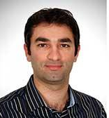
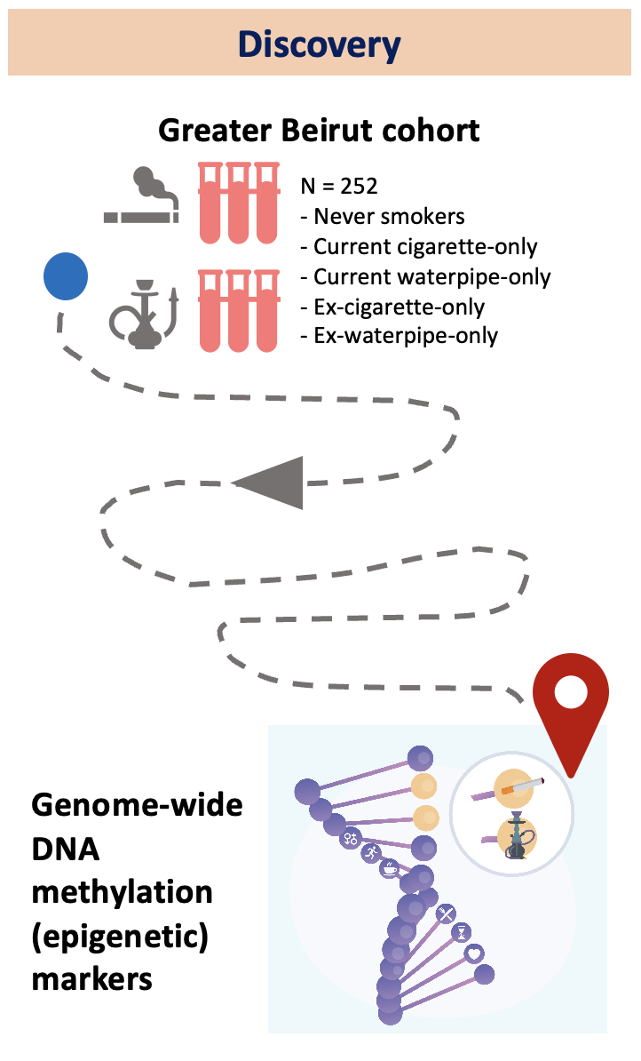
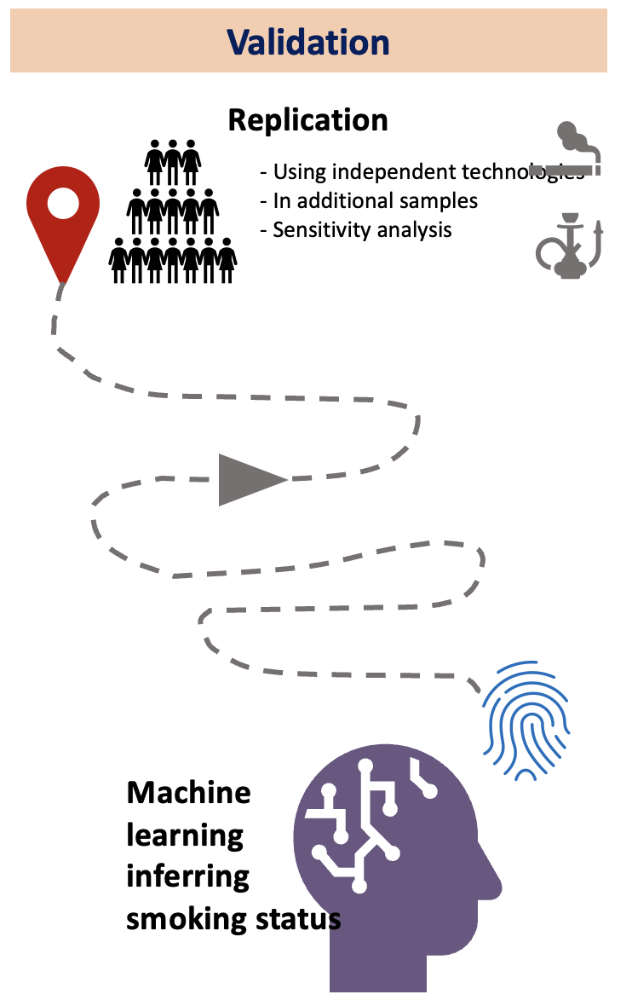
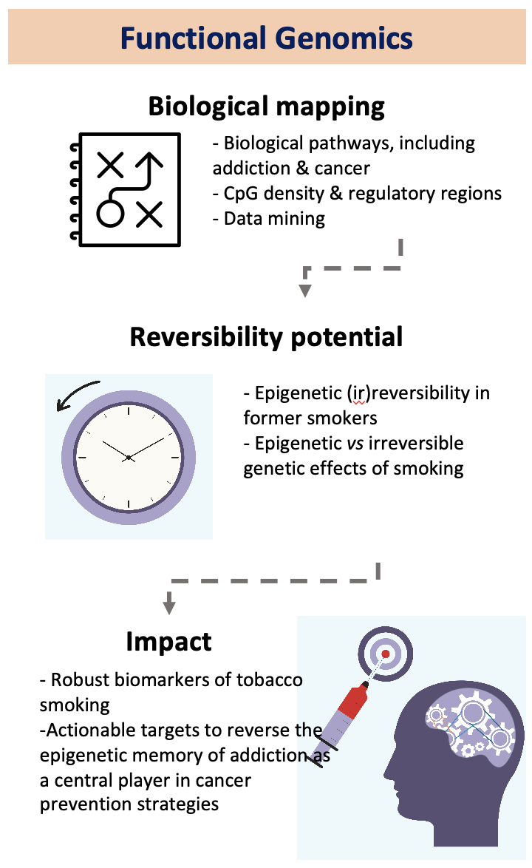
e-Poster #3 Waterpipe and cigarette epigenome analysis reveals markers implicated in addiction and smoking type inference
Akram Ghantous

Slide 10
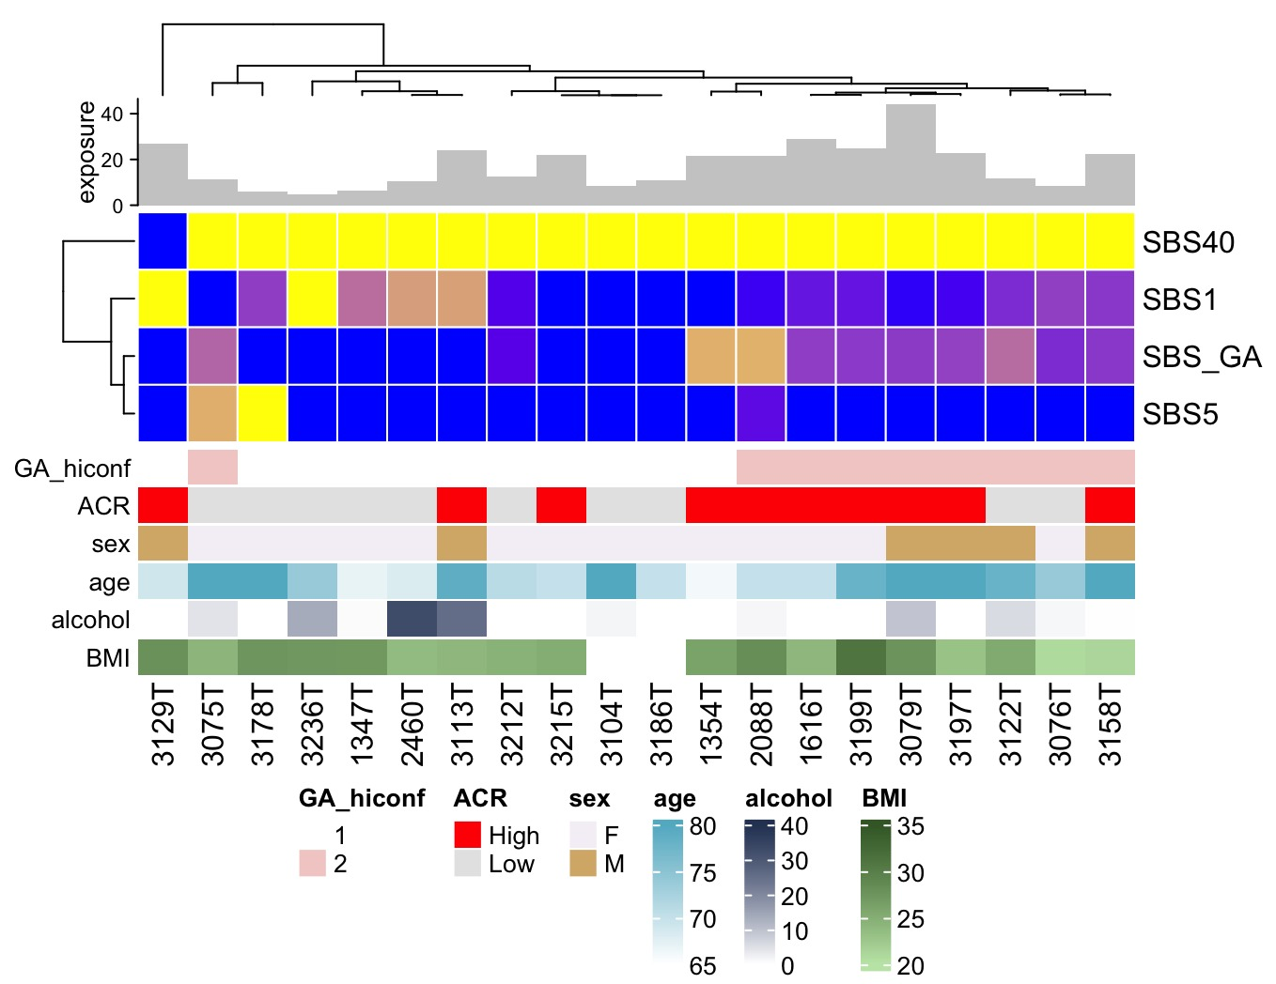
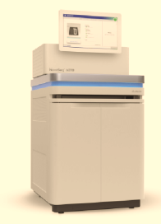
Poster #4 Identification of a mutational signature of dietary acrylamide in renal cancer genomes
Mutational signature of glycidamide, a metabolite of acrylamide forming in heated starchy foods
Acrylamide
Glycidamide
Metabolism
Jiri Zavadil
Molecular cancer epidemiology - dietary acrylamide exposure and renal cancer
Renal cancers from the prospective Dutch NLCS Study
FFPE WGS
Mutational signature refitting
First-of-its-kind findings of acrylamide mutagenesis in exposed humans
Likely to support future IARC Monographs evaluation of both agents

Slide 11
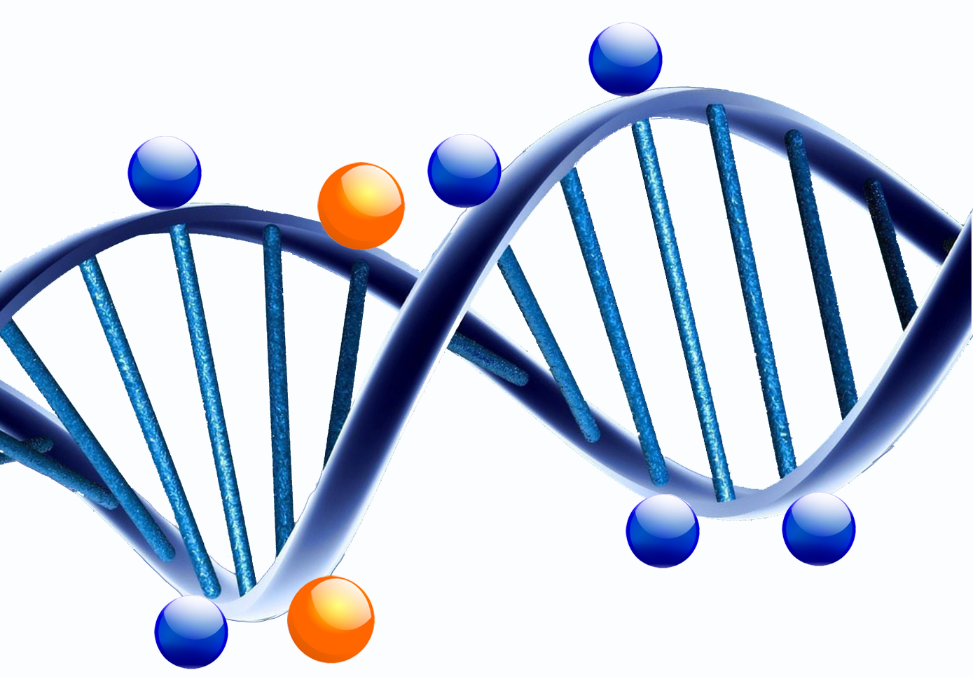
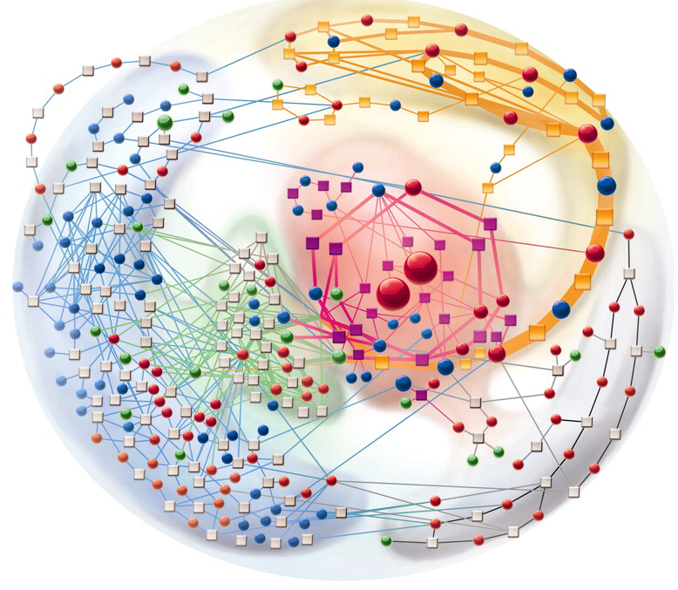
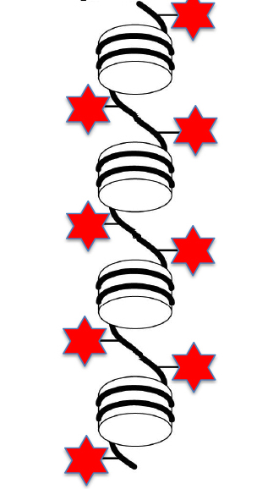
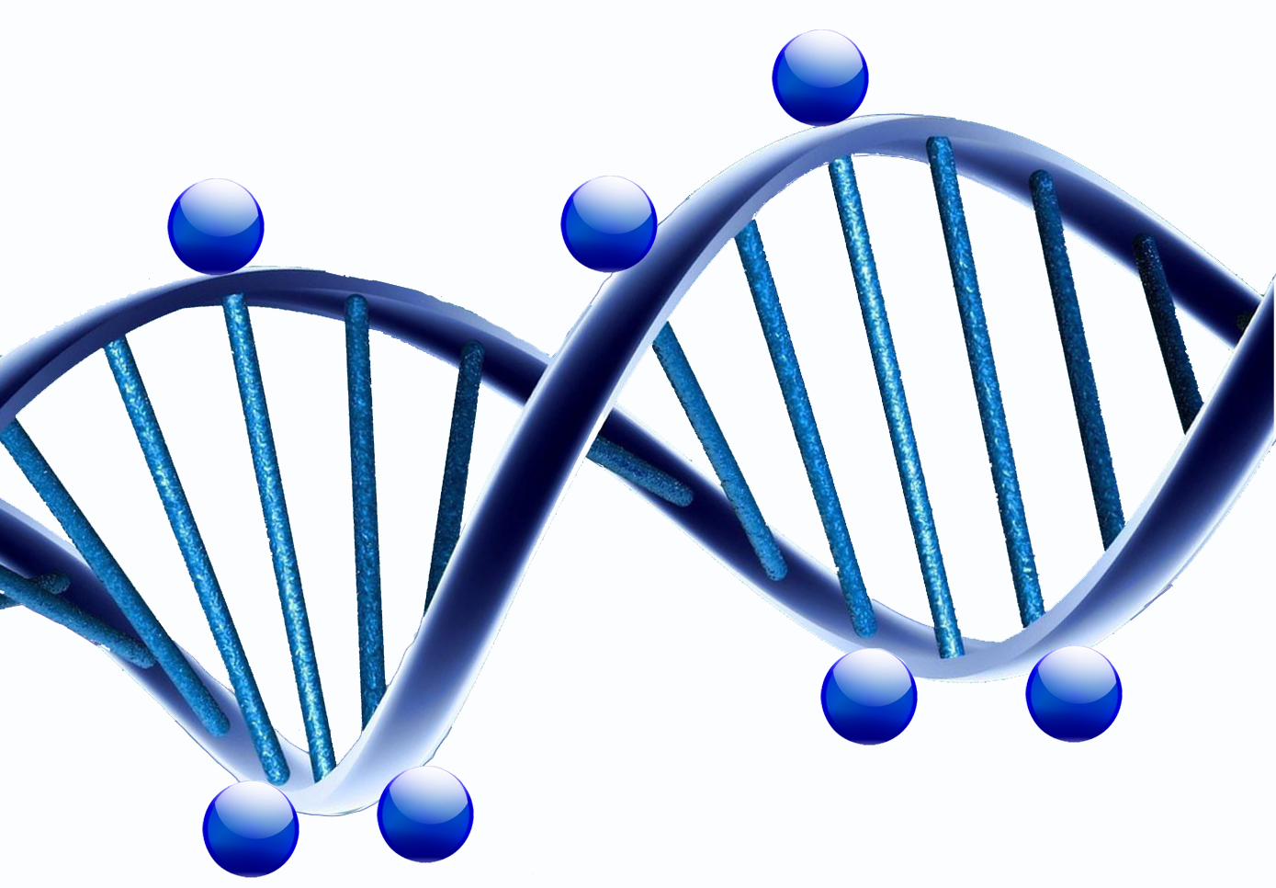
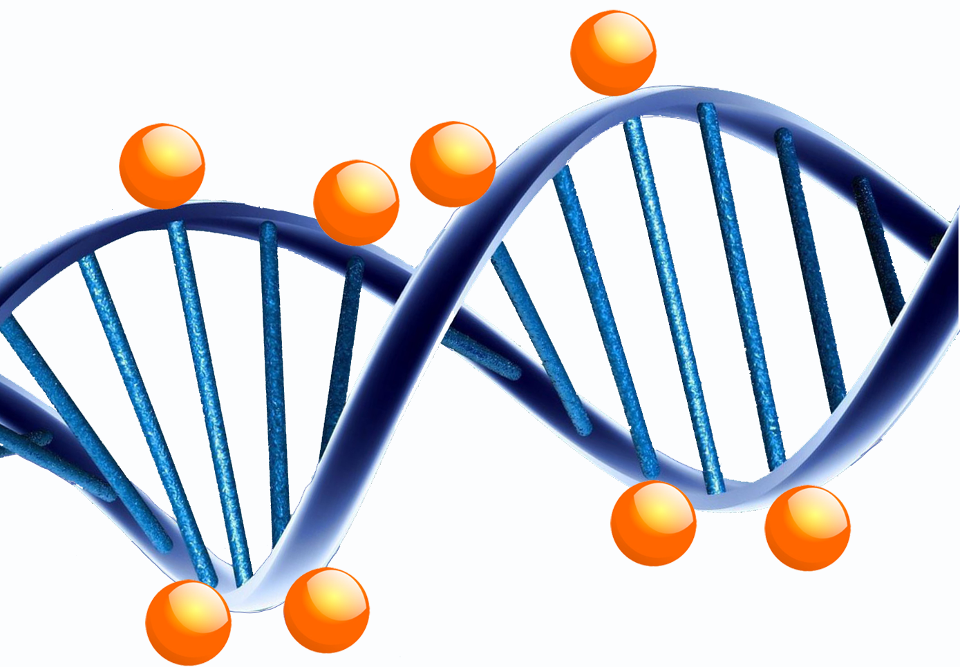
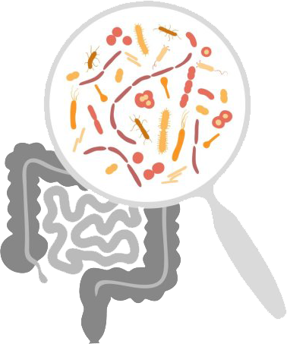
Poster #5 Development of epigenetic biomarkers of cancer risk in prospective studies – an integrated approach
Interventions (Epigenetic reversibility)
Normal weight
Unhealthy diet/lifestyle
Epigenome
Cure
Rita Khoueiry
Normal
Metabolome
Metabolic disorder
Therapy
Epigenome
Altered Epigenome
Cancer
Altered Epigenome
Recurence
Microbiome
Cohorts/biobanks: Prospective, retrospective, screening, interventions
OMICs: Methylome, transcriptome, metabolome, microbiome
Bioinformatics/statistics: Mediation anal., cross-OMICS, causal pathways
Understand role of epigenetics in initiation/progression
Epigenetic markers of cancer risk
Epigenetic markers of early detection
Epigenetic markers of prognosis and outcome

Slide 12
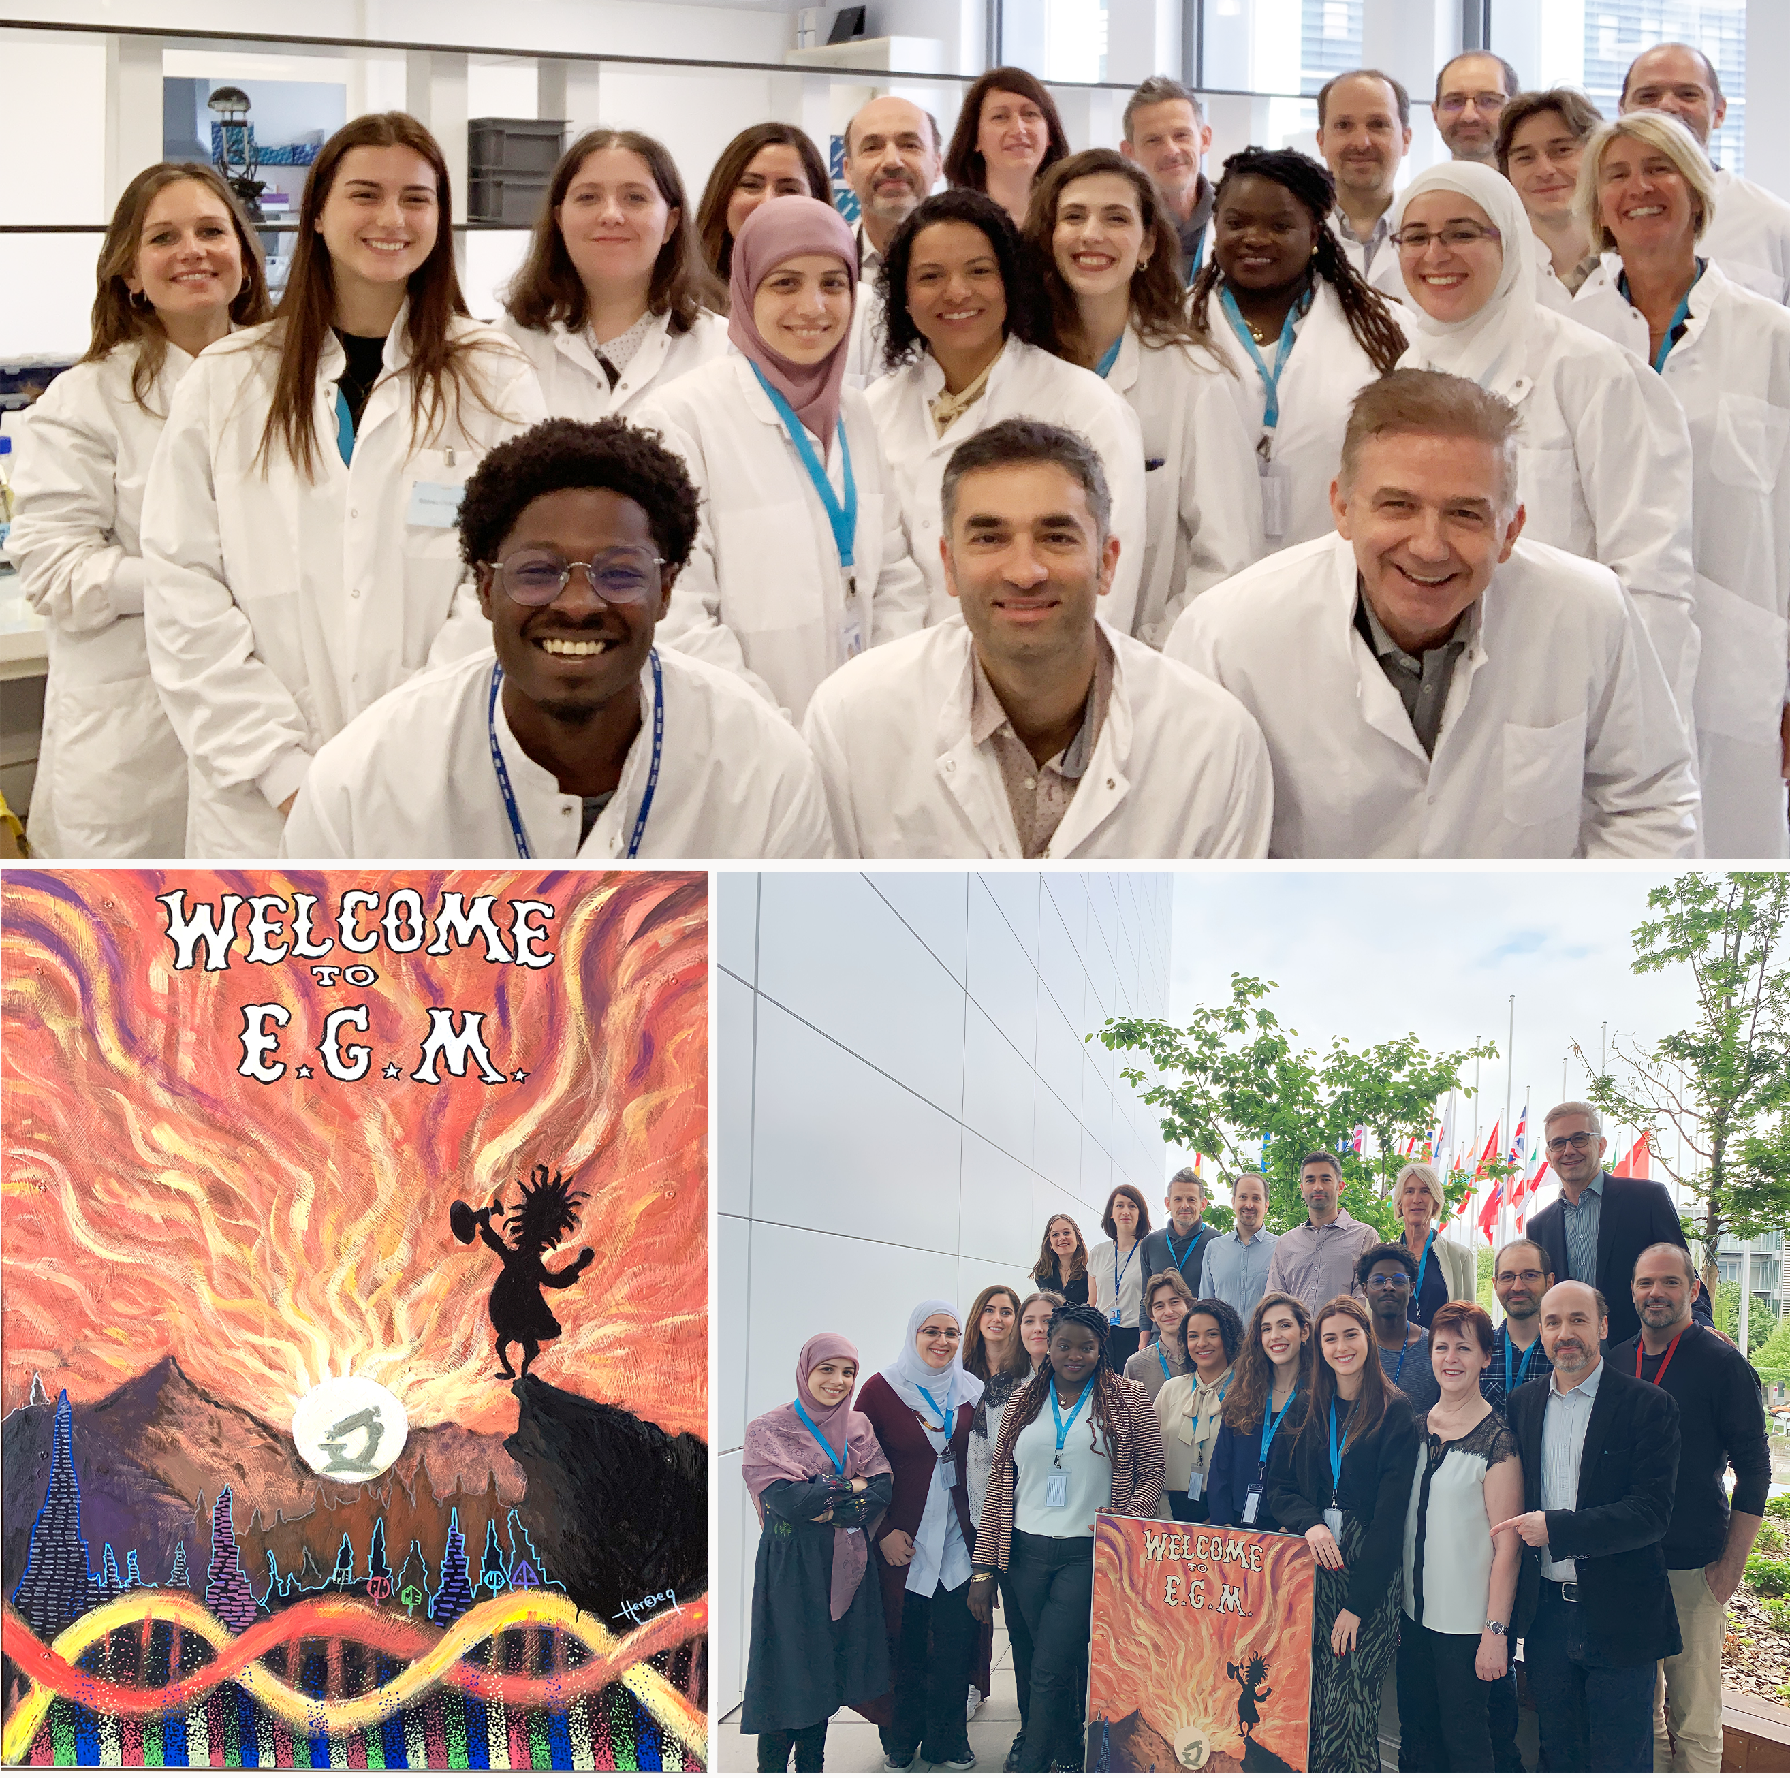
Acknowledgments
For more information:
www.iarc.who.int/branches-egm/
hercegz@iarc.who.int

